Slide 1
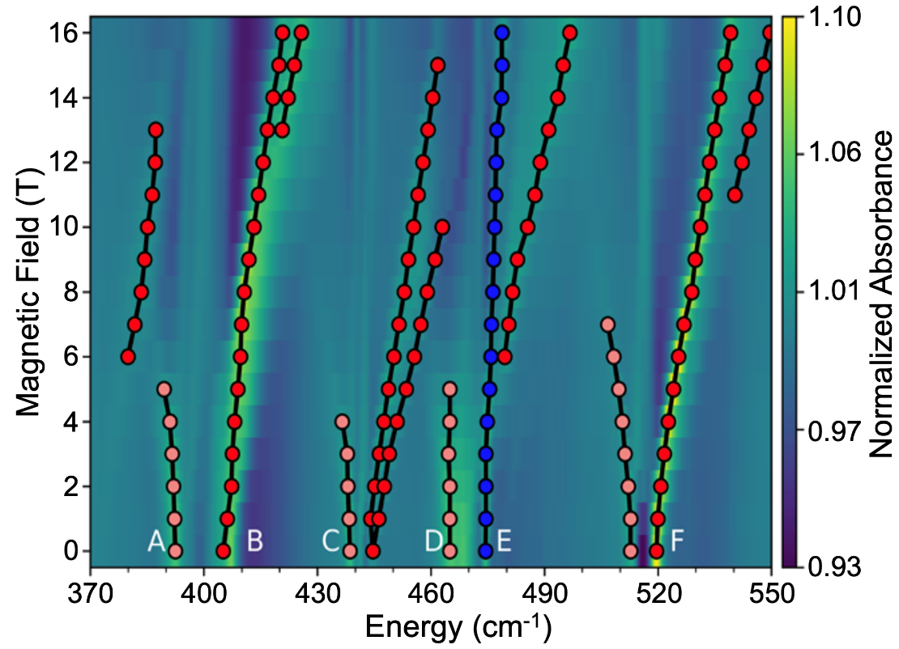
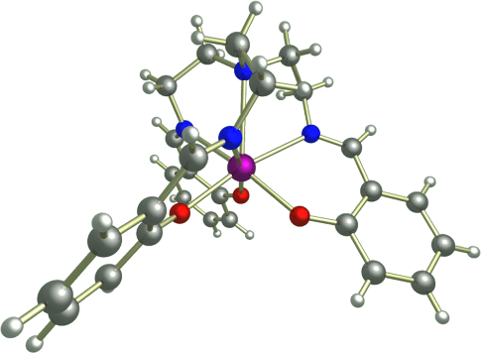
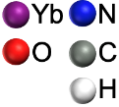
Vibronic Coupling in a 4f Molecular Magnet
Probed by Far-Infrared Magnetospectroscopy
J. G. C. Kragskow,¹ J. Marbey,^{2,3} C. D. Buch,⁴ J. Nehrkorn,² M. Ozerov,² S. Piligkos,⁴ S. Hill,^{2,3} N. F. Chilton¹
1. University of Manchester, UK; 2. MagLab; 3. FSU Physics; 4. University of Copenhagen, Denmark
Funding Grants: G.S. Boebinger (NSF DMR-1644779); N. F. Chilton (Royal Society and European Research Council,
grant # 851504); J. G. C. Kragskow (EPSRC); S. Hill (DOE DE-SC0020260); S. Piligkos (VILLUM FONDEN #13376).
Vibronic coupling, the interaction between molecular vibrations and electronic states, is a fundamental effect that profoundly influences a wide range of physical processes. In molecular magnetic materials, vibronic coupling causes relaxation, which equates to loss of magnetic memory in single-molecule magnets and loss of phase coherence in qubits.
The study of vibronic coupling is challenging, and most experimental evidence is indirect. In this investigation, far-infrared magnetospectroscopy (FIRMS) is used to directly probe electronic transitions coupled to vibrational excitations in an ytterbium molecule (inset of Figure) that has attracted interest as a potential spin qubit. High magnetic fields (Figure) enable a deconvolution of vibronic transitions - transitions that shift in energy due to the Zeeman interaction - from a forest of much stronger electronic transitions that do not shift with field.
MagLab users found that vibronic coupling is strongest for vibrational modes that simultaneously distort the first coordination sphere (the atoms that coordinate directly to the ytterbium ion) and break the C₃ symmetry of the molecule. With this knowledge, vibrational modes could be identified and engineered to shift their energy towards or away from particular electronic states to alter their impact. Hence, these findings provide new insights towards developing general guidelines for the control of vibronic coupling in molecules.
Figure: FIRMS map (top) of the Yb molecule (right). Purely vibrational modes are suppressed via normalization to remove field-independent signals. Assignments of cold/hot vibronic transitions are in red/orange. A purely electronic transition is shown in blue.
[Yb(trensal)]
Facilities and instrumentation used: Joint EMR/DC-Field Facility Operation (Infrared / Terahertz Magneto Optics in SCM3)
Citation: Kragskow, J.G.C.; Marbey, J.; Buch, C.D.; Nehrkorn, J.; Ozerov, M.; Piligkos, S.; Hill, S.; Chilton, N.F., Analysis of vibronic coupling in a 4f molecular magnet with FIRMS, Nature Communications 13, 825 (2022) doi.org/10.1038/s41467-022-28352-2 Links to Data Set 1 and Set 2

Slide 2
Vibronic Coupling in a 4f Molecular Magnet
Probed by Far-Infrared Magnetospectroscopy
J. G. C. Kragskow,¹ J. Marbey,^{2,3} C. D. Buch,⁴ J. Nehrkorn,² M. Ozerov,² S. Piligkos,⁴ S. Hill,^{2,3} N. F. Chilton¹
1. University of Manchester, UK; 2. MagLab; 3. FSU Physics; 4. University of Copenhagen, Denmark
Funding Grants: G.S. Boebinger (NSF DMR-1644779); N. F. Chilton (Royal Society and European Research Council,
grant # 851504); J. G. C. Kragskow (EPSRC); S. Hill (DOE DE-SC0020260); S. Piligkos (VILLUM FONDEN #13376).
What is the finding? Far-infrared measurements performed in high magnetic fields reveal microscopic details of the coupling between the electronic and vibrational degrees of freedom–-so-called vibronic coupling–-in a molecule containing a single magnetic ytterbium (Yb) ion (Figure). It is shown that a relatively small subset of the possible vibrational modes couples strongly to the magnetic moment of the Yb ion.
Why is this important? This class of magnetic molecules is of interest due to their potential use in next-generation nanoscale information technologies–-both classical and quantum. The molecular vibrations that couple most strongly to the magnetic moment of the Yb ion are the ones that dominate its relaxation, i.e., the loss of information encoded in the magnetic states of the molecule. Armed with this knowledge, chemists can design superior molecules with weaker vibrational coupling to the magnetic moment, hence enhanced information storage potential.
Why did this research need the MagLab? The trick to this study is that weak vibronic modes change their energies with magnetic field, while the much stronger pure vibrational modes do not. The weak vibronic modes can be identified via a data processing method that removes field-independent signals. The wider field range available at the MagLab enables identification of many more weak vibronic modes, thus providing information that could not be obtained elsewhere.
N
Yb
O
C
H
Figure: The [Yb(trensal)] molecule. Color code: Ytterbium – green; Nitrogen – blue; Oxygen – red; Carbon – gray; Hydrogen – white. This is an animation of one of the vibrational modes that couples strongly to the magnetic moment of the Yb ion (a vibrational mode that increases in energy from 520cm⁻¹ to 540cm⁻¹ as a magnetic field is ramped to 16T). Of particular relevance are the large displacements of the O and N atoms that coordinate directly to the Yb ion.
Facilities and instrumentation used: Joint EMR/DC-Field Facility Operation (Infrared / Terahertz Magneto Optics in SCM3)
Citation: Kragskow, J.G.C.; Marbey, J.; Buch, C.D.; Nehrkorn, J.; Ozerov, M.; Piligkos, S.; Hill, S.; Chilton, N.F., Analysis of vibronic coupling in a 4f molecular magnet with FIRMS, Nature Communications 13, 825 (2022) doi.org/10.1038/s41467-022-28352-2 Links to Data Set 1 and Set 2
Notes:
-

