Slide 1
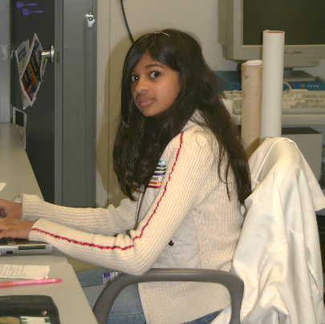
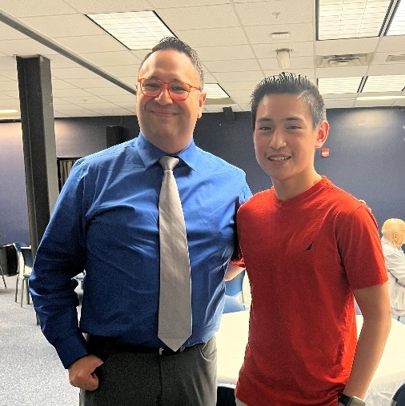
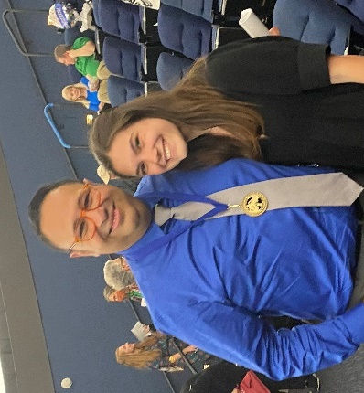
Tallahassee Scientific Society Gold Medal Award
Given to MagLab Educator Carlos Villa
C.R. Villa¹
1-Center for Integrating Research and Learning (CIRL) at the MagLab
Funding Grants: G.S. Boebinger (NSF DMR-1157490, NSF DMR-1644779)
What is the finding? Carlos R. Villa, who is usually surrounded by K-12 students, now joins a list of prestigious honorees recognized by the Tallahassee Scientific Society (TSS) for his contributions to science education. He is the first educator and first non-researcher to receive the TSS Gold Medal Award, which has also gone to founding MagLab Director Jack Crow (2004), Nobel Prize winning chemist and MagLab user Harry Kroto (2008), Ion Cyclotron Resonance Chief Scientist Alan Marshall (2011), and MagLab Chief Scientist Laura Greene (2019).
Why is this important? The Gold Medal is awarded annually to a member of the Tallahassee scientific community to recognize outstanding career contributions to science, public service, and science education. These are measured by peer recognition and highlight an entire career of achievement. The award was created to recognize accomplishment in expanding knowledge and public appreciation of STEM in Tallahassee and its surrounding communities.
Why did this research need the MagLab? In his role as the Director of K-12 Education Programs at the MagLab, Carlos helps support K-12 educational programming. In his 20 years at the MagLab, Carlos has directly educated over 120,000 students across hundreds of schools. This impressive tally includes field trips and classroom visits but does not include an additional 1,000 summer campers from the MagLab Summer Camps (TESLA & SciGirls) or an additional 300 students who have conducted research alongside MagLab scientists as a result of the MagLab’s Middle School Mentorship (MSM) program.
“I’m currently a PhD candidate working on antibiotic resistant (so mostly microbiology) but I recently had to send some samples off for some electron microscopy and I remember saying to my major professor, ‘The last time I had to do anything with an electron microscope was at the MagLab in middle school.’”
– Nitasha Menon, MSM 2006-2008.
“His kindness and compassion towards others makes him a special person. He has shared his interests of science with me and has helped me find my passion in it. He cares about the future generation of scientists deeply and encourages students to explore more into the field. I am very glad to see Mr. Villa receiving recognition for his work.”
-Julian Chavez, MSM 2018, TESLA 2019.
“Sci-Girls is why I am going into STEM. I have stayed connected with the MagLab ever since. Carlos's kindness, passion for teaching, and radiant personality changed my life. I will be attending Georgia Institute of Technology next year to study industrial engineering and I could not have made it there without Carlos and the MagLab.”
– Sophia Umaña, SciGirls 2015, 2017.
Facilities used: MagLab’s Center for Integrating Research and Learning.

