Slide 1


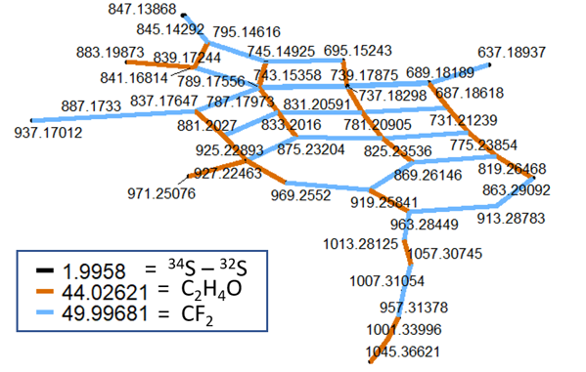
A Deep Dive Into Forever Chemical Dark Matter
Robert B. Young¹, Nasim E. Pica², Hamidreza Sharifan², Huan Chen³, Holly K. Roth², Greg T. Blakney³, Thomas Borch², Christopher P. Higgins⁴, John J. Kornuc⁵, Amy M. McKenna^{2,3}, Jens Blotevogel²
1. New Mexico State University; 2. Colorado State University; 3. National High Magnetic Field Laboratory; 4. Colorado School of Mines; 5. NAVFAC EXWC
Funding Grants: G.S. Boebinger (NSF DMR-1644779); Jens Blotevogel (SERDP ER20-1265)
Perfluoroalkyl and polyfluoroalkyl substances (PFAS) are a complex chemical family of thousands of individual compounds. An in-depth characterization of highly variable PFAS composition - with a focus on yet unknown polyfluorinated “dark matter” - is critical to advance our understanding of potentially adverse environmental and human health impacts of these “forever” PFAS compounds.
For the first time, researches used the MagLab’s unique ultrahigh resolution Fourier-Transform Ion Cyclotron Resonance Mass Spectrometers to shed light on the complex PFAS dark matter in a commercial firefighting foam sample, identifying hundreds of known and previously unknown PFAS. To take full advantage of the unrivaled mass resolving power these instruments provide, we developed both a suspect and a nontargeted screening approach using a custom-made fluorocarbon formula database, isotopologue analysis, and Kendrick-analogous mass difference networks.
This newly developed analytical approach has great potential to take the assessment of PFAS transport, transformation, exposure, uptake, and source attribution to the next level. The next steps for the research team are to collect additional structural information on newly discovered PFAS, to perform a reconnaissance studies on various environmental matrices, and to identify product-specific and source-specific marker compounds.
Figure: (Top) Network diagram suggesting the presence of sulfur-containing (black) PFAS chemicals with a range of perfluoroalkyl (CF2, blue) and ethoxy (C2H4O, orange) chain lengths. (Bottom) A possible chemical structure to explain these data.
Facilities and instrumentation used: Ion Cyclotron Resonance (9.4 T and 21 T FT-ICR MS)
Citation: Young, R.B.; Pica, N.E.; Sharifan, H.; Chen, H.; Roth, H.K.; Blakney, G.T.; Borch, T.; Higgins, C.P.; Kornuc, J.J.; McKenna, A.M.; Blotevogel, J., PFAS Analysis with Ultrahigh Resolution 21T FT-ICR MS: Suspect and Nontargeted Screening with Unrivaled Mass Resolving Power and Accuracy, Environmental Science and Technology, 56 (4), 2455–2465 (2022) doi.org/10.1021/acs.est.1c08143 - Data Set

Slide 2
A Deep Dive Into Forever Chemical Dark Matter
Robert B. Young¹, Nasim E. Pica², Hamidreza Sharifan², Huan Chen³, Holly K. Roth², Greg T. Blakney³, Thomas Borch², Christopher P. Higgins⁴, John J. Kornuc⁵, Amy M. McKenna^{2,3}, Jens Blotevogel²
1. New Mexico State University; 2. Colorado State University; 3. National High Magnetic Field Laboratory; 4. Colorado School of Mines; 5. NAVFAC EXWC
Funding Grants: G.S. Boebinger (NSF DMR-1644779); Jens Blotevogel (SERDP ER20-1265)
What is the finding? MagLab users and scientists teamed to develop a new method that can identify individual fluorinated environmental contaminants in mixtures consisting of thousands of other chemical compounds that are typically detected in natural water or soil samples.
Why is this important? Thousands of man-made perfluoroalkyl and polyfluoroalkyl substances (PFAS) contaminate our planet from the North to the South Pole. PFAS are known as “forever chemicals” because they do not break down in the environment. Only about 15-50 individual PFAS species are typically measured during water, soil, and food analysis. However, those PFAS that are yet unknown (“dark matter”) may be more harmful or spread faster in the environment than the few that are analyzed on an every day basis. This newly developed method will allow other scientists to take a closer look at how more of these PFAS chemicals move into water, soil, plants, feedstock, and eventually into humans, and ultimately at the risks they pose.
Why did this research need the MagLab? PFAS identification relies on measuring differences in weight between individual molecules. Only the Fourier-Transform Ion Cyclotron Resonance Mass Spectrometers at the MagLab can distinguish among the many PFAS that differ in mass by only a 10-trillion-quadrillionth fraction of an ounce.
Figure: (Top) Network diagram suggesting the presence of sulfur-containing (black) PFAS chemicals with a range of perfluoroalkyl (CF2, blue) and ethoxy (C2H4O, orange) chain lengths. (Bottom) A possible chemical structure to explain these data.
Facilities and instrumentation used: Ion Cyclotron Resonance (9.4 T and 21 T FT-ICR MS)
Citation: Young, R.B.; Pica, N.E.; Sharifan, H.; Chen, H.; Roth, H.K.; Blakney, G.T.; Borch, T.; Higgins, C.P.; Kornuc, J.J.; McKenna, A.M.; Blotevogel, J., PFAS Analysis with Ultrahigh Resolution 21T FT-ICR MS: Suspect and Nontargeted Screening with Unrivaled Mass Resolving Power and Accuracy, Environmental Science and Technology, 56 (4), 2455–2465 (2022) doi.org/10.1021/acs.est.1c08143 - Data Set

