Slide 1
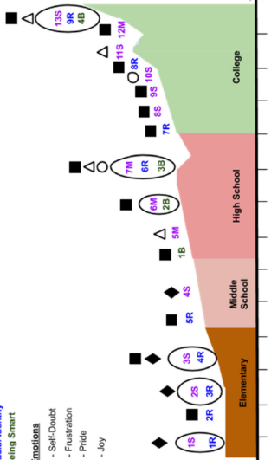
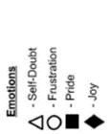
Education Research Highlight:
Intersectionality and Black Women in STEM
A. Ibourk¹, R. Hughes², C. Mathis³
Florida State University; 2. National High Magnetic Field Lab; 3. University of Washington;
Funding Grants: G.S. Boebinger (NSF DMR-1644779)
The MagLab’s Center for Integrating Research and Learning (CIRL) runs multiple programs for students that engage them with MagLab mentors and role models to learn about materials-related STEM careers. It also researches STEM identity – one’s sense of belonging and future success in STEM. This education research collaboration highlights the STEM identity trajectory of a MagLab camp alumna – given the pseudonym Marie - from middle school, through high school and undergraduate studies, all the way to graduate school.
STEM identity has become a popular lens and outcome in science education research. However, few studies have focused on how intersectionality, specifically the domains of power within our society, affects women of color as they navigate both informal and formal schooling. This paper uses narrative inquiry methodology to examine how a young Black woman, Marie, constructs her math and science identities through stories to which she could refer during moments of doubt. The positive emotions associated with these stories about her social experiences (e.g., MagLab summer camps, research opportunities, and attending an HBCU) created a resilience storyline that allowed her to connect her positive science and racial storied-identity across time and settings.
A timeline of Marie’s STEM storied-identity trajectory and the emotions that surfaced. Sub-identities are categorized by color. Emotions are categorized by shape.
By using this intersectionality lens, these researchers were able to highlight how recognition from family, friends, teachers, and faculty led to the positive emotions of joy and pride that strengthened not only Marie’s science and math identities but also her racial identity. Conclusions from this research support the call for structural changes within K-12 and higher education that are crucial for equity goals within STEM education.
Facilities and instrumentation used: Center for Integrating Research and Learning, FSU College of Education
Citation: Ibourk, A.; Hughes, R.; Mathis, C., “It is What it Is”: Using Storied-Identity and Intersectionality Lenses to Understand What Shaped a Young Black Woman's STEM Identity Trajectory, Journal of Research on Science Teaching, (2022) doi.org/10.1002/tea.21753

Slide 2
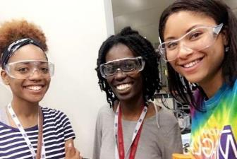
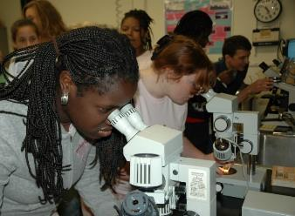
Education Research Highlight:
Intersectionality and Black Women in STEM
A. Ibourk¹, R. Hughes², C. Mathis³
Florida State University; 2. National High Magnetic Field Lab; 3. University of Washington;
Funding Grants: G.S. Boebinger (NSF DMR-1644779)
What is the finding? Marie (a pseudonym) is a young Black alumna of MagLab summer camps. Strong support from family and positive experiences in STEM gave Marie stories of resilience that she could fall back on for support during moments of doubt in high school and college.
Why is this important? The moments of doubt that Marie experienced were due to the cultural, institutional, disciplinary and interpersonal domains of power that intersect and influence Black girls’ and women’s experiences in STEM. To better support Black girls and women seeking places in the STEM workforce, it is important for researchers and educators to consider the complex cultural, social, and institutional factors that too often prevent them from thriving in STEM. Racism and sexism exist throughout the structure of the nation’s institutions and culture. This means that K-12 schools, STEM disciplines and departments cannot ignore these domains of power. Rather science educators and STEM faculty need to discuss the role that stereotypes, and biases have played in our lives both historically and currently.
Why did this research need the MagLab? Two of Marie’s influential stories of resilience included MagLab summer camps in which she participated: Camp Tesla and SciGirls. This study indicates that experiences in summer camps and programs like those that the MagLab provides can create positive memories for girls to fall back on during moments of doubt. However, these programs are not sufficient to combat the pervasive systems in our society that marginalize girls, particularly girls of color, in education and STEM. Marie’s success in STEM was also influenced by her college experience at an HBCU that helped her see her strength and value as a Black woman in STEM.
Facilities and instrumentation used: Center for Integrating Research and Learning, FSU College of Education
Citation: Ibourk, A.; Hughes, R.; Mathis, C., “It is What it Is”: Using Storied-Identity and Intersectionality Lenses to Understand What Shaped a Young Black Woman's STEM Identity Trajectory, Journal of Research on Science Teaching, (2022) doi.org/10.1002/tea.21753

