Slide 1
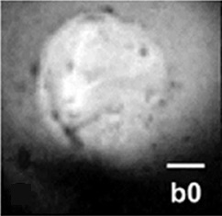
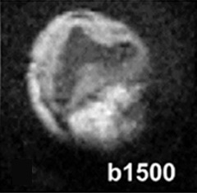
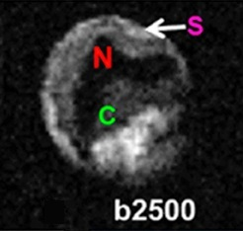
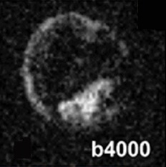
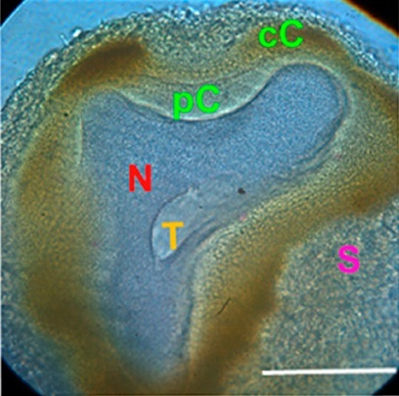
On the Origin of MRI Signal In Stroke
SJ Blackband^{1,2}, JJ Flint¹, B Hansen³ , TM Shepherd⁴ , CH Lee^{1,4}, WJ Streit¹, JR Forder^{1,2}
University of Florida; 2. National MagLab;
3. Aarhus University, Denmark; 4. New York University School of Medicine
Funding Grants: Boebinger (NSF DMR-1644779); Blackband (NIH R01EB012874)
Glial cells represent a major fraction of the total brain volume, and they are responsible for maintaining homeostasis to ensure accurate and consistent neuronal function. In diffusion magnetic resonance (MR) microscopy studies of tissue infarct using isolated Aplysia (sea slug) neurons, they are surrounded by satellite glial cells which appear hyperintense, as they balance water to the neuron following injury, compared to the hypointense dark interior of the neuron. Instead of a swelling in the neuronal cells, this research presents evidence that a swelling of glial cells following ischemia is the cause of the MR hyperintensity in stroke, potentially solving a 30 year old mystery on the origin of the MRI signal in stroke victims.
A quantitative understanding of changes in glial cell volume will allow the development of working mathematical models that can be used on tissues in situ to understand signal changes in disease, like reversible and irreversible ischemia. Instrumentation is being developed to improve these measurements by moving to higher magnetic fields, including the MagLab’s 32T magnet. These studies ultimately aim to improve clinical MR significantly by increasing its sensitivity and specificity.
We expect that this work will lead to improved diagnostics for other brain disorders where glial cells may play a role, including mood disorders, sleep disorders, movement disorders such as Parkinson’s, and memory disorders such as Alzheimer’s.
Diffusion MR microscopy of a sea slug neuron at 7.8 μM resolution (top) showing hyperintensity (brightness) due to water diffusion in glial satellite cells. The cellular structures can also be identified using 40X traditional light microscopy (bottom).
N = nucleus
C = cytoplasm (perinuclear and cortical)
T = trophospongium (sea slug invagination)
S = satellite cells.
Scale bar is 100 μm.
Facilities and instrumentation used: AMRIS Facility, AMRIS RF capabilities including the micro-5 3000 mT/m imaging gradient that enables imaging at 7.8 μm in-plane resolution, MagLab’s User Collaboration Grant Program.
Citation: Blackband, S.J.; Flint, J.J.; Hansen, B.; Shepherd, T.M.; Lee, C.H.; Streit, W.J.; Forder, J.R., On the Origins of Diffusion MRI Signal Changes in Stroke, Frontiers in Neurology, 11, 549 (2020) doi.org/10.3389/fneur.2020.00549

Slide 2
On the Origin of MRI Signal In Stroke
SJ Blackband^{1,2}, JJ Flint¹, B Hansen³ , TM Shepherd⁴ , CH Lee^{1,4}, WJ Streit¹, JR Forder^{1,2}
University of Florida; 2. National MagLab;
3. Aarhus University, Denmark; 4. New York University School of Medicine
Funding Grants: Boebinger (NSF DMR-1644779); Blackband (NIH R01EB012874)
What is the finding? Magnetic resonance imaging (MRI) is a leading diagnostic technique for neurological studies. Glial cells in the brain are responsible for maintaining water balance to ensure accurate and consistent neuron function. In MRI scans taken within the first hours after a stroke, the images appear bright around the injury, but this has been a mystery because the direct effect on neuronal swelling appears dark. In this work, a MagLab user collaboration finds that it is the changes in glial cell volumes that cause the bright effect in the MRI signal after stroke.
Why is this important? This work is a milestone of thirty-five years of ongoing research, starting with the first MRI image of a single cell by the lead collaborator on this team. A decades-long-held belief had been that MRI image changes seen in stroke were due to neuronal swelling. Instead, the finding is that it is glial cell swelling, leading to a better understanding of the changes in MRI signals that might one day distinguish reversible and irreversible stroke events that require different treatments.
Why did this research need the MagLab? Physicists and neuroscientists utilize highly sensitive MR imaging gradients and microcoils at the AMRIS Facility because they enable resolution of perfused neuronal cells and capture diffusion measurements at the microscopic cellular level. Instrumentation is being developed to improve these measurements by moving to higher magnetic fields, including the MagLab’s unique 32T superconducting magnet.
Diffusion MR microscopy of a sea slug neuron at 7.8 μM resolution (top) showing hyperintensity (brightness) due to water diffusion in glial satellite cells. The cellular structures can also be identified using 40X traditional light microscopy (bottom).
N = nucleus
C = cytoplasm (perinuclear and cortical)
T = trophospongium (sea slug invagination)
S = satellite cells.
Scale bar is 100 μm.
Facilities and instrumentation used: AMRIS Facility, AMRIS RF capabilities including the micro-5 3000 mT/m imaging gradient that enables imaging at 7.8 μm in-plane resolution, MagLab’s User Collaboration Grant Program.
Citation: Blackband, S.J.; Flint, J.J.; Hansen, B.; Shepherd, T.M.; Lee, C.H.; Streit, W.J.; Forder, J.R., On the Origins of Diffusion MRI Signal Changes in Stroke, Frontiers in Neurology, 11, 549 (2020) doi.org/10.3389/fneur.2020.00549

