Slide 1
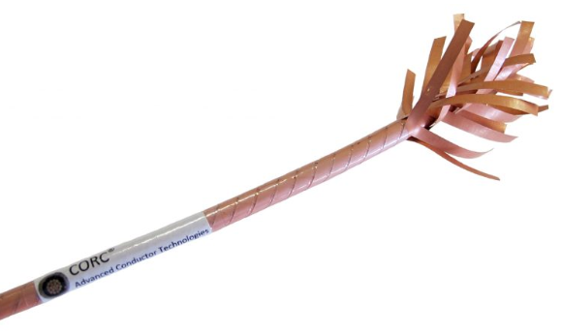
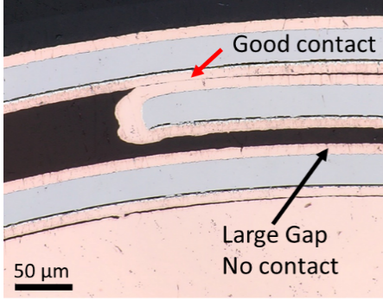
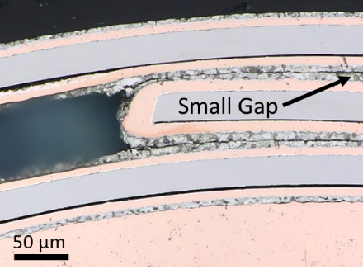
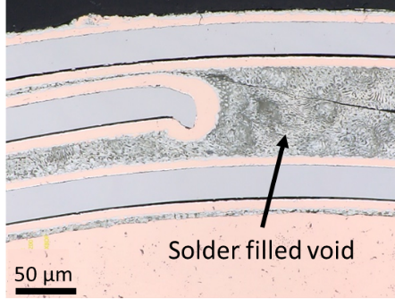
The high temperature superconducting CORC® cabling technology
V. Phifer^{1,2}, M. Small^{1,2} , G. Bradford^{1,2}, J. Weiss^{3,4}, D. van der Laan^{3,4} and L. Cooley^{1,2}
Florida Sate University; 2. Applied Superconductivity Center-NHMFL; 3. Advanced Conductor Technologies
Funding Grants: G.S. Boebinger (NSF DMR-1644779); S. Pamidi (DE-EE0007872); D. Larbalestier (DE-SC0014009)
Conductor on Round Core (CORC®) technology is a cable structure with multiple layers of helically wound high-temperature-superconducting REBCO tapes. The CORC® cable design aims to mitigate potential degradation or failure in any individual tape because current can bypass imperfections by transferring to other tapes. This flexibility in current path reduces the risk for conductor burnout in large magnets. The tape-to-tape contact resistance, R_{c}, plays a critical role in the CORC® cable’s ability to share current.
Researchers investigated the contact topography for various tape coatings intended to give the cable flexibility. A remarkable finding was relatively large regions with no contact between layers for lubricant coatings, which explains the undesired high contact resistance. In contrast, electroplated solder was found to fill in contours between the conductors, producing a more uniform contact surface between layers, resulting in R_{c} values that are two to three orders of magnitude lower. Interestingly, heating the tinned wires to flow the solder resulted in only a small further decrease in R_{c}, suggesting that wires need not be made inflexible to achieve low contact resistance.
One key feature of CORC® is an ability to achieve tight bends without degradation, making magnet winding straightforward. These results indicate that electroplated solder not only ensures good contact topography, R_{c} is also low enough to permit current transfer over lengths comparable to the helical winding pitch of the tapes, accomplished while maintaining wire flexibility.
CORC® wire coating type | Contact Resistance (μΩ cm²)
Teflon-like lube | 1300 ± 1000
Bare (no coating) | 160 ± 80
Graphite-like lube | 41 ± 25
Electroplated PbSn | 2 ± 0.4
Electro. PbSn plus 200 °C for 5 min | 0.7 ± 0.4
Top left shows CORC® wire with shrink wrapping removed and tapes unfurled. At right are photos of the wire cross-section for (top) Teflon-like lubrication, (middle) electroplated solder, and (bottom) electroplated solder after heating. The table above shows results of contact resistance measurements for multiple configurations of current feeding and contact crossing. Hundreds of measurements were performed.
Facilities and instrumentation used: MagLab’s Applied Superconductivity Center, in collaboration with CORC® cable fabrication at Advanced Conductor Technologies, Boulder CO.
Citation: This manuscript is under review by Supercond. Sci. Technol.

Slide 2
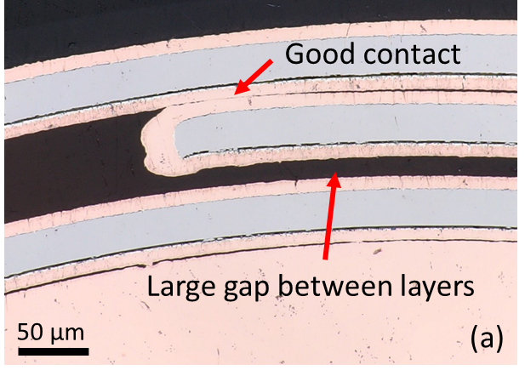
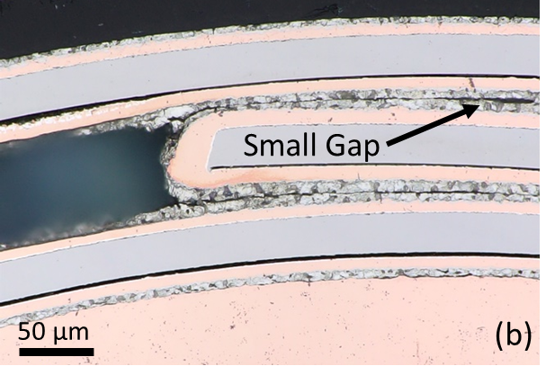
The high temperature superconducting CORC® cabling technology
V. Phifer^{1,2}, M. Small^{1,2} , G. Bradford^{1,2}, J. Weiss^{3,4}, D. van der Laan^{3,4} and L. Cooley^{1,2}
Florida Sate University; 2. Applied Superconductivity Center-NHMFL; 3. Advanced Conductor Technologies
Funding Grants: G.S. Boebinger (NSF DMR-1644779); S. Pamidi (DE-EE0007872); D. Larbalestier (DE-SC0014009)
What is the finding? Cross-sectional images of superconducting Conductor on Round Core (CORC®) wires (Figure 1) revealed insights to improve the contact between conductors.
Why is this important? In magnets, one of the biggest concerns is that a localized area of degraded conductor may lead to hot spot formation and cause irreversible damage to the magnet. The ability for current to transfer between conductors - and thereby bypass degraded conductor regions - minimizes the chances of conductor burnout. In CORC® cables, current transfer depends on the contact resistance between layers. Imaging revealed that there are large regions without contact in typical cables (Figure 2a), leading to a high resistance between conductors. Winding wires from PbSn tinned tapes provides more uniform contact between layers (Figure 2b), decreasing the contact resistance by three orders of magnitude and yielding a cable that is more resistant to burnout.
Why did this research need the MagLab? The MagLab’s Applied Superconductivity Center hosts unique expertise on superconducting materials. The imaging and resistivity measurements reported here were coupled with electromagnetic measurements like those used for MagLab’s 32T superconducting magnet
CORC®
CORC®
Figure 1: A Conductor on Round Core, CORC®, cable, in which the tape conductor has been unfurled at the top of the image to reveal the complex braiding around the round core.
Figure 2: Fifty-fold magnification showing (a) typically non-ideal contact between conductors for untinned CORC® wire and (b) improved contact between tinned CORC® wire before heat treatment
Facilities and instrumentation used: MagLab’s Applied Superconductivity Center, in collaboration with CORC® cable fabrication at Advanced Conductor Technologies, Boulder CO.
Citation: This manuscript is under review by Supercond. Sci. Technol.

