Slide 1
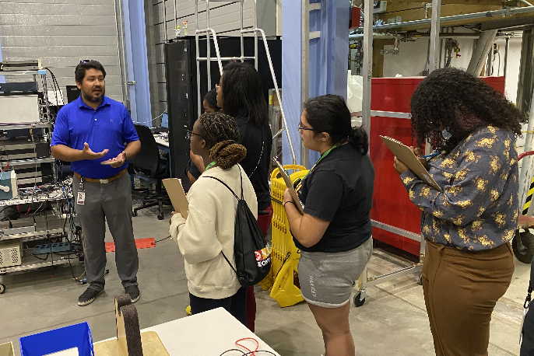
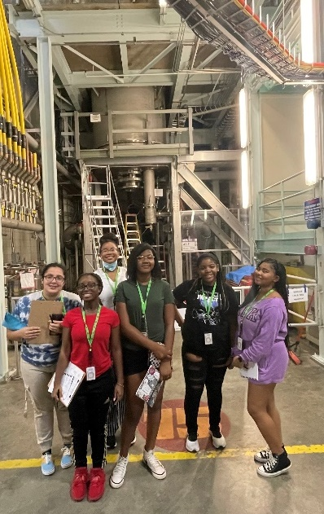
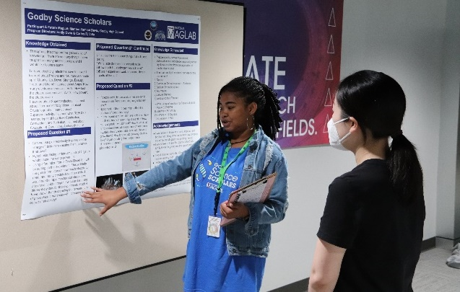
MagLab’s K-12 Education: Godby Science Scholars
C.R. Villa¹, E.D. Gwin², R.M. Hughes¹
1-Center for Integrating Research and Learning (CIRL) at the National High Magnetic Field Laboratory,
2- Godby Senior High School
Funding Grant: G.S. Boebinger (NSF DMR-1644779)
What is the event? One of the MagLab’s core missions is to build a more diverse STEM workforce. To accomplish this goal, the MagLab's Center for Integrating Research and Learning (CIRL) held its inaugural Godby Science Scholars (GSS) program this summer. GSS is a partnership with Godby High School, a local Title-1 school¹ with a predominantly (72%) Black student population. The purpose of the GSS program is to introduce participating students to the MagLab and STEM research. The program ran for three weeks and included tours of multiple MagLab research spaces by diverse MagLab role models. The program culminated with a poster session during which participants proposed a MagLab related-research project. Our first cohort was comprised of six young women (5 Black and one Latina). This program serves as a feeder program for the MagLab’s High School Externship program, which is an academic year program open to all local high school students. By the end of the program, five out of the six students already had MagLab mentors lined up for the academic year program.
Why is this important? African Americans make up 13% of the US population but only 4% of engineering and physics bachelor’s degrees. A similar situation exists for the US Latinx population, comprising 18% of the population but only 8% of physics bachelor's degrees.² The American Institute of Physics reported that African Americans are the only demographic group to show a decline in representation in physics (5% in 1999 to 4% in 2017) over the last 20 years.³ In this same time period, the overall number of physics bachelor’s degrees awarded has increased, but not for African Americans.
Why did this program need the MagLab? Emily Gwin, a chemistry teacher at Godby High school, helped facilitate the program with the MagLab’s Carlos R. Villa. The MagLab climate also contributes: One participant said that "I felt like a scientist or engineer. It's a lot of work, and it's overwhelming, but here, basically everybody, they love their job. They're happy to be here, happy to talk to people. Seeing that they actually enjoy it makes me be like 'Hmm, okay. There's something that I wanna do or something that I want to pursue.'"
Right: GSS Students touring
Below: GSS students at the 45T hybrid magnet (Photo by Carlos Villa).
Below: GSS student, Yamani Davis, presenting her research proposal . (Photo by Carlos Villa).
Facility: The MagLab’s Center for Integrating Research and Learning
1- A school in which at least 40% of students are from low-income families
2- https://www.aip.org/statistics/data-graphics/proportion-physics-bachelors-degrees-awarded-african-americans-and-hispanic
3- https://www.aip.org/diversity-initiatives/team-up-task-force

