Slide 1
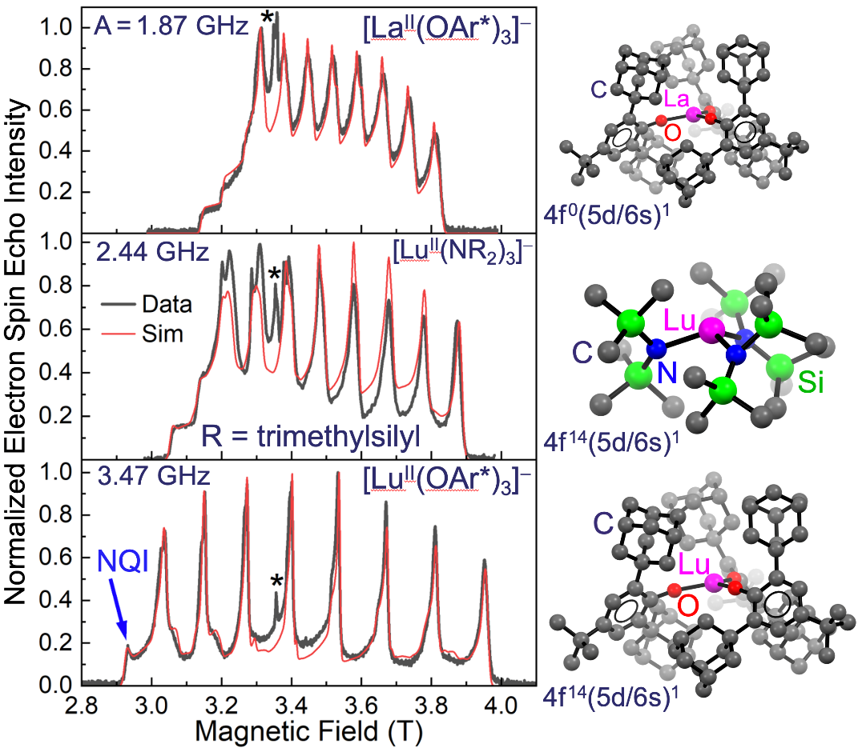
Massive Hyperfine Interaction in a Lu(II) Qubit
K. Kundu¹, J. R. K. White², S. A. Moehring², J. M. Yu², J. W. Ziller², F. Furche², W. J. Evans², S. Hill¹
1. NHMFL and Florida State University; 2. University of California, Irvine
Funding Grants: G. S. Boebinger (NSF DMR-1644779); F. Furche (NSF CHE-2102568);
W. J. Evans (NSF CHE-1855328); S. Hill (DOE DE-SC0020260)
Electron spin coherence, important in quantum information science, can be significantly enhanced at so-called clock transitions (CTs) – optimal operating points that are immune to magnetic noise. CTs can be generated via the hyperfine interaction (HFI) between electron and nuclear spins in atoms. Maximizing this interaction to achieve optimum coherence and a desirable operating frequency in the microwave regime requires enhancing electron spin density at the location of the nucleus, which can be achieved using coordination chemistry.
Chemists from UC Irvine prepared a family of molecules containing a single lanthanide (Ln = La or Lu) ion in the rare 2+ oxidation state. In each case, a single unpaired electron resides in a mixed 5d/6s orbital. The HFI can be controlled through choice of: (i) coordinating ligand, which tunes the s-orbital character and, hence, the spin density at the nucleus; and (ii) Ln ion, with increased orbital contraction for heavier Lu. As seen from the peak spacing in the high-field echo-detected ESR spectra (Figure), significant control of the 5d/6s mixing is achievable, with [Lu^{II}(OAr*)₃]– exhibiting a massive 3.47 GHz HFI (c.f. < 100 MHz is typical for related molecules).
Hyperfine CTs are currently employed in more mature trapped ion quantum computers. This investigation demonstrates that the same approach is viable in molecular qubit platforms, giving rise to measurably enhanced coherence and prospects for future scalability via chemical self-assembly.
Figure. Pulsed electron spin-echo spectra recorded at 94GHz and 5K, for the three compounds shown. The eight (= 2I + 1) lines arise due to the hyperfine interaction (HFI) with the I = ⁷/₂ ¹⁷⁵Lu or ¹³⁹La nuclear spin; the spacing between peaks is a direct measure of the HFI strength, A, which increases from top to bottom. The asterisk marks an impurity and the “NQI” feature is attributed to a strong nuclear quadrupole interaction.
Facilities and instrumentation used: EMR (W-Band HiPER Pulsed ESR Spectrometer); Citation: Kundu, K.; White, J.R.K.; Moehring, S.A.; Yu, J.M.; Ziller, J.W.; Furche, F.; Evans, W.J.; Hill, S., 9.2-GHz clock transition in a Lu(II) molecular spin qubit arising from a 3,467-MHz hyperfine interaction, Nature Chemistry, 14, 1-6 (2022) doi.org/10.1038/s41557-022-00894-4 - Data Set
Notes:
How to compress files size:
On PowerPoint, you can save the attached image (Right click on an image -> Select “Save as picture” -> Then you save the image as PNG). PNG is the image compression without losing the image quality. You replace the original image with the PNG one on PowerPoint. This should reduce the PowerPoint file size.
One thing to be careful about is that you should enlarge your image a bit on PowerPoint before saving so is to avoid losing much resolution.

Slide 2
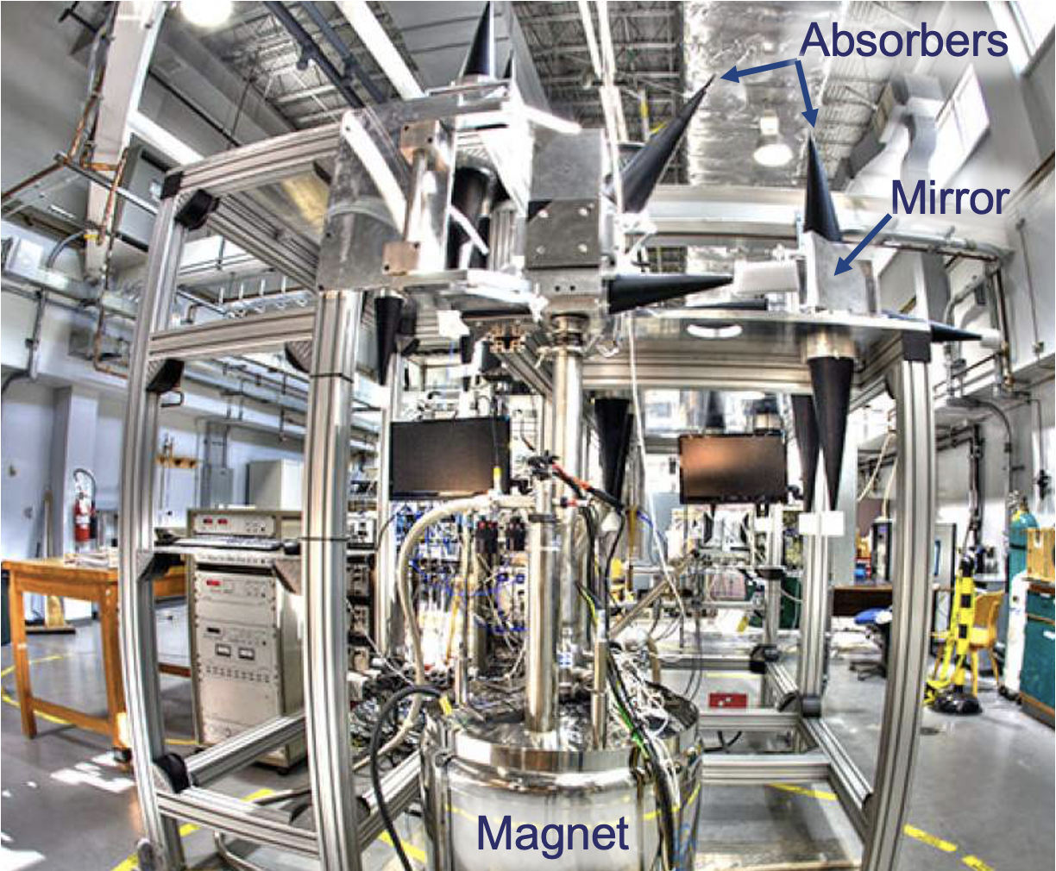
Massive Hyperfine Interaction in a Lu(II) Qubit
K. Kundu¹, J. R. K. White², S. A. Moehring², J. M. Yu², J. W. Ziller², F. Furche², W. J. Evans², S. Hill¹
1. NHMFL and Florida State University; 2. University of California, Irvine
Funding Grants: G. S. Boebinger (NSF DMR-1644779); F. Furche (NSF CHE-2102568);
W. J. Evans (NSF CHE-1855328); S. Hill (DOE DE-SC0020260)
What is the finding? High-power pulsed electron spin-echo measurements at high magnetic fields demonstrate that it is possible to exert synthetic control over the hyperfine coupling between electron and nuclear spins in molecular lanthanide compounds. In turn, this allows chemists to enhance electron spin coherence via engineering of so-called clock transitions.
Why is this important? The strategy of employing clock transitions to enhance quantum coherence is employed in trapped-ion quantum computers. This study shows that the same approach is viable in magnetic molecules, which show promise for next-generation quantum technologies because chemical self-assembly of magnetic molecules may eventually prove to be more scalable than trapped-ion architectures.
Why did this research need the MagLab? Studies of spin coherence require advanced spectrometers that operate in pulsed mode. The strong electron-nuclear hyperfine coupling deduced from this study gives rise to huge spectral splitting patterns that are not resolvable using commercial low-field instruments; hence the need for the HiPER spectrometer at the MagLab (Figure). Several other features of this instrument proved essential for this investigation, including (i) its uniquely high-power (1kW) that enables coherent spin manipulations on nanosecond timescales, and (ii) a rapid sample loading capability that facilitates rapid transfer of the air-sensitive samples that were synthesized under cryogenic conditions and shipped to the MagLab under liquid nitrogen.
The HiPER Spectrometer features a unique design in which high-power (1kW peak) pulsed microwave signals are processed using free space optical components, enabling coherent spin manipulations on nanoscale timescales that are short relative to the quantum spin lifetime. The long wavelength of the microwaves results in a huge instrument footprint; hence, this approach is not not feasible at lower fields and frequencies.
Facilities and instrumentation used: EMR (W-Band HiPER Pulsed ESR Spectrometer); Citation: Kundu, K.; White, J.R.K.; Moehring, S.A.; Yu, J.M.; Ziller, J.W.; Furche, F.; Evans, W.J.; Hill, S., 9.2-GHz clock transition in a Lu(II) molecular spin qubit arising from a 3,467-MHz hyperfine interaction, Nature Chemistry, 14, 1-6 (2022) doi.org/10.1038/s41557-022-00894-4 - Data Set

