Slide 1
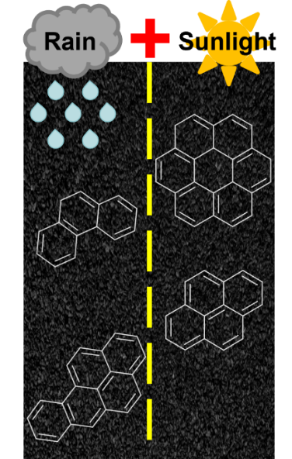
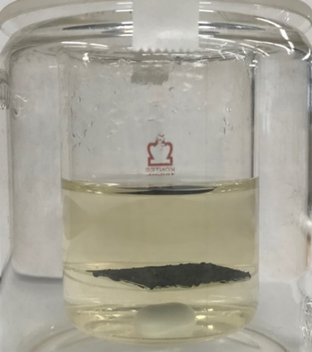
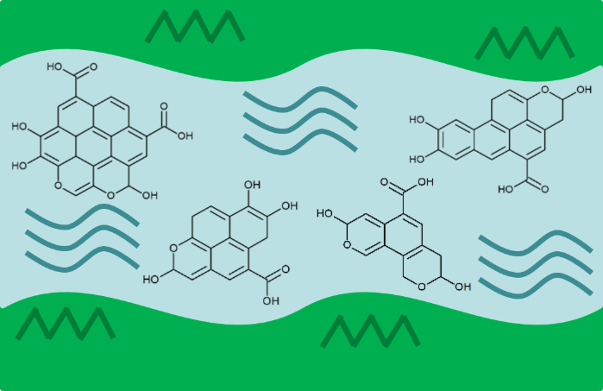
Pavement Sealant Leaches Environmental Contaminants
Taylor J. Glattke^{1,2}, Martha L. Chacón-Patiño², Sarajeen Saima Hoque³, Thomas E. Ennis⁴, Steven Greason ⁵,
Alan G. Marshall^{1,2}, Ryan P. Rodgers^{1,2}
1. Ion Cyclotron Resonance Program, National High Magnetic Field Laboratory 2. Department of Chemistry and Biochemistry, Florida State University 3. Department of Civil & Environmental Engineering, FAMU-FSU College of Engineering 4. Watershed Protection Department, City of Austin, TX 5. Sitelab Corporation
Funding Grants: G.S. Boebinger (NSF DMR-1644779)
Coal tar pavement sealant can protect roads and parking lots from degradation. However, these sealants are known to contain high concentrations of carcinogenic polycyclic aromatic hydrocarbons (PAHs). In this user collaboration, coal tar sealant was submerged in water and exposed to laboratory-simulated sunlight. The weathered sealant and water-soluble fraction were analyzed using ultrahigh-resolution Fourier Transform Ion Cyclotron Resonance Mass Spectrometry (FT-ICR MS). FT-ICR MS assigned tens of thousands of compounds in the weathered sealant and the water fractions.
The FT-ICR data find that coal tar pavement sealants are oxidized by sunlight into toxic water-soluble compounds (oxy-PAHs) that can pollute waterways. Water fractions were tested for toxicity, which revealed that coal tar sealant can transfer toxic compounds into groundwater and marine environments.
FT-ICR MS and toxicity testing provide evidence that coal tar-based sealants should be avoided. However, testing to determine toxic effects on humans requires additional research on human cell lines, research that is now underway in an ongoing collaboration with MIT.
Laboratory-scale Weathering (“Rain” and ”Sunlight”)
Coal Tar Pavement Sealant: 50,000 – 75,000 ppm PAHs
Toxic Chemicals in Groundwater Ecosystems
Facilities and instrumentation used: 9.4 T, 220 mm Fourier
Transform – Ion Cyclotron Resonance Mass Spectrometer, ICR facility
Citation: Glattke, T.; Chacon Patino, M.L.; Hoque, S.S.; Ennis, T.E.; Greason, S.; Marshall, A.G.; Rodgers, R.P., Complex Mixture Analysis of Emerging Contaminants Generated from Coal Tar- and Petroleum-Derived Pavement Sealants: Molecular Compositions and Correlations with Toxicity Revealed by Fourier Transform Ion Cyclotron Resonance Mass Spectrometry, Environmental Science and Technology (2022) doi.org/10.1021/acs.est.2c00582
Coal tar pavement sealant contains 50,000 to 75,000 ppm of carcinogenic polycyclic aromatic hydrocarbons (PAHs). Weathering by sunlight and rain can contaminate natural waterways through oxidation of the PAHs contained in the pavement sealant. Image Credit: Taylor Glattke, MagLab
Notes:
How to compress files size:
On PowerPoint, you can save the attached image (Right click on an image -> Select “Save as picture” -> Then you save the image as PNG). PNG is the image compression without losing the image quality. You replace the original image with the PNG one on PowerPoint. This should reduce the PowerPoint file size.
One thing to be careful about is that you should enlarge your image a bit on PowerPoint before saving so is to avoid losing much resolution.

Slide 2
Pavement Sealant Leaches Environmental Contaminants
Taylor J. Glattke^{1,2}, Martha L. Chacón-Patiño², Sarajeen Saima Hoque³, Thomas E. Ennis⁴, Steven Greason ⁵,
Alan G. Marshall^{1,2}, Ryan P. Rodgers^{1,2}
1. Ion Cyclotron Resonance Program, National High Magnetic Field Laboratory 2. Department of Chemistry and Biochemistry, Florida State University 3. Department of Civil & Environmental Engineering, FAMU-FSU College of Engineering 4. Watershed Protection Department, City of Austin, TX 5. Sitelab Corporation
Funding Grants: G.S. Boebinger (NSF DMR-1644779)
What is the finding? Laboratory simulated weathering of coal tar pavement sealant revealed that carcinogenic polycyclic aromatic hydrocarbons (PAHs) are oxidized by sunlight into oxy-PAHs and then transferred into water. Toxicity testing of water that contained oxy-PAHs revealed high toxicity of water fractions collected from coal tar sealant.
Why is this important? Little has been known about how pavement sealant is transformed when it is exposed to weathering, such as sunlight and rain. This new research reveals that toxic compounds in coal tar sealant can easily leach into and pollute natural water systems and thus can negatively impact marine ecosystems and public health. These new findings provide critical evidence to support phase out of these materials in the United States and elsewhere.
Why did this research need the MagLab? The MagLab’s ultrahigh-resolution FT-ICR (Fourier Transform - Ion Cyclotron Resonance) mass spectrometers allow for identification of tens of thousands of compounds from complex mixtures, such as the weathered coal tar sealant and water samples analyzed in this work.
Laboratory-scale Weathering (“Rain” and ”Sunlight”)
Coal Tar Pavement Sealant: 50,000 – 75,000 ppm PAHs
Toxic Chemicals in Groundwater Ecosystems
Facilities and instrumentation used: 9.4 T, 220 mm Fourier
Transform – Ion Cyclotron Resonance Mass Spectrometer, ICR facility
Citation: Glattke, T.; Chacon Patino, M.L.; Hoque, S.S.; Ennis, T.E.; Greason, S.; Marshall, A.G.; Rodgers, R.P., Complex Mixture Analysis of Emerging Contaminants Generated from Coal Tar- and Petroleum-Derived Pavement Sealants: Molecular Compositions and Correlations with Toxicity Revealed by Fourier Transform Ion Cyclotron Resonance Mass Spectrometry, Environmental Science and Technology (2022) doi.org/10.1021/acs.est.2c00582
Coal tar pavement sealant contains 50,000 to 75,000 ppm of carcinogenic polycyclic aromatic hydrocarbons (PAHs). Weathering by sunlight and rain can contaminate natural waterways through oxidation of the PAHs contained in the pavement sealant. Image Credit: Taylor Glattke, MagLab

