Slide 1
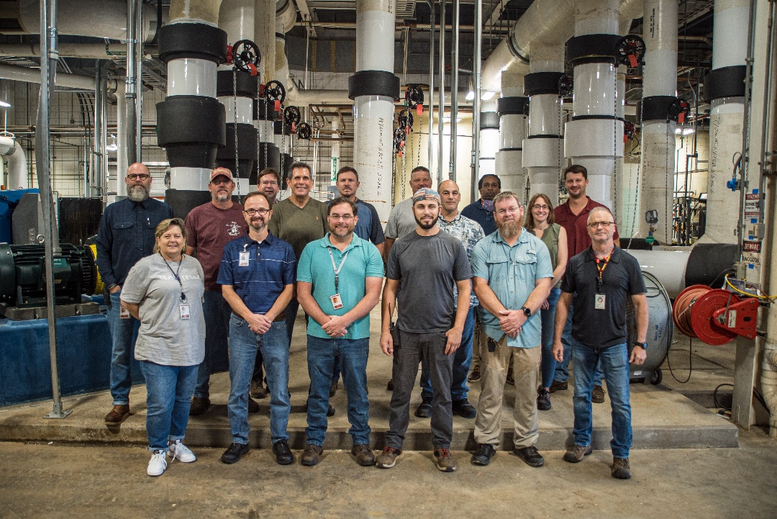
MagLab 2022 Summer Shutdown
Funding Grants: G.S. Boebinger
(NSF DMR-1644779)
A major upgrade to the cooling water system at MagLab’s DC Field User Facility was completed during the 2022 Summer Shutdown.
The MagLab’s resistive magnets generate a massive amount of heat when energized, heat that must be removed via a highly engineered cooling water system. This chilled water system received crucial upgrades with the installation and integration of four new 2,000 ton (i.e. 7 megawatt) industrial-grade chillers and a suite of eight chilled water circulating pumps. These upgrades were funded by the NSF via supplemental funding to the MagLab’s core grant.
During the same Summer Shutdown, new electrical infrastructure and instrumentation were installed that were funded by Florida State University, the host of the MagLab’s DC Field User Facility. Together, these upgrades underpin the continued reliability of DC magnet operations, while offering enhanced control of the magnet cooling water temperature which provides additional magnetic field stability.
The construction work necessary to install these industrial pumps, piping, and electrical gear - within the limited time available during shutdown - required the skill and dedication of the MagLab’s engineering, operations, technical staff, and safety departments, as well as coordination with outside contractors. All groups needed to work together to safely accomplish this challenging project.
The project used over 30,000 labor hours and did not experience a single safety incident. This was accomplished through the MagLab’s ongoing dedication to its Integrated Safety Management (ISM) safety program. In addition to numerous task hazard analyses, ISM includes pre-job planning meetings and daily morning pre-work briefings. It also includes the appointment of specific worksite superintendents and daily safety audits. The success of this complex installation resulted directly from the MagLab’s commitment to safety as a core value, a value that cannot be de-prioritized.
Facilities: Facilities, Operations, Environmental, Health, and Safety Department.

