Slide 1
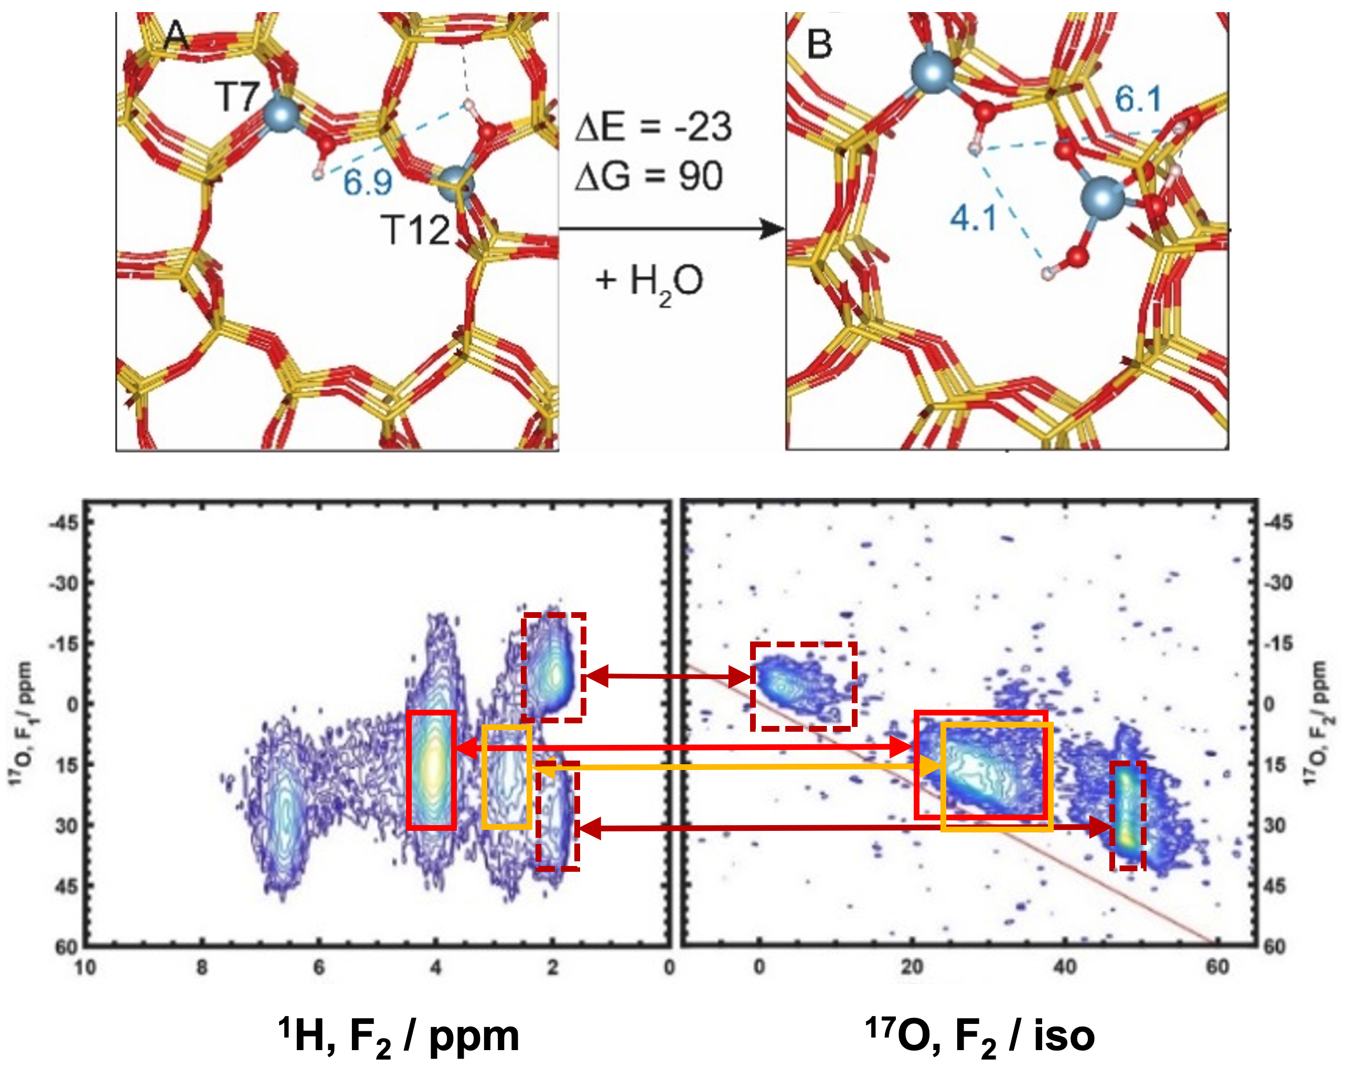
¹⁷O Labeling Reveals Paired Active Sites in Zeolite Catalysts
Kuizhi Chen,¹ Anya Zornes,² Vy Nguyen,³ Bin Wang,³ Zhehong Gan,¹ Steven P. Crossley, and Jeffery L. White² 1.National High Magnetic Field Laboratory; 2. Oklahoma State University;
3. University of Oklahoma
Funding : J. L. White (CHE-1764116 and CHE-1764130); G.S. Boebinger (NSF DMR-1644779)
There is increasing evidence that active sites in zeolites, which comprise one of the most important classes of industrial catalysts, are more complex than previously recognized. Indeed, active sites that are in close proximity are known in some catalysts to produce advantageous catalytic effects. Differentiating these sites, which are often structurally similar, can be extremely challenging, presenting obstacles for the investigation of their synergistic effects.
In this work, ultra-high-magnetic field solid-state nuclear magnetic resonance (ssNMR) platforms and state-of-the-art probes, available only at the MagLab, were employed to investigate oxygen and aluminum sites in zeolites, with a focus on ¹⁷O and ²⁷Al, which are quadrupolar nuclei (nuclear spin > ½). High magnetic fields greatly reduce the breadths of ¹⁷O and ²⁷Al ssNMR patterns, enhancing signal and resolution, and yielding rich structural information. This structural information is able, for the first time, to correlate structural and spatial aspects of active sites with their synergistic catalytic activities.
These findings will inspire new approaches for characterizing the nature of complex catalytic sites. They offer insights into acid site activities toward new rational design and engineering strategies for developing more effective catalysts.
Top: Structural evolution of paired acid sites upon hydrothermal treatment, as investigated by plane-wave Density Function Theory calculations. Bottom: Two-dimensional ¹⁷O Multiple Quantum Magic Angle Spinning and ¹H-¹⁷O correlation NMR spectra taken at 19.6T, showing the complex structures of the acid sites and their proximities.
Facilities and instrumentation used: NMR Facility: 14.1T/600 MHz and 19.6T/830 MHz; DC Facility: 36T SCH
Citation: Chen, K.; Zornes, A.; Nguyen, V.; Wang, B.; Gan, Z.; Crossley, S.; White, J., 17O Labeling Reveals Paired Active Sites in Zeolite Catalysts, Journal of the American Chemical Society, 144 (37), 16916-16929 (2022) DOI: doi.org/10.1021/jacs.2c05332

Slide 2
¹⁷O Labeling Reveals Paired Active Sites in Zeolite Catalysts
Kuizhi Chen,¹ Anya Zornes,² Vy Nguyen,³ Bin Wang,³ Zhehong Gan,¹ Steven P. Crossley, and Jeffery L. White² 1.National High Magnetic Field Laboratory; 2. Oklahoma State University;
3. University of Oklahoma
Funding : J. L. White (CHE-1764116 and CHE-1764130); G.S. Boebinger (NSF DMR-1644779)
What is the finding? Crucial details on the structures and proximities of active catalytic sites in zeolite catalysts are revealed by ultra-high-magnetic-field solid-state nuclear magnetic resonance (ssNMR) methods that include enrichment of the catalyst by ¹⁷O isotopic substitution.
Why is this important? Zeolite catalysts are widely used in modern industrial processes, such as petrochemical refinement and biomass conversion. Recent studies show that active catalytic sites are more complex than previously thought. A phenomenon of great importance is the synergistic effect, where the reactivity of two proximate (nearby) active sites is increased relative to that of two sites separated by a large distance. Ultra-high-magnetic-field ¹⁷O ssNMR experiments conducted on a variety of catalyst samples enriched with ¹⁷O isotopes revealed potential synergistic site structures. Such information is crucial for the rational design, synthesis, and manufacture of catalysts with improved efficiency and yields.
Why did this research need the MagLab? Ultra-high-magnetic-field (UHMF) ssNMR spectroscopy of ²⁷Al and ¹⁷O nuclei provides structural details that cannot be obtained from experiments at lower fields, offering an unprecedented combination of high signal and high resolution that is required for these observations. This is made possible by the combination of UHMF ssNMR platforms and state-of-the-art probes available only at the MagLab.
Top: A zeolite micropore and pair of active sites.
Bottom: The signal-to-noise and spectral resolution in ¹⁷O NMR spectra is significantly enhanced at higher magnetic fields, due in part to reductions in the breadths of the powder patterns. Such effects offer new opportunities for two-dimensional NMR experiments capable of revealing proximities and correlations that will aid our understanding of the nature of synergistic effects of active catalytic sites in zeolites.
Facilities and instrumentation used: NMR Facility: 14.1T/600 MHz and 19.6T/830 MHz; DC Facility: 36T SCH
Citation: Chen, K.; Zornes, A.; Nguyen, V.; Wang, B.; Gan, Z.; Crossley, S.; White, J., 17O Labeling Reveals Paired Active Sites in Zeolite Catalysts, Journal of the American Chemical Society, 144 (37), 16916-16929 (2022) DOI: doi.org/10.1021/jacs.2c05332

