Slide 1
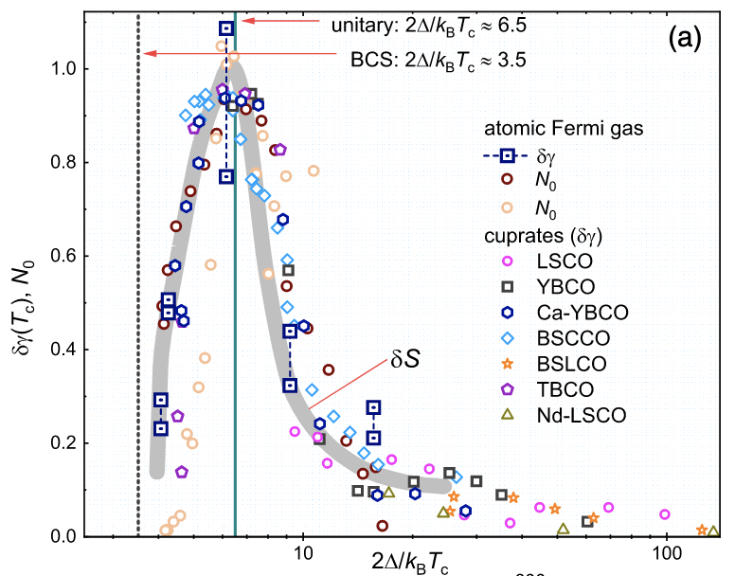
Magic gap ratio at the “BCS Superconducting to Bose-Einstein Condensate” crossover in the high-T_{c} cuprates
Neil Harrison and Mun K. Chan National High Magnetic Field Laboratory - LANL
Funding Grants: G.S. Boebinger (NSF DMR-1644779); N. Harrison (BES LANLF100)
Superfluidity of fermions occurs when they form pairs. In the weak pairing limit, this behavior is well captured by the Bardeen-Schrieffer-Cooper (BCS) theory of super-conductivity. In the strong pairing limit, pairs can form at temperatures much higher than that of the superfluidity causing the superfluidity to occur by a process known as Bose-Einstein condensation (BEC), analogous to that occurring in liquid ⁴He. A BCS-BEC crossover has been observed in a cold atomic Fermi gas, where it is possible to continuously tune the strength of the pairing interactions. Whether such a crossover occurs in other systems such as the high-T_{c} cuprates has remained an open question.
MagLab scientists discovered a BCS-BEC crossover in the high-T_{c} cuprates by identifying a universal magic gap ratio 2Δ/k_{B}T_{c} ≈ 6.5 (where Δ is the pairing gap and T_{c} is the superconducting transition temperature) at which the paired-fermion condensates become optimally robust. At this gap ratio, corresponding to the unitary point in a cold atomic Fermi gas, the jump in the specific heat at T_{c} reaches a maximum for seven different cuprates. In the cuprates, this jump is peaked at the magic gap ratio when Δ corresponds to the antinodal spectroscopic gap, thus reinforcing its interpretation as the superconducting pairing gap in the cuprates. The peak also coincides with a normal state specific heat maximum, which is indicative of a pseudogap above the superconducting transition temperature arising from pairing fluctuations.
Figure: A comparison of the jump δγ at T_{c} in the specific heat coefficient for seven different cuprate superconductors, with the equivalent quantity in a cold atomic gas. Also shown are the change in entropy δS and the condensate fraction N₀. All quantities are plotted versus the gap ratio, 2Δ/k_{B}T_{c} . The common peak at 2Δ/k_{B}T_{c} ≈ 6.5 indicates a “magic gap ratio” at a crossover from BCS to BEC condensation.
Facility used: MagLab’s Pulsed Field Facility
Citation: Harrison, N.; Chan, M.K., Magic Gap Ratio for Optimally Robust Fermionic Condensation and Its Implications for High−T_{C} Superconductivity, Physical Review Letters 129, 017001 (2022) DOI: doi.org/10.1103/PhysRevLett.129.017001
This paper was featured at the Physical Review Journal Club: https://www.youtube.com/watch?v=6kxAEh02bIY
Notes:
How to compress files size:
On PowerPoint, you can save the attached image (Right click on an image -> Select “Save as picture” -> Then you save the image as PNG). PNG is the image compression without losing the image quality. You replace the original image with the PNG one on PowerPoint. This should reduce the PowerPoint file size.
One thing to be careful about is that you should enlarge your image a bit on PowerPoint before saving so is to avoid losing much resolution.

Slide 2
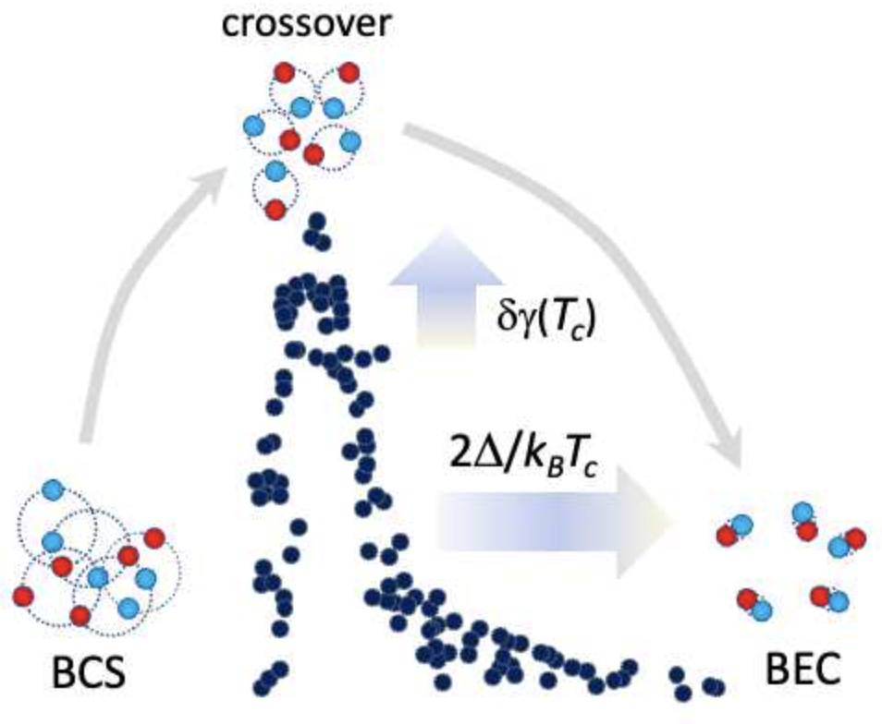
Magic gap ratio at the “BCS Superconducting to Bose-Einstein Condensate” crossover in the high-T_{c} cuprates
Neil Harrison and Mun K. Chan National High Magnetic Field Laboratory - LANL
Funding Grants: G.S. Boebinger (NSF DMR-1644779); N. Harrison (BES LANLF100)
What is the finding? A Bose-Einstein condensate (BEC) is a macroscopic quantum state in which all of the particles acquire phase coherence at low temperatures. In doing so, they exhibit superfluidity. MagLab scientists compared data from seven different superconducting cuprates and found a magic gap ratio at which the robustness of the condensed state is a maximum. This indicates that the same underlying principles that cause pairs of fermions to acquire macroscopic phase coherence at ultracold temperatures also cause the same effect to occur in the high-T_{c} cuprates.
Why is this important? Tunable interactions that lead to a crossover in the pairing from conventional (BCS) superconductivity to BEC are believed to be universal to all fermionic systems throughout the cosmos. Tunable interactions are believed to be important for understanding the formation of atomic nuclei, quark-gluon plasmas in the early universe, and color superconductivity in neutron stars. A similar magic gap ratio, at which superfluid states become optimally robust, is also predicted to occur in the iron-based superconductors and twisted graphene.
Why did this research need the MagLab? In addition to having unique high magnetic field magnets, the MagLab supports world-class in-house scientific research. This much-publicized in-house research benefited from interactions with many MagLab users and was supported in part by the “Science of 100 Tesla” grant from the Department of Energy’s Basic Energy Sciences.
Figure: BCS (left) refers to a conventional Bardeen-Schrieffer-Cooper state (i.e. weak pairing state) found in most superconductors, while BEC (right) refers to the strong pairing limit of a Bose-Einstein Condensate. These data, compiled from seven different superconducting cuprates, plot the robustness of the condensed state as a function of the measured gap ratio, 2Δ/k_{B}T_{c}. The data indicate a common peak for all seven cuprates, indicating a “magic gap ratio” of 2Δ/k_{B}T_{c} ≈ 6.5, which corresponds to the location of the peak in the data. This peak and the magic gap ratio are defining signatures of a crossover in the strength of the pairing interactions in a fermion superfluid.
Facility used: MagLab’s Pulsed Field Facility
Citation: Harrison, N.; Chan, M.K., Magic Gap Ratio for Optimally Robust Fermionic Condensation and Its Implications for High−T_{C} Superconductivity, Physical Review Letters 129, 017001 (2022) DOI: doi.org/10.1103/PhysRevLett.129.017001
This paper was featured at the Physical Review Journal Club: https://www.youtube.com/watch?v=6kxAEh02bIY

