Slide 1
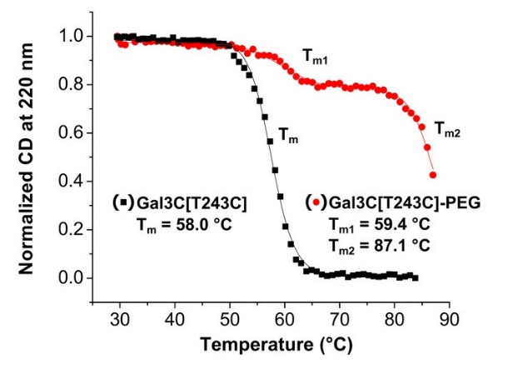
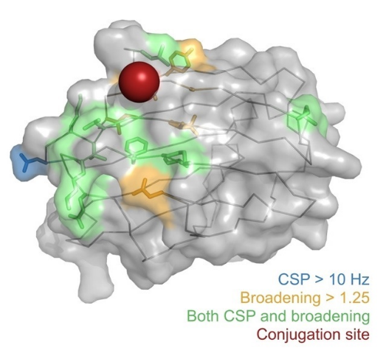
Atomic-Level Insights into How Polymers Improve Protein Therapeutics
A Pritzlaff, G Ferré, E Mulry, L Lin, N Gopal Pour, DA Savin, ME Harris, MT Eddy
University of Florida, Department of Chemistry
Funding Grants: G.S. Boebinger (NSF DMR-1644779); M.T. Eddy (NIH R35GM138291);
E. Mulry (NIH T32 GM136583); M. Harris (NIH R35GM127100)
Therapeutic biologics, specifically protein drugs, can be complex and unstable in the harsh environment of the human body. A promising approach to overcoming these challenges is covalent attachment of a polymer such as polyethylene glycol (PEG) to reactive groups in protein side chains. However, little structural information is available for protein-polymer conjugates that would allow one to design PEGylated proteins with predictable properties.
This collaborative team of polymer chemists, biochemists, and structural biologists determined a structural model of a PEGylated human protein to visualize how the polymer and protein interact and related this model to thermodynamic and functional properties of the PEGylated protein. This interdisciplinary team included both undergraduate and graduate students. Key to obtaining new insights into protein-polymer interactions was use of the high field NMR facilities at the MagLab’s AMRIS facility, including highly sensitive NMR probes and spectrometers.
This work establishes a toolbox for systematically evaluating the impacts of PEGylation on proteins. Improved insights into protein-polymer interactions will allow future design of protein-polymer conjugates with predictable chemical and physical properties, enabling new pharmaceuticals and protein-polymer conjugates with important industrial applications.
PEGylation of of the human galectin-3C protein (Gal3C) provided a significant increase in the thermal stability of the protein without hindering its functional properties (above right, red curve).
High resolution NMR spectroscopy at the MagLab’s AMRIS Facility provided variable temperature ¹H-¹⁵N correlation spectra that enabled a visualization of the interactions of the polymer and the protein with amino acid specificity in order to develop a model indicating that the polymer behaved as a loosely-attached “cloud” surrounding a particular region of the protein (colored areas in the schematic above).
Facilities and instrumentation used: AMRIS Facility, University of Florida, 800 MHz NMR instrument with a cryogenic probe
Citation: Pritzlaff, A.; Ferre, G.; Mulry, E.; Lin, L.; Gopal Pour, N.; Savin, D.; Harris, M.; Eddy, M.T.,
Atomic-Scale View of Protein-PEG Interactions that Redirect the Thermal Unfolding Pathway of PEGylated Human Galectin-3,
Angewandte Chemie International Edition, 61, e202203784 (2022) doi.org/10.1002/anie.202203784 Click to access the original Data Set
Notes:
How to compress files size:
On PowerPoint, you can save the attached image (Right click on an image -> Select “Save as picture” -> Then you save the image as PNG). PNG is the image compression without losing the image quality. You replace the original image with the PNG one on PowerPoint. This should reduce the PowerPoint file size.
One thing to be careful about is that you should enlarge your image a bit on PowerPoint before saving so is to avoid losing much resolution.

Slide 2
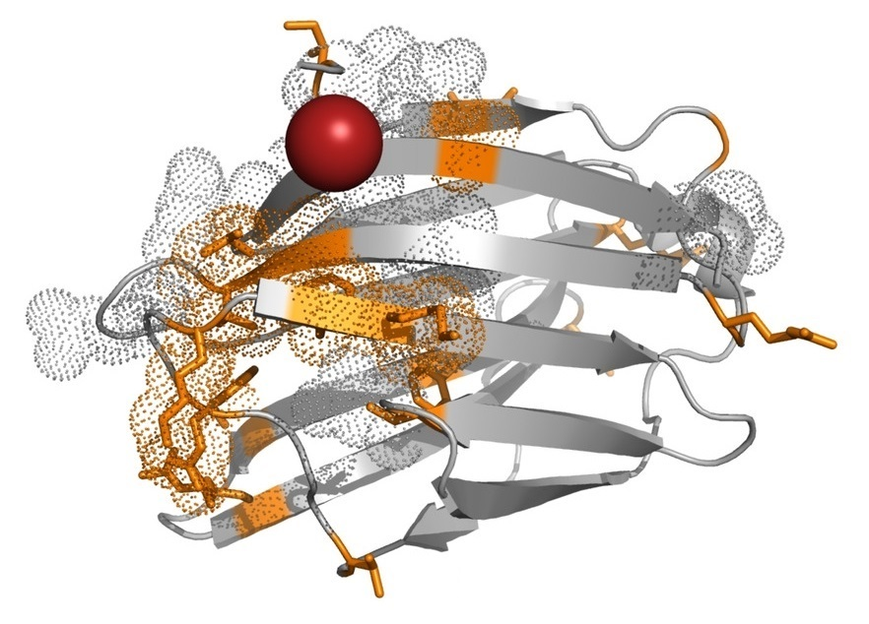
Atomic-Level Insights into How Polymers Improve Protein Therapeutics
A Pritzlaff, G Ferré, E Mulry, L Lin, N Gopal Pour, DA Savin, ME Harris, MT Eddy
University of Florida, Department of Chemistry
Funding Grants: G.S. Boebinger (NSF DMR-1644779); M.T. Eddy (NIH R35GM138291);
E. Mulry (NIH T32 GM136583); M. Harris (NIH R35GM127100)
What is the finding? This collaborative team of chemists, biochemists, and structural biologists were able to attach a polymer to a protein and determine how the polymer can improve the potential to develop the protein into a therapeutic drug. Polyethylene glycol (PEG), a commonly used polymer was found to improve the stability of a protein to make it more useful as a potential therapeutic for treating cancers and inflammatory diseases.
Why is this important? Proteins are promising therapeutics but are typically unstable in the harsh environment of the human body. This research provides new insights into how polymers can be used to make protein drugs more robust.
Why did this research need the MagLab? To observe the protein-polymer conjugates, the research team needed the high magnetic fields and sensitive NMR instrumentation provided by the instruments at the MagLab’s AMRIS Facility.
By using powerful magnets at the MagLab’s AMRIS Facility, researchers were able to visualize how polyethylene glycol (PEG), a polymer used in many clinical and industrial applications, improves the stability of a protein drug, a β-galactoside-binding lectin that is required for cell adhesion. The colored regions of the protein in the above schematic were revealed to be interacting with the polymer, resulting in its improved stability as a potential therapeutic.
Facilities and instrumentation used: AMRIS Facility, University of Florida, 800 MHz NMR instrument with a cryogenic probe
Citation: Pritzlaff, A.; Ferre, G.; Mulry, E.; Lin, L.; Gopal Pour, N.; Savin, D.; Harris, M.; Eddy, M.T.,
Atomic-Scale View of Protein-PEG Interactions that Redirect the Thermal Unfolding Pathway of PEGylated Human Galectin-3,
Angewandte Chemie International Edition, 61, e202203784 (2022) doi.org/10.1002/anie.202203784 Click to access the original Data Set

