Slide 1


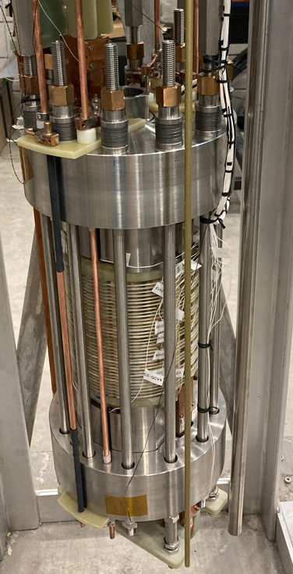
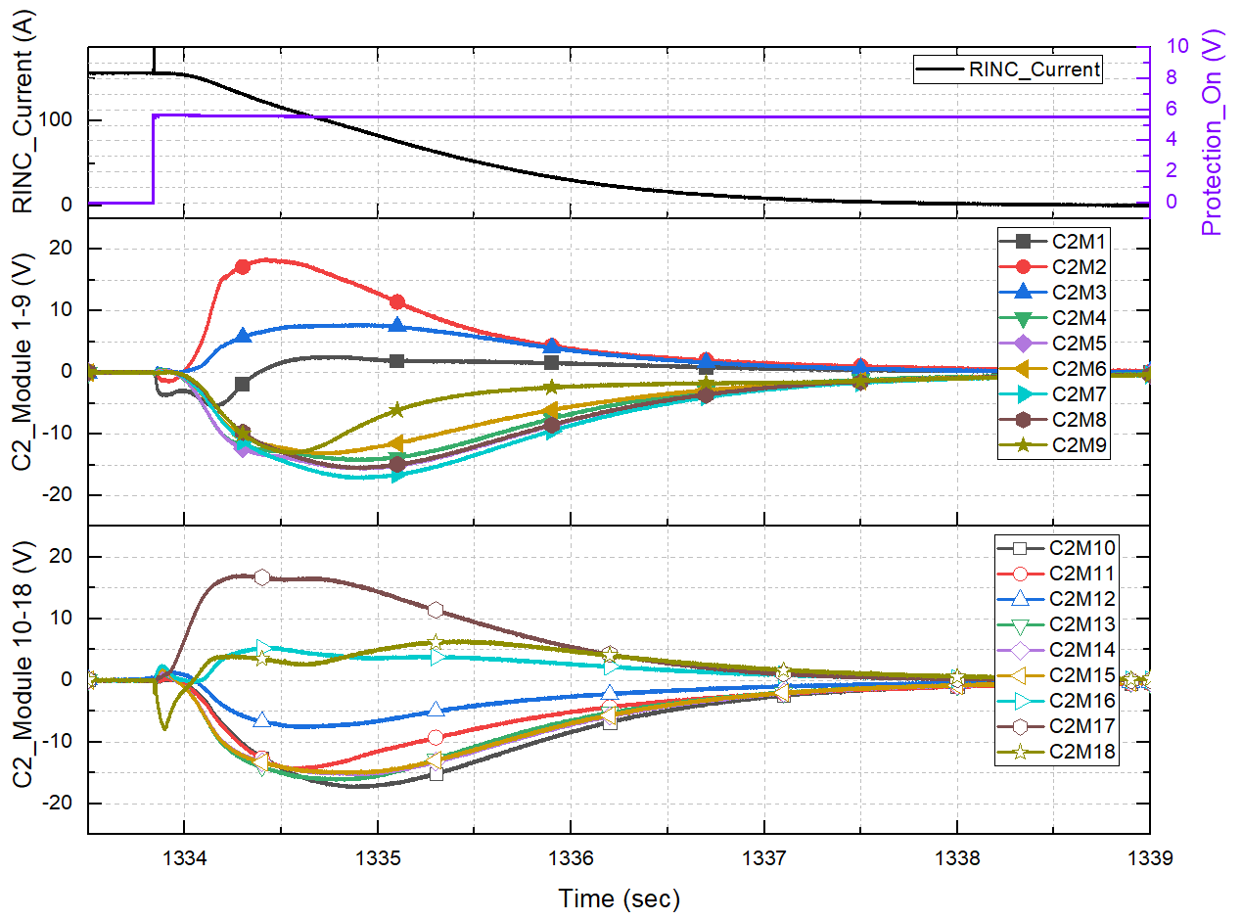
19T Resistive Insulation Test Magnet for Demonstration of
Technology Applicable to a 40T All-Superconducting Magnet
Iain Dixon¹, Kwangmin Kim¹, Jun Lu¹, Denis Markiewicz¹, Emsley Marks¹, Peng Xu¹, Hongyu Bai¹
National High Magnetic Field Laboratory, Tallahassee, FL
Funding Grants: G.S. Boebinger (NSF DMR-1644779); M. D. Bird (NSF DMR-2131790)
“Resistive Insulation” (RI) magnet technology is one of the leading design options for the MagLab’s 40T all-superconducting magnet. Instead of traditional electrical insulation between turns of REBCO high temperature superconductor (HTS) tape, hard oxides are deposited on the surfaces of stainless-steel tape which is co-wound with the superconductor. In this configuration, there is a finite resistance between turns and current is not constrained to flow along the turns of the HTS under fault conditions. This results in magnets that are stable despite conductor defects. As a result, less stabilizing copper is needed in the REBCO winding pack and the coils become more compact.
A significant test coil (Figure 1) has been built and tested to a central field of 19.2T with a stored energy of 0.1MJ. The resistive insulation was measured to be 3.25mΩ over the entire coil, within the design window. The ability to successfully prescribe a contact resistance on a magnet of this scale had not been demonstrated before. An RI magnet could be damaged by a quench occurring that is not symmetric about the mid-plane. The protection strategy consists of energizing heaters embedded at both ends of the coils to create symmetric quenches that overwhelm the initial asymmetric quench. The graph in Figure 2 shows the evolution of intentional symmetric quenches in the outer of the two nested coils. The lower panel in Fig. 2 shows how the quench propagates through the top 9 modules. The lower 9 modules experience similar quench propagation, resulting in the safe decay of the magnet current (black trace in the upper panel).
This demonstration advances resistive insulation technology as a viable design option for the 40T all-superconducting magnet.
Figure 1: Resistive Insulation-Nested Coils (RINC) test magnet containing an inner coil with 12 double-pancake modules and an outer coil with 18 double-pancake modules. The magnet reached 19.2T and studies of quench protection were performed, comprising a demonstration of RINC technology for a 40T all-superconducting magnet.
Figure 2: Voltages recorded from a protective quench from the upper-most 9 modules in the outer coil, showing propagation of the quench to multiple modules, which results in a successful quench energy management without damaging modules. Similar voltage traces are recorded from the lower nine modules.
463 mm
Nucleation of Protective Quench
Resulting Voltages from
Individual Modules
Facilities and instrumentation used: Magnet Science & Technology, DC Magnet Facility, Superconducting Magnet Test Cell #4

Slide 2
19T Resistive Insulation Test Magnet for Demonstration of
Technology Applicable to a 40T All-Superconducting Magnet
Iain Dixon¹, Kwangmin Kim¹, Jun Lu¹, Denis Markiewicz¹, Emsley Marks¹, Peng Xu¹, Hongyu Bai¹
National High Magnetic Field Laboratory, Tallahassee, FL
Funding Grants: G.S. Boebinger (NSF DMR-1644779); M. D. Bird (NSF DMR-2131790)
What is the finding? A novel quench protection system for large high-temperature superconducting (HTS) magnets was demonstrated. A large test coil (Figure 1) was fabricated using REBCO high temperature superconductor that does not have electrical insulation between the turns of superconductor. The successful tests of this coil demonstrated the effectiveness of a process to precisely control the electrical resistance between superconducting turns. It also demonstrated a strategy to safely protect the magnet through controlled, symmetric quench propagation that is nucleated simultaneously from the top and bottom of the coil.
Why is this important? The MagLab has embarked on an ambitious NSF-funded project to design a 40T all-superconducting HTS magnet. The “resistive insulation” strategy described above is one of the novel magnet technologies being considered in place of traditional insulations for several reasons: (1) it results in magnets that are stable despite conductor defects, and (2) it has the potential to result in more compact and lower cost magnets.
Why did this research need the MagLab? The MagLab is host to a number of key elements required for success: (1) the large-bore superconducting magnet; (2) the pulse-forming network used to energize the protection system; (3) the software used to compute the strain distribution in the magnet, including the effects of screening currents; and (4) the team of experts capable of designing, building, and conducting such a demanding test.
Figure 1: Resistive Insulation-Nested Coils (RINC) test magnet containing an inner coil with 12 double-pancake modules and an outer coil with 18 double-pancake modules. The magnet reached 19.2T and studies of quench protection were performed, comprising a demonstration of RINC technology for a 40T all-superconducting magnet.
Figure 2: Voltages recorded from a protective quench from the upper-most 9 modules in the outer coil, showing propagation of the quench to multiple modules, which results in a successful quench energy management without damaging modules. Similar voltage traces are recorded from the lower nine modules.
463 mm
Nucleation of Protective Quench
Resulting Voltages from
Individual Modules
Facilities and instrumentation used: Magnet Science & Technology, DC Magnet Facility, Superconducting Magnet Test Cell #4

