Slide 1
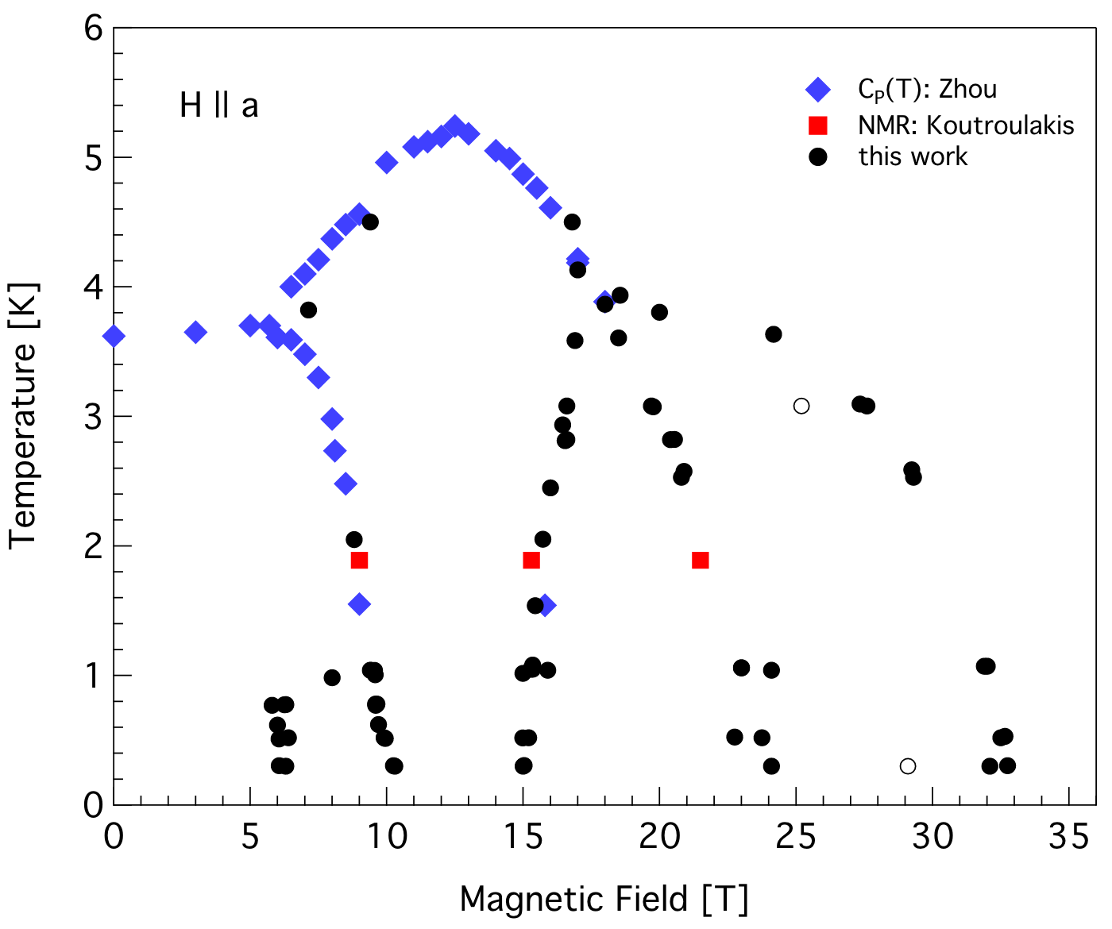
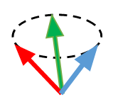
Quantum Fluctuations Induce Stable Magnetic Arrangements in Layered Materials
N.A. Fortune¹, S.T. Hannahs², E.S. Choi², Y. Takano³, H.D Zhou⁴
1. Smith College; 2. National High Magnetic Field Laboratory ; 3. University of Florida ; 4. University of Tennessee
Funding Grants: G.S. Boebinger (NSF DMR-1644779), Y. Takano & E.S. Choi (NHMFL UCGP)
Quantum fluctuations can lift the classical degeneracy of the antiferromagnetic ground state in a magnetic field, producing a series of novel spin structures. This was demonstrated in the effective spin-1/2, layered triangular-lattice quantum Heisenberg antiferromagnet Ba₃CoSb₂O₉ when magnetic fields were applied within the crystallographic ab plane. One of the four states arising from quantum fluctuations was found to be the celebrated collinear “up-up-down” (UUD) ordering, with a magnetization equal to 1/3 of the saturation magnetization. This collaboration, led by a MagLab user from an undergraduate institution, employed specific heat, neutron diffraction, thermal conductivity, and magnetic torque measurements to map the phase diagram as a function of magnetic field intensity, temperature, and magnetic field orientation.
The results find that a theoretically unexpected magnetic-field-induced phase exists below the UUD phase at temperatures below 1K, as well as the discovery of an unexpected tetracritical point in the phase diagram at high field for H ∥ a. This feature — and the second order nature of the phase transition — eliminates the theoretically predicted spin structure for the phase that exists between 24 T and 33T and indicates instead the so-called “Ψ” phase, so denoted due to the co-planar trident arrangement of the three spins.
The existence of a tetracritical point further reveals that weak interlayer coupling plays an essential role in the magnetic ordering of ‘2D’ triangular lattice quantum antiferromagnets, doubling the period of the magnetic structure along the direction perpendicular to the layers. This allows the spins to change directions in alternating layers, and, in so doing, alters which spin arrangement minimizes magnetic energy in a particular high field phase.
The MagLab’s unique combination of a 35 T resistive magnet, dilution refrigerator, and single-axis rotator made it possible for users to calorimetrically map out the complete phase diagram from zero field to beyond the saturation field of 33 T.
H ∥ a
The classical paramagnetic spin structure is a 3D cone
Calorimetrically determined magnetic phase diagram for Ba₃CoSb₂O₉ for in-plane magnetic field (H ∥ a). Insets show the classical ground state (a 3D cone), which contrasts with the observed series of four co-planar (2D) spin arrangements that are stabilized by quantum fluctuations. Note the still-unexplained phase below 1K for magnetic fields between 6T and 11T, as well as the tetracritical point at 4K and 18T, where four states meet at a single point.
Facilities and instrumentation used: DC field Facility. Heat capacity measurements shown in black done in 35 T resistive magnet and dilution refrigerator. Blue points done using SCM1.
Citation: Fortune, N.A.; Huang, Q.; Hong, T.; Ma, J.; Choi, E.S.; Hannahs, S.T.; Zhao, Z.Y.; Sun, X.F.; Takano, Y.; Zhou, H.D., Evolution of magnetic field induced ordering in the layered quantum Heisenberg triangular-lattice antiferromagnet, Ba3CoSb2O9Ba3CoSb2O9, Physical Review B, 103 (18), 184425 (2021) doi.org/10.1103/PhysRevB.103.184425.
Notes:
How to compress files size:
On PowerPoint, you can save the attached image (Right click on an image -> Select “Save as picture” -> Then you save the image as PNG). PNG is the image compression without losing the image quality. You replace the original image with the PNG one on PowerPoint. This should reduce the PowerPoint file size.
One thing to be careful about is that you should enlarge your image a bit on PowerPoint before saving so is to avoid losing much resolution.

Slide 2
Quantum Fluctuations Induce Stable Magnetic Arrangements in Layered Materials
N.A. Fortune¹, S.T. Hannahs², E.S. Choi², Y. Takano³, H.D Zhou⁴
1. Smith College; 2. National High Magnetic Field Laboratory ; 3. University of Florida ; 4. University of Tennessee
Funding Grants: G.S. Boebinger (NSF DMR-1644779), Y. Takano & E.S. Choi (NHMFL UCGP)
What is the finding? In the quantum world, individual magnetic atoms behave like compass needles and we call these atomic-scale magnets ‘spins.’ A change in orientation of one spin can cause a neighboring spin to change direction as well, and because no atom ever has zero quantum energy, the spins fluctuate in a disordered way. Surprisingly, there are conditions under which these “quantum fluctuations” can cause sets of three spins to stumble upon an ordered arrangement of their spin orientations. That is, quantum fluctuations can create magnetically-ordered materials from typically disordered fluctuations.
This user collaboration, led by a researcher from an undergraduate institution, studied Ba₃CoSb2O₉, in which magnetic cobalt (Co) atoms are placed in a repeating triangular pattern to form two-dimensional (2D) layers. They discovered that this provides the precise physical arrangement in which a magnetic field directed parallel to the 2D layers will enable quantum fluctuations to create an entire series of stable spin orientations. The four new spin configurations are shown in the figure, with the changes in spin orientation occurring as the magnetic field is increased.
Why is this important? Stable magnetic spin arrangements in layered materials can be used to store and retrieve information, but researchers do not yet have good models of how having multiple layers (instead of a single isolated layer) will change what happens. These measurements have: (1) discovered new arrangements of magnetic spins in strong magnetic fields, (2) determined what kinds of arrangements are physically possible, and (3) demonstrated that even though the spins are confined to the 2D planes, the magnetic interaction between these planes changes what arrangements are possible.
Why did this research need the MagLab? Mapping out the magnetic behavior of this material beyond the saturation field at 33T required the MagLab’s unique combination of low temperature cryostats (a dilution refrigerator with a sample rotator), high field resistive magnets, and expert scientific staff.
The magnetic phase diagram for Ba₃CoSb₂O₉ with the observed series of four ordered 2D spin arrangements that are stabilized by quantum fluctuations. Note the discovery of an extremely unusual tetracritical point, where four states meet at a single point when the temperature is 4K and the magnetic field is 18T.
Facilities and instrumentation used: DC field Facility. Heat capacity measurements shown in black done in 35 T resistive magnet and dilution refrigerator. Blue points done using SCM1.
Citation: Fortune, N.A.; Huang, Q.; Hong, T.; Ma, J.; Choi, E.S.; Hannahs, S.T.; Zhao, Z.Y.; Sun, X.F.; Takano, Y.; Zhou, H.D., Evolution of magnetic field induced ordering in the layered quantum Heisenberg triangular-lattice antiferromagnet, Ba3CoSb2O9Ba3CoSb2O9, Physical Review B, 103 (18), 184425 (2021) doi.org/10.1103/PhysRevB.103.184425.
Notes:
How to compress files size:
On PowerPoint, you can save the attached image (Right click on an image -> Select “Save as picture” -> Then you save the image as PNG). PNG is the image compression without losing the image quality. You replace the original image with the PNG one on PowerPoint. This should reduce the PowerPoint file size.
One thing to be careful about is that you should enlarge your image a bit on PowerPoint before saving so is to avoid losing much resolution.

