Slide 1


Probing the Reactivity of New Metalloproteins With High-Field Pulsed Electron Magnetic Resonance
E.C. Kisgeropoulos,¹ Y.J. Gan,¹ S.M. Greer,² J.M. Hazel,¹ and H.S. Shafaat¹
1. The Ohio State University; 2. National High Magnetic Field Laboratory
Funding Grants: G.S. Boebinger (NSF DMR-1644779); H.S. Shafaat (NIH GM128852)
Metalloproteins catalyze the most challenging chemical reactions seen in nature. R2lox metalloproteins have an unusual “mixed-metal” manganese-iron (Mn/Fe) active site and are recognized as a virulence factor in pathogens like Mycobacterium tuberculosis, the causative agent of tuberculosis. While diiron (Fe/Fe) proteins are well-studied, Mn/Fe proteins represent a new class of metalloprotein for which the chemistry is largely unexplored. In this work, the reactivity of R2lox towards O₂ and the structure of a key, short-lived oxidized state have been characterized, demonstrating unusually weak electronic interactions between the Fe and Mn centers and a critical hydrogen bond within the active site that likely play an important role in determining the reactions that R2lox can perform.
Experiments at the MagLab EMR program capitalized on the sensitivity and resolution of the HiPER spectrometer to study transient biochemical species that could only be obtained at low concentrations. High-field experiments enable resolution of the spin Hamiltonian parameters of the Mn center, suggesting the presence of an open coordination site that a target molecule could subsequently use to bind to the metal(s) and undergo reaction(s). Researchers also took advantage of the high-power pulsed EPR capabilities to directly examine protons near the active site using the Electron-Detected NMR technique, which indicated a strongly coupled proton in this short-lived state that disappears as the reaction proceeds, consistent with the proton-coupled reactivity hypothesized for these proteins.
This research revealed what R2lox looks like before it reacts with a target, which will aid in identifying the role that R2lox plays in enhancing tuberculosis virulence. Moreover, this study provides a roadmap for understanding electronic structure-function relationships in novel Mn/Fe metalloproteins.
@ g₁
Control
R2lox
EDNMR Amplitude
A(H)
A(H)
g₁
R2lox
H₂O
D₂O
g-value
Figure. (Center) Magnetic field-swept pulsed electron echo-detected (ED) spectrum of a reactive, short-lived state of Mn/Fe R2lox after binding oxygen. (Top left) High-field ED-NMR spectrum of the same Mn/Fe R2lox state. The weak signals due to the observed protons [A(H)] are highlighted. (Top right) Structure of the trapped species proposed from EPR spectroscopy.
Facilities and instrumentation used: EMR (W-Band HiPER Pulsed EPR Spectrometer).
Citation: Kisgeropoulos, E.C.; Gan, Y.J.; Greer, S.; Hazel, J.M.; Shafaat, H.S., Pulsed Multifrequency Electron Paramagnetic Resonance Spectroscopy Reveals Key Branch Points for One- vs Two-Electron Reactivity in Mn/Fe Proteins, Journal of the American Chemical Society, 144 (27), 11991-12006 (2022) doi.org/10.1021/jacs.1c13738

Slide 2
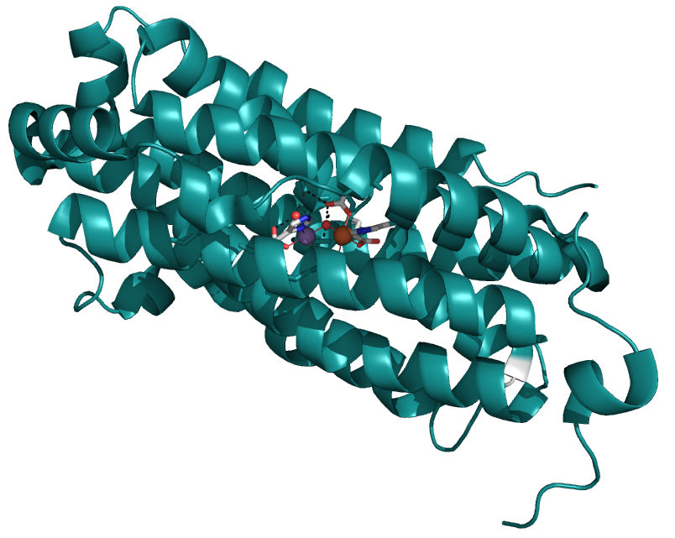
Probing the Reactivity of New Metalloproteins With High-Field Pulsed Electron Magnetic Resonance
E.C. Kisgeropoulos,¹ Y.J. Gan,¹ S.M. Greer,² J.M. Hazel,¹ and H.S. Shafaat¹
1. The Ohio State University; 2. National High Magnetic Field Laboratory
Funding Grants: G.S. Boebinger (NSF DMR-1644779); H.S. Shafaat (NIH GM128852)
What is the finding? Using high-magnetic-field pulsed electron magnetic resonance, MagLab users were able to interrogate the electrons that are presumed to play an important role in the disease-causing activity of a particular protein in the tuberculosis bacterium, a protein that features an unusual manganese-iron pair of metal atoms. The extremely fine structural information afforded by these experiments revealed an unoccupied atomic site right next to the manganese atom (dashed box in the Figure) which signifies a likely way that target molecules can approach and bind to the metal core. This finding represents a critical first step towards understanding the chemistry that R2lox performs in tuberculosis bacteria.
Why is this important? Tuberculosis superbugs have evolved many ways to overcome the immune system of their hosts. While all organisms need iron to live, one way that bacteria can survive is to substitute other metals for iron in their metabolisms. In tuberculosis and some other pathogens, the metalloprotein “R2lox” has evolved with a “mixed-metal” manganese-iron (Mn/Fe) site in place of the typical two-iron (Fe/Fe) active site. Because R2lox has been identified as a virulence factor for tuberculosis, understanding its chemistry offers a new and potentially valuable approach towards fighting this disease. This study investigates the structure of the two metals at the center of R2lox during the first reaction cycle with oxygen, with a specific emphasis on the short-lived state that controls downstream reactions.
Why did this research need the MagLab? R2lox shows unusually weak communication between its Mn and Fe atoms, necessitating the ultra-high resolution HiPER instrument available in the MagLab’s EMR user program. This interaction would otherwise be impossible to resolve using commercial low-field spectrometers. Furthermore, in order to study atoms bound to the metals, the uniquely high-power capabilities of HiPER were essential. Indeed, these studies can interrogate both the electrons and protons (hydrogens) involved in the reactivity of R2lox in the same experiment, directly showing which protons interact with the metal center (also shown in the Figure).
H₂O
H
Mn
O
Fe
Figure. The figure at top right shows the detailed structure of the “R2lox” metalloprotein, a protein in which one or more metal atoms plays an active role. High-field pulsed electron magnetic resonance acts as a magnifying glass, enabling researchers to propose the arrangement of atoms around the manganese (Mn) / iron (Fe) core within R2lox. The empty spot where the target binds to the Mn metal atom is highlighted.
Facilities and instrumentation used: EMR (W-Band HiPER Pulsed EPR Spectrometer).
Citation: Kisgeropoulos, E.C.; Gan, Y.J.; Greer, S.; Hazel, J.M.; Shafaat, H.S.,
Pulsed Multifrequency Electron Paramagnetic Resonance Spectroscopy Reveals Key Branch Points for One- vs Two-Electron Reactivity in Mn/Fe Proteins, Journal of the American Chemical Society, 144 (27), 11991-12006 (2022) doi.org/10.1021/jacs.1c13738

