Slide 1
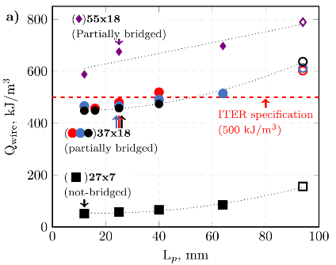
Highly efficient twisted multifilament Bi-2212 round wires
Y. Oz¹, D. Davis¹, J. Jiang¹, E. E. Hellstrom^{1,2}, D. C. Larbalestier^{1,2},
Applied Superconductivity Center, National High Magnetic Field Laboratory, Florida State University, Florida, 32310, USA;
2. FAMU-FSU College of Engineering, Tallahassee, Florida, 32310, USA;
Funding Grants: G. S. Boebinger (NSF DMR-1157490, DMR-1644779, DMR-2128556); DOE DE-SC0010421
Bi₂Sr₂Ca₁Cu₂O_{x} (Bi-2212) is one of only two superconducting materials that can be used to build electromagnets capable of generating magnetic fields that exceed 25T, the long-standing practical limit of superconducting magnets based on Nb₃Sn. However, the same manufacturing process that promotes the high-current-carrying capacity necessary for generating high magnetic fields also forms unwanted interconnections between separate superconducting filaments in Bi-2212 round wires. These intermittent interconnections couple the ideally discrete filaments, which increases unwanted magnetization and heat generation when the superconducting magnet is charged or discharged.
Researchers accessed the diverse array of electromagnetic characterization techniques at the MagLab’s Applied Superconductivity Center to characterize the electrical performance and magnetic loss properties of state-of-the-art, high-performance Bi-2212 round wires. The wires were twisted to minimize magnetization losses. It was found that all wires had losses (normalized to wire volume) that are near to - or even below - the maximum loss limit specified by the ITER project, the biggest nuclear energy project in the world. Certain configurations of Bi-2212 round wires with widely separated filaments had even lower losses, so low as to approach specifications required for motors, generators, and other electrical infrastructure applications.
The results highlight the versatility of round wire Bi-2212 for high-field, low-loss applications. The publication of this work in the journal Superconductor Science and Technology claimed the 2022 Jan Evetts Award sponsored by the Institute of Physics.
Fig: (a) A cross section view of a Bi-2212 superconducting round wire used in the study, showing 18 bundles, each of which contains 37 superconducting filaments, and (b) a closeup of some of the bundles from the same cross section. The red ovals highlight unwanted filament inter-connections that increase magnetization losses. (c) Magnetization loss per cycle as a function of twist length (L_{p}) normalized to wire volume. Losses are very close to - and even below - the ITER specification (red dashed line) for maximum magnetization losses.
(c)
Facilities and instrumentation used: Applied Superconductivity Center. Instrumentation included Thermo Fisher Scientific Helios G4 high resolution Scanning Electron Microscope,
Oxford Instruments 14T Vibrating Sample Magnetometer, Oxford Instruments 15T Superconducting Magnet
Citation: Oz, Y.; Davis, D.S.; Jiang, J.; Hellstrom, E.; Larbalestier, D.C., Influence of twist pitch on hysteretic losses and transport Jc in overpressure processed high Jc Bi-2212 round wires,
Superconductor Science and Technology, 35 (6), 064004 (2022) doi.org/10.1088/1361-6668/ac68a8
Notes:
How to compress files size:
On PowerPoint, you can save the attached image (Right click on an image -> Select “Save as picture” -> Then you save the image as PNG). PNG is the image compression without losing the image quality. You replace the original image with the PNG one on PowerPoint. This should reduce the PowerPoint file size.
One thing to be careful about is that you should enlarge your image a bit on PowerPoint before saving so is to avoid losing much resolution.

Slide 2
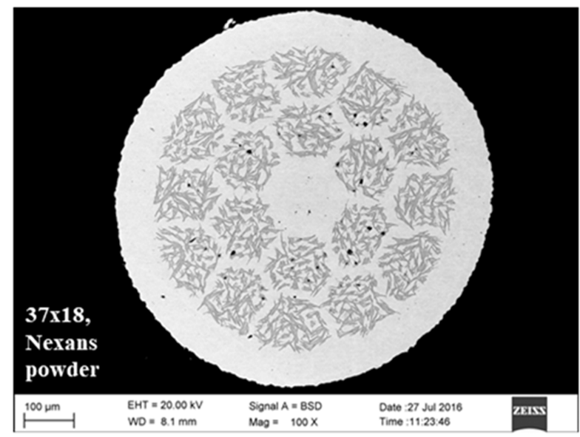
Highly efficient twisted multifilament Bi-2212 round wires
Y. Oz¹, D. Davis¹, J. Jiang¹, E. E. Hellstrom^{1,2}, D. C. Larbalestier^{1,2},
Applied Superconductivity Center, National High Magnetic Field Laboratory, Florida State University, Florida, 32310, USA;
2. FAMU-FSU College of Engineering, Tallahassee, Florida, 32310, USA;
Funding Grants: G. S. Boebinger (NSF DMR-1157490, DMR-1644779, DMR-2128556); DOE DE-SC0010421
What is the finding? Round wires made with Bi₂Sr₂Ca₁Cu₂O_{x} (Bi-2212), a high-temperature superconducting material, have been developed to feature enhanced performance that meets an important efficiency requirement of the largest nuclear energy project in the world (ITER).
Why is this important? These findings prove that Bi-2212 round wires have a combination of efficiency and performance that could enable the next generation of powerful magnets for fusion and other applications that require superconducting magnets to be frequently charged and discharged during regular operation. The publication of this work in Superconductor Science and Technology claimed the 2022 Jan Evetts Award sponsored by the Institute of Physics.
Why did this research need the MagLab? The MagLab supports research into high-temperature superconductors for use in ultra-high-field next-generation superconducting magnets. Bi-2212 is one of the promising conductors for such magnets. The MagLab’s Applied Superconductivity Center is home to a diverse array of electromagnetic characterization devices, as well as the interdisciplinary expertise necessary to develop and utilize these techniques to study the Bi-2212 conductor and the test coils that demonstrate its capabilities.
Facilities and instrumentation used: Applied Superconductivity Center, Thermo Fisher Scientific Helios G4 high resolution Scanning Electron Microscope, Oxford Instruments 14T Vibrating Sample Magnetometer, Oxford Instruments 15T Superconducting Magnet
Citation: Oz, Y.; Davis, D.S.; Jiang, J.; Hellstrom, E.; Larbalestier, D.C., Influence of twist pitch on hysteretic losses and transport Jc in overpressure processed high Jc Bi-2212 round wires, Superconductor Science and Technology, 35 (6), 064004 (2022) doi.org/10.1088/1361-6668/ac68a8
Figure: Electron microscopy image of a high performance, high efficiency Bi-2212 round wire cross section, showing the arrangement of the fine superconducting Bi-2212 filaments embedded in the silver wire. The wire contains 18 bundles of filaments, each of which contains 37 superconducting filaments. Enhanced performance, suitable for leading applications of superconducting magnets, was achieved by minimizing the interconnections between the individual superconducting filaments.
Notes:
How to compress files size:
On PowerPoint, you can save the attached image (Right click on an image -> Select “Save as picture” -> Then you save the image as PNG). PNG is the image compression without losing the image quality. You replace the original image with the PNG one on PowerPoint. This should reduce the PowerPoint file size.
One thing to be careful about is that you should enlarge your image a bit on PowerPoint before saving so is to avoid losing much resolution.

