Slide 1
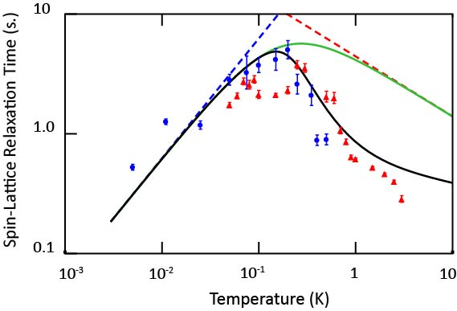
Luttinger Liquid Behavior of ³He Atoms in a One-Dimensional Nanochannel
Donald Candela¹, Johnny Adams^{2,3}, Chao Huan^{2,3}, Naoto Masuhara^{2,3}, Neil S. Sullivan^{2,3},
1. University of Massachusetts, Amherst; 2. National High Magnetic Field Laboratory; 3. University of Florida;
Funding Grants: G.S. Boebinger (NSF DMR-2128556 and DMR-1644779), C. Huan (MagLab UCGP)
Although three-dimensional many-body systems can often be well understood by theoretical descriptions with quasi-particle excitations, in a one-dimensional (1D) world, quasi-particles do not exist due to strong interactions. Instead, the Luttinger Liquid theory was proposed to cast light on the dynamics of 1D systems. A variety of experimental studies have explored and tested the predictions of the Luttinger Liquid theory as it applies to electrons in quantum wells and wires. However, degenerate charged systems are prone to instabilities and there are few suitably degenerate charge-neutral systems that are experimentally accessible.
In this research, unique ultra-low-temperature nuclear magnetic resonance (NMR) methods are applied in the MagLab’s High B/T facility to study the dynamics of ³He atoms confined in the interior of 1D channels of a special mesoporous material known as MCM-41 (Mobil Composition of Matter Number 41) that have been pre-plated with ⁴He atoms. Ultra-low-temperature NMR is able to probe this charge-neutral 1D system at temperatures comparable to and below the Fermi temperature, which is the regime in which the Luttinger liquid theory is expected to be valid. The measured spin-lattice relaxation times (T₁) are related linearly with temperature (T) when the temperatures are well below the degenerate temperature, which is a signature of Luttinger liquid dynamics. At higher temperatures, there is a peak at twice the Fermi temperature, followed by a decrease that fits the higher temperature data once the presence of transverse motions is taken into account.
This research is one of the first measurements of Luttinger liquid dynamics in a neutral fermion system well below the degeneracy temperature. It broadens the scope of 1D physics and calls for further investigation in this physical system that is dominated by quantum interactions.
The temperature dependence of the spin-lattice relaxation times (T₁) of a sample with Ag powder providing increased thermal anchoring (solid blue circles), compared to another sample without Ag powder (solid red triangles). The Ag powder was necessary to acquire data through the peak at twice the Fermi temperature and down to much lower temperatures. The green line is the theoretical dependence of a Luttinger liquid. The black line is the expected dependence once the lowest transverse mode is included.
Facilities and instrumentation used: MagLab High B/T Facility, Bay 2 Instrument.
Citation: Adams, J.; Lewkowitz, M.; Huan, C.; Masuhara, N.; Candela, D.; Sullivan, N.S., Dynamics of ³He in one dimension in the Luttinger liquid limit,
Physical Review B, 106, 195402 (2022) doi.org/10.1103/PhysRevB.106.195402 This research was supported, in part, by a MagLab User Collaboration Grant Program.
Notes:
How to compress files size:
On PowerPoint, you can save the attached image (Right click on an image -> Select “Save as picture” -> Then you save the image as PNG). PNG is the image compression without losing the image quality. You replace the original image with the PNG one on PowerPoint. This should reduce the PowerPoint file size.
One thing to be careful about is that you should enlarge your image a bit on PowerPoint before saving so is to avoid losing much resolution.

Slide 2
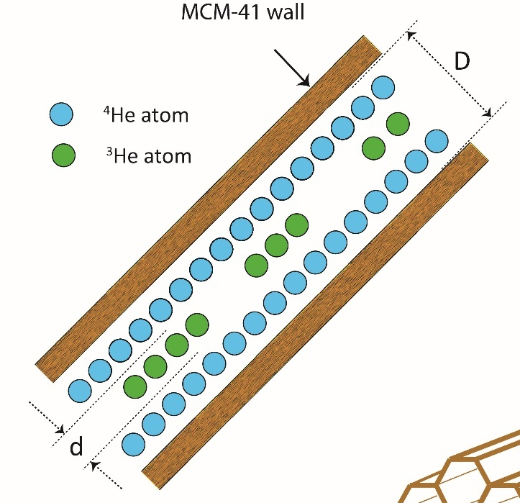
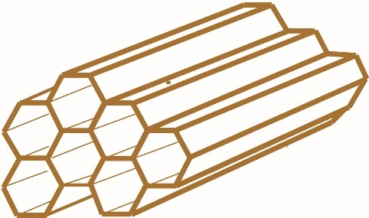
Luttinger Liquid Behavior of ³He Atoms in a One-Dimensional Nanochannel
Donald Candela¹, Johnny Adams^{2,3}, Chao Huan^{2,3}, Naoto Masuhara^{2,3}, Neil S. Sullivan^{2,3},
1. University of Massachusetts, Amherst; 2. National High Magnetic Field Laboratory; 3. University of Florida;
Funding Grants: G.S. Boebinger (NSF DMR-2128556 and DMR-1644779), C. Huan (MagLab UCGP)
What is the finding? For this research, users access the unique ultra-low-temperature nuclear magnetic resonance (NMR) techniques at the MagLab’s High B/T facility to probe a one-dimensional (1D) system built from ³He atoms confined to a one-dimensional region that is only 1 nanometer in diameter. This is achieved by inert ⁴He atoms that line the interior of a hollow nanotube (see Figure). At ultra-low temperatures - from 1K down to below 0.01K - the dynamics of the ³He atoms demonstrate a clear signature of the behavior expected from Luttinger liquid theory, an exact quantum mechanical solution of interacting fermions in one-dimension.
Why is this important? Although Fermi liquid theory works very well in understanding the properties of three-dimensional fermion systems such as electrons in metals and liquid ³He at very low temperatures, Fermi liquid theory completely breaks down in the case of 1D fermion systems. Instead, the dynamics of 1D systems are believed to be characterized by interactions described by the Luttinger liquid theory. Numerous experimental efforts have focused on searching for signatures of a Luttinger liquid in electron systems, however due to instabilities in electron systems arising from the fact that electrons are charged particles, definitive evidence for the existence of a Luttinger liquid has remained elusive. This user research represents one of the first investigations of dynamics in a charge-neutral 1D fermion system that has been sufficiently cooled to ultra-low temperatures where experimental signatures of the Luttinger liquid can be detected.
Why did this research need the MagLab? This research requires ultra-low temperatures, high-homogeneity magnetic fields, and the instrumentation and expertise required to perform NMR measurements under such extreme conditions, a combination that can only be met at the MagLab’s High B/T facility.
Hexagonal Nanochannel
⁴He atom
³He atom
The illustration shows a cross section of a hexagonal nanochannel. The inner surface (with diameter, D, of roughly 2.2 nanometers) has been coated by a single layer of ⁴He atoms (blue). The adsorbed ³He atoms (green) are thus confined inside a one-dimensional region with a diameter, d, of about 1 nanometer. The illustration at lower right depicts the stacking of the hexagonal nanochannels as bunches of nanotubes.
Facilities and instrumentation used: MagLab High B/T Facility, Bay 2 Instrument.
Citation: Adams, J.; Lewkowitz, M.; Huan, C.; Masuhara, N.; Candela, D.; Sullivan, N.S., Dynamics of ³He in one dimension in the Luttinger liquid limit,
Physical Review B, 106, 195402 (2022) doi.org/10.1103/PhysRevB.106.195402 This research was supported, in part, by a MagLab User Collaboration Grant Program.
Notes:
How to compress files size:
On PowerPoint, you can save the attached image (Right click on an image -> Select “Save as picture” -> Then you save the image as PNG). PNG is the image compression without losing the image quality. You replace the original image with the PNG one on PowerPoint. This should reduce the PowerPoint file size.
One thing to be careful about is that you should enlarge your image a bit on PowerPoint before saving so is to avoid losing much resolution.

