Slide 1
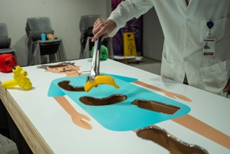
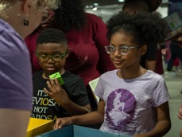
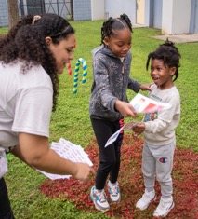
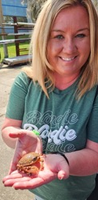
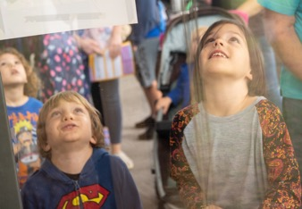
Fun and Games for Ten Thousand at the MagLab’s 2023 Open House
National High Magnetic Field Laboratory, Florida State University
Funding Grants: G.S. Boebinger (NSF DMR-2128556
More than 11,700 visitors came from across the southeastern United States to play with the nearly 100 hands-on games and demonstrations at the MagLab’s 2023 Open House. This was the first in-person MagLab Open House since 2020.
In addition to Open House classics like the popular Quarter Shrinker, Potato Launcher, Junkyard Magnet, Human Levitator, and Cryogenic Ice Cream, the 2023 event offered many special game-themed experiences included:
A giant Operation game that explained to players the kinds of things that can now be imaged with more powerful MRIs.
An outdoor CandyLab experience that took children through science-inspired magical lands like Glucose Gardens, Candy Chemistry Forest, Confection Coil Mountain, and Superconducting Pass as they learned about colors on the visible light spectrum.
A Pokémon Go Scavenger Hunt that took visitors around the lab to find Pokémon connected with MagLab spaces and activities.
A MagLab Game Show Network where visitors could play MagLab versions of classic TV game shows including Jeopardy, Pictionary, Match Game and Two Truths & A Lie.
A Super MagLab World with activities themed around Super Mario including a Super Mario Kaleidoscope, Rainbow Road, Lakitu’s Lagoon, and Bananas for Donkey Kong
Plus Name that Tune with Audio Fourier Transform, a Bitter Disk Bottle Toss, a Floor is Lava geochemistry game, and a Super(con)nect Four game about superconductivity and more.
More than twenty community partners contributed their own science fun to the MagLab event, including Ask A Scientist Gaming who hosted an on-site TWITCH live stream. The live stream featured MagLab scientists and FSU Political Science Professor Dr. Jason Davis, who explained the science of Game Theory using games like rock-paper-scissors as examples.
Facilities: The Open House features every FSU-based MagLab Facility and is run by the lab’s Public Affairs Team with immense support from the MagLab Facilities and Safety Groups

Slide 2
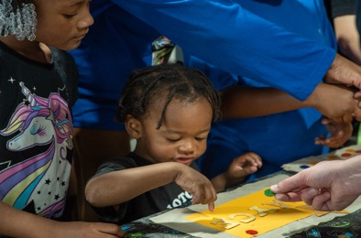
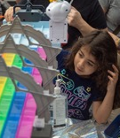
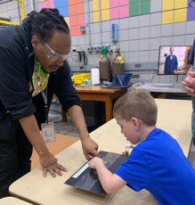
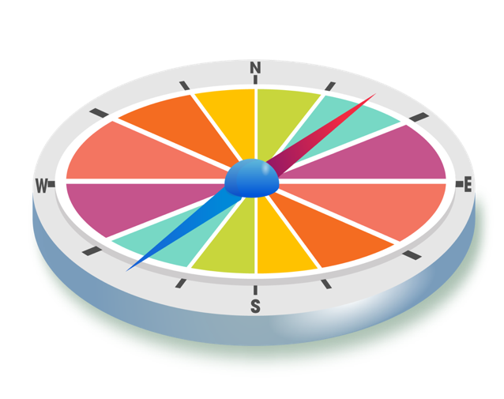
Fun and Games for Ten Thousand at the MagLab’s 2023 Open House
National High Magnetic Field Laboratory, Florida State University
Funding Grants: G.S. Boebinger (NSF DMR-2128556
What is the event? More than 11,700 visitors came from across the southeastern United States to play with the nearly 100 hands-on games and demonstrations at the MagLab’s flagship event, Open House 2023. This event marked the first return to an in-person Open House experience since February 2020 and it featured the largest Open House attendance in MagLab history.
This year's game-themed event included one-of-a-kind experiences based on classic board games, video games, carnival games and even TV game shows. Highlights included an Operation game that explained the kinds of things that are able to be imaged with more powerful MRIs; an outdoor CandyLab experience with a colorful path through science-inspired magical lands teaching about colors on the visible light spectrum; a Pokémon Go Scavenger Hunt that took visitors around the lab to find Pokémon connected with MagLab spaces and activities; a MagLab Game Show Network where visitors could play MagLab versions of classic TV game shows including Jeopardy, Pictionary, Match Game and Two Truths and A Lie; and a Super MagLab World with activities themed around Super Mario.
Why is it important? Events like the MagLab’s Open House provide an important pathway for people of all ages to connect with the MagLab by meeting our researchers, seeing our unique lab spaces, and enjoying the fun of hands-on science. Events excite and inspire young visitors and remind adults that science is important and worthy of continued support. Survey data from the 2023 Open House shows that about half of our Open House visitors had never been to the MagLab before the event and that 75% agreed or strongly agreed that the event helped them better understand the science at the MagLab and how it benefits our community.
Why did this it need the MagLab? The Open House is a one-of-a-kind event that brings the energy and fun of a science festival and places it inside a world-unique research laboratory. This special combination and the participation from about 200 MagLab scientists, students and staff is what makes Open House possible.
Facilities: The Open House features every FSU-based MagLab Facility and is run by the lab’s Public Affairs Team with immense support from the MagLab Facilities and Safety Groups
Notes:
How to compress files size:
On PowerPoint, you can save the attached image (Right click on an image -> Select “Save as picture” -> Then you save the image as PNG). PNG is the image compression without losing the image quality. You replace the original image with the PNG one on PowerPoint. This should reduce the PowerPoint file size.
One thing to be careful about is that you should enlarge your image a bit on PowerPoint before saving so is to avoid losing much resolution.

