Slide 1
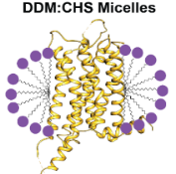
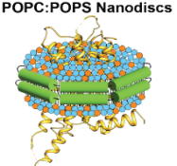
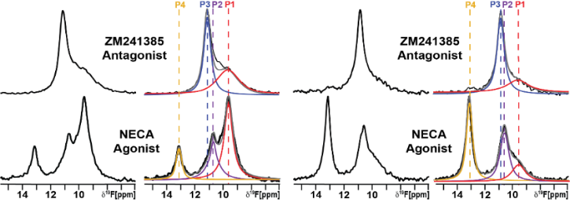
Different Protein Receptor Responses Resulting from Different Membrane Environments
N. Thakur¹, A.P. Ray¹, L. Sharp², B. Jin¹, A. Duong¹, N. Gopal Pour¹, S. Obeng³, A.V. Wijesekara¹,
Z.-G. Gao⁴, C.R. McCurdy³, K.A. Jacobson⁴, E. Lyman², M.T. Eddy¹
1. University of Florida, Dept. of Chemistry 2. University of Delaware, Dept. of Physics and Astronomy
3. University of Florida, Dept. of Medicinal Chemistry 4. Laboratory of Bioorganic Chemistry, NIDDK, National Institutes of Health
Funding Grants: Boebinger (NSF DMR-2128556); Eddy (NIH R35GM138291), Lyman (R01GM120351), Gao and Jin (ZIA DK031117)
G protein-coupled receptors (GPCRs) play a crucial role in many physiological processes, first by detecting signals from external stimuli, such as hormones, neurotransmitters, and drugs, and then by transmitting those signals to the inside of the cell. Despite their significance as drug targets, the impact of the cellular membrane environment on the function of GPCRs is still largely unknown.
In this interdisciplinary collaborative study, MagLab users investigated how phospholipids within the cellular environment strongly influence the response of GPCRs to stimulating drugs. NMR spectroscopy played a central role in this study, allowing researchers to carefully observe receptors and their responses to drugs in different membrane environments (see Figure). State-of-the art NMR instrumentation at the MagLab is uniquely suited for precise measurements of lipid compositions and simultaneous investigation of receptor proteins on the same instrument through visualization of multiple nuclei, in particular 1H, 19F, and 31P. By combining NMR data with computational modeling and in vitro experiments, the research team obtained new insights into the molecular mechanisms underlying receptor-lipid interactions.
The specific focus of this work was an adenosine receptor, the target for caffeine and a validated drug target for Parkinson’s disease and several cancers. The success of this study has broad implications for many other receptors, including human receptors for opioids, hormones, and neurotransmitters.
Figure: Receptor proteins respond differently to drugs depending on the environment in which they are studied. NMR spectroscopy at the MagLab’s AMRIS facility enabled the investigation of the synergistic response between drug efficacy and the membrane environment, demonstrated above by different responses of the same receptor protein in (left) detergents and (right) lipid nanodiscs.
Facilities and instrumentation used: The MagLab’s AMRIS Facility at the University of Florida, particularly the ¹⁹F NMR probe on the 600MHz wide bore NMR instrument
Citation: Thakur, N.; Ray, A.; Sharp, L.; Jin, B.; Duong, A.; Gopal Pour, N.; Obeng, S.; Wijesekara, A.; Gao, Z.; McCurdy, C.; Jacobson, K.; Lyman, E.; Eddy, M.T., Anionic Phospholipids Control Mechanisms of GPCR-G Protein Recognition, Nature Communications, 14, 794 (2023) doi.org/10.1038/s41467-023-36425-z - Data Set 1, Data Set 2
Notes:
How to compress files size:
On PowerPoint, you can save the attached image (Right click on an image -> Select “Save as picture” -> Then you save the image as PNG). PNG is the image compression without losing the image quality. You replace the original image with the PNG one on PowerPoint. This should reduce the PowerPoint file size.
One thing to be careful about is that you should enlarge your image a bit on PowerPoint before saving so is to avoid losing much resolution.

Slide 2
Different Protein Receptor Responses Resulting from Different Membrane Environments
N. Thakur¹, A.P. Ray¹, L. Sharp², B. Jin¹, A. Duong¹, N. Gopal Pour¹, S. Obeng³, A.V. Wijesekara¹,
Z.-G. Gao⁴, C.R. McCurdy³, K.A. Jacobson⁴, E. Lyman², M.T. Eddy¹
1. University of Florida, Dept. of Chemistry 2. University of Delaware, Dept. of Physics and Astronomy
3. University of Florida, Dept. of Medicinal Chemistry 4. Laboratory of Bioorganic Chemistry, NIDDK, National Institutes of Health
Funding Grants: Boebinger (NSF DMR-2128556); Eddy (NIH R35GM138291), Lyman (R01GM120351), Gao and Jin (ZIA DK031117)
What is the finding?
This interdisciplinary research team showed how phospholipids in the cellular environment can influence the drug response of receptor proteins and thereby alter cellular signaling by those receptor proteins.
Why is this important?
One or more of the more than eight-hundred human G protein-coupled receptors (GPCRs) plays a role in nearly all physiological responses. As such, GPCRs are targets for more than one-third of all FDA-approved drugs. The findings from this study imply that hereditary factors or dietary factors that alter lipid compositions of cells may influence the effectiveness of drugs.
Why did this research need the MagLab?
NMR spectroscopy can observe different three-dimensional conformations of protein receptors and determine how drugs and lipids impact these conformations that correlate with changes in receptor function. State-of-the-art NMR instrumentation at the MagLab’s AMRIS Facility is uniquely suited for precise measurements of lipid compositions and simultaneous investigation of receptor protein conformations because it enables the visualization of multiple different nuclei of importance to these studies, in particular 1H, 19F, and 31P.
Figure: Receptor proteins respond differently to drugs depending on the environment in which they are studied. NMR spectroscopy at the MagLab’s AMRIS facility enabled the investigation of the synergistic response between drug efficacy and the membrane environment, demonstrated above by different responses of the same receptor protein in (left) detergents and (right) lipid nanodiscs.
Facilities and instrumentation used: The MagLab’s AMRIS Facility at the University of Florida, particularly the ¹⁹F NMR probe on the 600MHz wide bore NMR instrument
Citation: Thakur, N.; Ray, A.; Sharp, L.; Jin, B.; Duong, A.; Gopal Pour, N.; Obeng, S.; Wijesekara, A.; Gao, Z.; McCurdy, C.; Jacobson, K.; Lyman, E.; Eddy, M.T., Anionic Phospholipids Control Mechanisms of GPCR-G Protein Recognition, Nature Communications, 14, 794 (2023) doi.org/10.1038/s41467-023-36425-z - Data Set 1, Data Set 2

