Slide 1
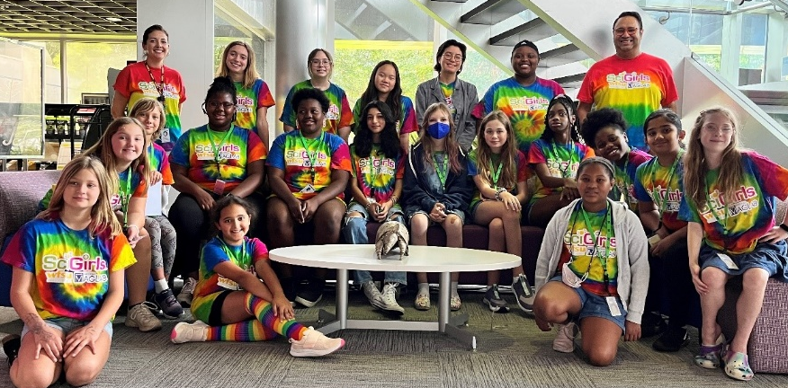
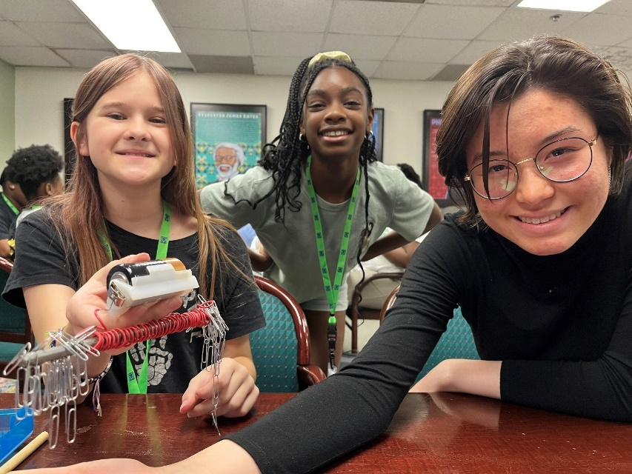
Research Worth Reading National Award for Educational Researchers
A. Ibourk¹, R. Hughes², and C. Mathis³
1. Florida State University; 2. National MagLab 3. Michigan State University
Funding Grants: G.S. Boebinger (NSF DMR-2128556)
Since 2006, the MagLab has hosted the Sci-Girls summer camps for middle-school-aged girls to gain experience with hands-on science and engineering projects, meet female role models, and interact with scientists and engineers, all while learning about the MagLab and the world of science. In 2022, the Director of the MagLab’s Center for Integrating Research and Learning (CIRL) published a collaborative article in the Journal of Research in Science Teaching that focused on the science identity trajectory of a SciGirls’ alumna, Marie (a pseudonym). The paper was titled “‘It is What it Is’: Using Storied-Identity and Intersectionality Lenses to Understand What Shaped a Young Black Woman's STEM Identity Trajectory”.
Recently, the National Association for Research in Science Teaching (NARST) announced that that publication had been chosen for a national Research Worth Reading award. The Research Worth Reading award is given to three papers among all those published in the Journal of Research in Science Teaching during the past year, chosen for presenting the most significant implications for science educators and practitioners. The authors received their award at the annual NARST conference in April 2023.
The study highlights the importance of both formal and informal institutional structures that can act as bridges or barriers to Black women and girls’ persistence in science and math fields. In recounting her experiences, which include the MagLab’s SciGirls summer camp and a high school internship at a Historically Black University, Marie referenced seeing other girls who looked like her and educators and mentors who supported her scientific curiosity and successes. These stories of recognition provided memories that helped her persevere in moments of self-doubt.
This award will boost readership of MagLab educational research to further inform science teaching practices, a major goal of the MagLab’s Center for Integrating Research and Learning.
(top)
MagLab SciGirls group photo with MagLab educator, Carlos Villa (back row on the right).
(bottom) MagLab SciGirls Building an Electromagnet
Facilities used: The MagLab’s Center for Integrating Research and Learning (CIRL)
Citation: Ibourk, A.; Hughes, R.; Mathis, C., “It is What it Is”: Using Storied-Identity and Intersectionality Lenses to Understand What Shaped a Young Black Woman's STEM Identity Trajectory, Journal of Research on Science Teaching (2022) doi.org/10.1002/tea.21753
Notes:
How to compress files size:
On PowerPoint, you can save the attached image (Right click on an image -> Select “Save as picture” -> Then you save the image as PNG). PNG is the image compression without losing the image quality. You replace the original image with the PNG one on PowerPoint. This should reduce the PowerPoint file size.
One thing to be careful about is that you should enlarge your image a bit on PowerPoint before saving so is to avoid losing much resolution.

