Slide 1
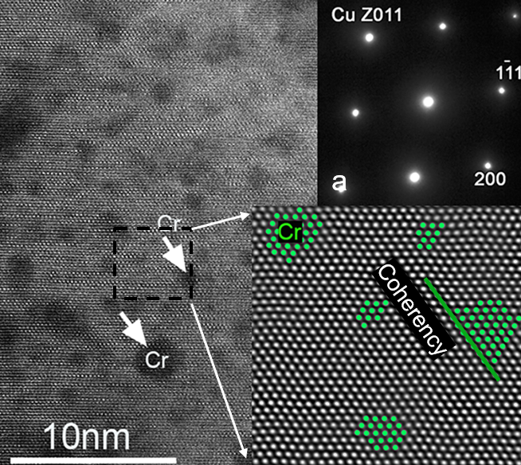
High strength Copper-Chromium-Zirconium conductors for pulsed magnets
R. Niu ¹, V. Toplosky ¹, W. Starch ¹, T. Adkins ¹, I.R. Dixon¹, J.W. Levitan ¹, J. Lu ¹, D. N. Nguyen ², and K. Han¹
1. Florida State University; 2. Los Alamos National Laboratory
Funding Grants: G.S. Boebinger (NSF DMR-1644779 and DMR-2128556)
Pulsed magnets achieve the highest non-destructive magnetic fields by carrying immense electrical currents that generate substantial heating and mechanical stress on the conductor. One MagLab goal to advance its newly-commissioned pulsed magnets that are very popular with users by developing a conductor that features the difficult-to-achieve combination of electrical conductivity greater than 75% of the International Annealed Copper Standard (IACS) and strength greater than 500MPa. Such a conductor would find applications in the next-generation mid-pulse magnets (large magnets that enable longer-duration pulses lasting 50 to 500 msec) and the outer coils of duplex pulsed magnets (nested pulsed magnets that are powered by independent capacitor banks to achieve higher magnetic fields). In order to optimize conductivity and strength, MagLab engineers and materials scientists investigated Copper-Chromium-Zirconium (Cu-Cr-Zr) alloys subjected to various deformation and aging treatments.
Researchers found that an optimized deformation and aging treatment produced a high density of Cr precipitates (dark contrast in the main image of the Figure) that are uniformly distributed throughout the Cu matrix. The precipitate size varied from 1 to 4 nm, much finer than the grain size (300nm) in the Cu matrix.
This optimized treatment contributed to higher conductivity than has ever been achieved in commercial Cu-Cr-Zr alloys. In the MagLab’s recent collaboration with Hypertech, Inc. and Yantai Wanlong Vacuum Metallurgy Co., a Cu-Cr-Zr conductor with a cross-section of 4.0 x 5.5mm² and a continuous length of over 250 meters was fabricated. This conductor reached conductivity higher than 80% IACS and strength greater than 550MPa. The MagLab will exploit this achievement to (1) wind a mid-pulse magnet to reach fields greater than 55T, and (2) upgrade duplex pulsed magnets to reach fields greater than 80T.
Figure: An atomic-resolution, high-angle annular dark-field image of an aged sample showing uniformly distributed Cr precipitates (dark contrast in main image. A fast Fourier transformed image (lower inset) shows coherent interfaces (such as the one indicated by a green line) between the Cu matrix and the precipitates (shown in green). Due to the coherent structure between the precipitates and the matrix, only one set of diffraction spots appears in the selected area diffraction pattern (top inset).
Citation: Niu, R.; Toplosky, V.J.; Han, K., Cryogenic Temperature Properties and Secondary Phase Characterization of CuCrZr Composites, IEEE Transactions on Applied Superconductivity, 32 (6), 4300405 (2022)
doi.org/10.1109/TASC.2022.3152992
Notes:
How to compress files size:
On PowerPoint, you can save the attached image (Right click on an image -> Select “Save as picture” -> Then you save the image as PNG). PNG is the image compression without losing the image quality. You replace the original image with the PNG one on PowerPoint. This should reduce the PowerPoint file size.
One thing to be careful about is that you should enlarge your image a bit on PowerPoint before saving so is to avoid losing much resolution.

Slide 2
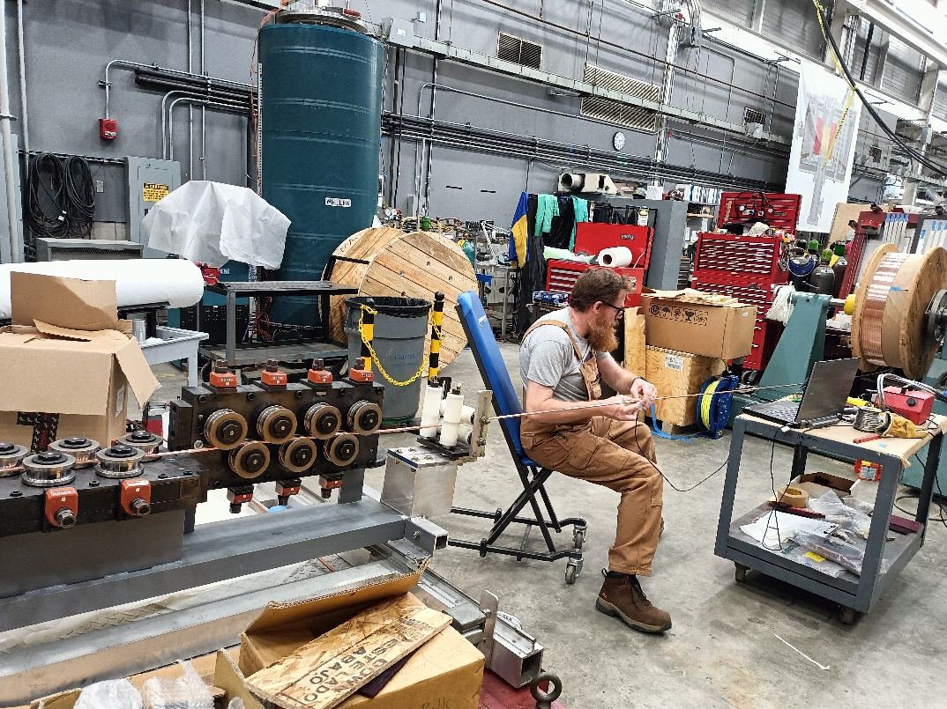
High strength Cu-Cr-Zr conductors for pulsed magnets
R. Niu ¹, V. Toplosky ¹, W. Starch ¹, T. Adkins ¹, I.R. Dixon¹, J.W. Levitan ¹, J. Lu ¹, D. N. Nguyen ², and K. Han¹
1. Florida State University; 2. Los Alamos National Lab
Funding Grants: G.S. Boebinger (NSF DMR-1644779 and DMR-2128556)
What is the finding? MagLab researchers found a way to improve both the mechanical strength and electrical conductivity in Copper-Chromium-Zirconium (Cu-Cr-Zr) conductor. These two properties tend to compete: when one increases, the other decreases. The proper combination of aging and cold drawing optimized the size and distribution of nanoscale particles in such a way that the conductor exhibited the desired properties at both room temperature and cryogenic temperatures.
Why is this important? Cu-Cr-Zr conductors are commercially available, but they have been unsuitable for use in pulsed magnets because they lack the requisite combination of strength and conductivity: conductivity greater than 80% of pure copper and strength greater than the steel in automobile body panels. The development of this new processing protocol enabled the MagLab to engineer the microstructure of the conductor to simultaneously improve both strength and conductivity.
Why did this research need the MagLab? The MagLab has a rare capability to characterize candidate conductor materials from the atomic scale up to the full conductor dimensions of several millimeters on a side. This is because the MagLab is the home of atomic-resolution microscopes, unique cryogenic mechanical testing facilities, and special fabrication and inspection equipment tailored for high-strength conductors. MagLab metallurgists and materials scientists bring expertise that is both broad and deep to the advancement of high-strength conductors.
Facilities and instrumentation used: Facilities for wire drawing, winding, inspection, and microstructure examination
Citation: Niu, R.; Toplosky, V.J.; Han, K., Cryogenic Temperature Properties and Secondary Phase Characterization of CuCrZr Composites, IEEE Transactions on Applied Superconductivity, 32 (6), 4300405 (2022)
doi.org/10.1109/TASC.2022.3152992
Photo showing the inspection and detailing process for high-strength conductor wire. Joseph Lucia is inspecting the wire using an eddy-current machine The conductor material passes from a large pay-off spool (on the far right) through a detector held by Mr. Lucia and then between several sets of rollers designed to straighten the wire.
Notes:
How to compress files size:
On PowerPoint, you can save the attached image (Right click on an image -> Select “Save as picture” -> Then you save the image as PNG). PNG is the image compression without losing the image quality. You replace the original image with the PNG one on PowerPoint. This should reduce the PowerPoint file size.
One thing to be careful about is that you should enlarge your image a bit on PowerPoint before saving so is to avoid losing much resolution.

