Slide 1
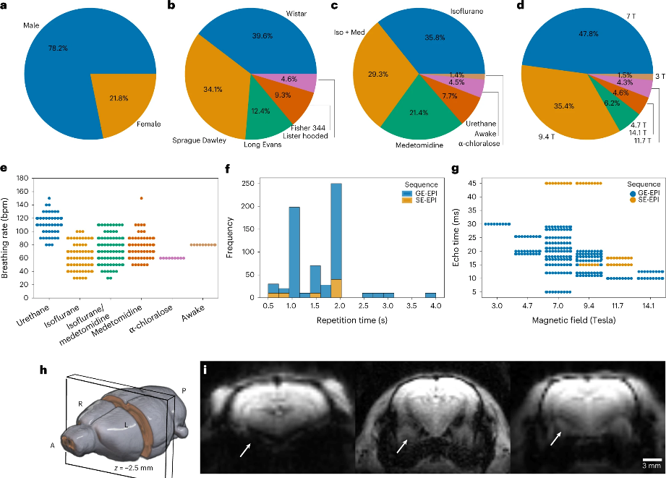
A standardized FAIR data protocol to make rat brain imaging datasets more reproducible and interoperable
Joanes Grandjean^{1,2}, et al. (including more than 200 researchers in the collaboration)
Donders Institute for Brain, Behaviour, and Cognition, Radboud University, Nijmegen, The Netherlands
Department for Medical Imaging, Radboud University Medical Center, Nijmegen, The Netherlands
Funding Grants: G.S. Boebinger (NSF DMR-1644779)
Researchers at the MagLab’s Advanced Magnetic Resonance Imaging and Spectroscopy (AMRIS) facility at the University of Florida’s McKnight Brain Institute participated in a multi-institution study that developed methods to make rat brain imaging datasets more Findable, Accessible, Interoperable, and Reusable.
Rat brain imaging data are typically collected under a variety of conditions (e.g. different rat sex, strain, anesthesia, breathing rate, or magnetic field strength) that make it difficult to combine and compare different datasets. In this study, the authors aggregated 65 rat brain functional magnetic resonance imaging (fMRI) datasets from 45 institutions collected under a broad variety of conditions. These data were designated as the MultiRat collection and used to develop an optimized consensus protocol and reproducible data analysis pipeline to be used by researchers for rat brain fMRI experiments. A StandardRat collection of 21 datasets taken from the MultiRat collection was prepared based on this protocol.
By using the optimized StandardRat protocol created by the authors, researchers can ensure their datasets can be effectively reused by others. This advancement will facilitate large-scale rat neuroimaging studies across multiple institutions, greatly increasing the current and future availability of high-quality rat brain fMRI data. The adoption of these FAIR data protocols will improve researchers’ ability to study rat brain functional connectivity and to make new discoveries using datasets from a variety of prior experiments. The authors have openly shared the datasets, consensus protocol, and reproducible data analysis pipeline in the OpenNeuro database and GitHub to maximize their value for the neuroscience community.
A variety of factors such as sex, strain, anesthesia, magnetic field strength, and breathing rate can affect the results of an fMRI scan. Image reprinted from original citation.
Facility and instrumentation used: Advanced Magnetic Resonance Imaging and Spectroscopy (AMRIS), 750 MHz/89 mm Bruker Avance III HD
Citation: Grandjean, J. et al. A consensus protocol for functional connectivity analysis in the rat brain. Nat Neurosci 26, 673–681 (2023). (https://doi.org/10.1038/s41593-023-01286-8)
Data Citation: MultiRat dataset (https://doi.org/10.18112/openneuro.ds004114.v1.0.0); StandardRat dataset (https://doi.org/10.18112/openneuro.ds004116.v1.0.0)
Software Citation: RABIES: Rodent Automated Bold Improvement of EPI Sequences (https://github.com/CoBrALab/RABIES)
Notes:
How to compress files size:
On PowerPoint, you can save the attached image (Right click on an image -> Select “Save as picture” -> Then you save the image as PNG). PNG is the image compression without losing the image quality. You replace the original image with the PNG one on PowerPoint. This should reduce the PowerPoint file size.
One thing to be careful about is that you should enlarge your image a bit on PowerPoint before saving so is to avoid losing much resolution.

Slide 2
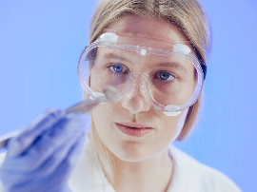
A standardized FAIR data protocol to make rat brain imaging datasets more reproducible and interoperable
Joanes Grandjean^{1,2}, et al. (including more than 200 researchers in the collaboration)
Donders Institute for Brain, Behaviour, and Cognition, Radboud University, Nijmegen, The Netherlands
Department for Medical Imaging, Radboud University Medical Center, Nijmegen, The Netherlands
Funding Grants: G.S. Boebinger (NSF DMR-1644779)
What is the development? The MagLab’s AMRIS facility, hosted at the University of Florida’s McKnight Brain Institute, participated in an international collaboration that aggregated and analyzed 65 rat brain fMRI (function magnetic resonance imaging) datasets from 45 institutions. The collaboration developed an optimized and standardized protocol to be used by researchers to store data from future rat brain imaging experiments.
Why is this important? Rats are commonly used in pharmacological studies due to their similarities with humans in terms of drug metabolism, brain structure, and ability to learn complex tasks. However, combining and comparing datasets from different experiments has historically been made very difficult because brain imaging data is typically collected under a variety of different conditions (for example, different rat strains, anesthesia, or imaging instrumentation). By conducting experiments with the standardized protocol created by this collaboration, researchers can ensure that their datasets are able to be reused effectively by others. This innovation will greatly increase the pool of available high-quality data, improving researchers’ ability to study rat brain connectivity and make new discoveries. The authors have openly shared all the data and the details of the protocol in open access databases to maximize their accessibility and value for the neuroscience community.
Why did they need the MagLab? The MagLab contributed a portion of the data in the MultiRat dataset that was used to develop the standardized protocol. The authors needed to ensure that their protocol would be valid across a wide range of different magnetic resonance imaging instruments, including those with both low and high magnetic field strength. The MagLab’s high magnetic field strength magnets were essential for this purpose.
Without standardization:
These rat brains don’t match up…
With standardization:
Now I can compare them with confidence!
Facility and instrumentation used: Advanced Magnetic Resonance Imaging and Spectroscopy (AMRIS), 750 MHz/89 mm Bruker Avance III HD
Citation: Grandjean, J. et al. A consensus protocol for functional connectivity analysis in the rat brain. Nat Neurosci 26, 673–681 (2023). (https://doi.org/10.1038/s41593-023-01286-8)
Data Citation: MultiRat dataset (https://doi.org/10.18112/openneuro.ds004114.v1.0.0); StandardRat dataset (https://doi.org/10.18112/openneuro.ds004116.v1.0.0)
Software Citation: RABIES: Rodent Automated Bold Improvement of EPI Sequences (https://github.com/CoBrALab/RABIES)
Notes:
How to compress files size:
On PowerPoint, you can save the attached image (Right click on an image -> Select “Save as picture” -> Then you save the image as PNG). PNG is the image compression without losing the image quality. You replace the original image with the PNG one on PowerPoint. This should reduce the PowerPoint file size.
One thing to be careful about is that you should enlarge your image a bit on PowerPoint before saving so is to avoid losing much resolution.

