Slide 1
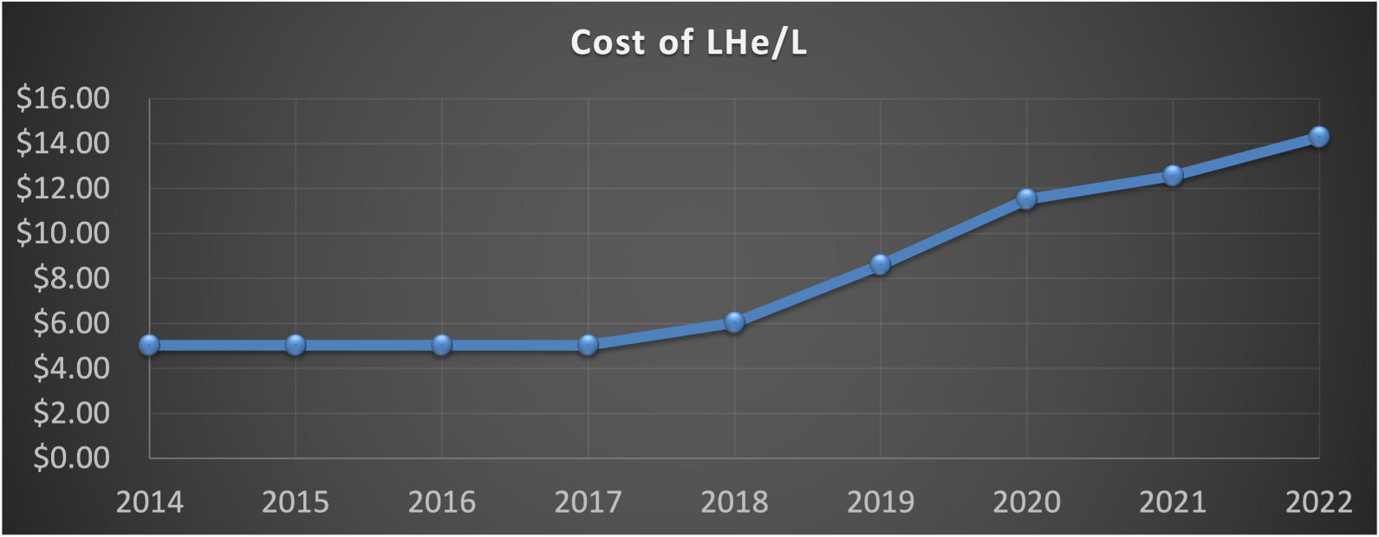
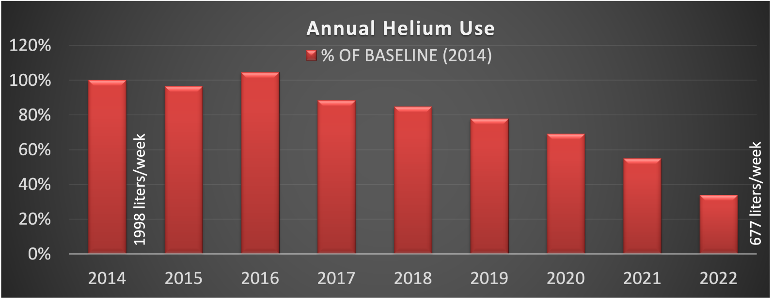
Helium Conservation at the MagLab
John Kynoch¹, Scott Hannahs¹, Mark Vanderlaan¹, Eric Palm¹
National High Magnetic Field Laboratory, Florida State University
Funding Grants: G.S. Boebinger (NSF DMR-2128556)
What is the advance? Many of the MagLab’s magnets and scientific experiments use liquid helium. Since 2008, the MagLab has proactively and systematically improved the capture and re-use of helium. Between 2016 and 2022, the MagLab’s consumption of helium has decreased by a factor of three due to improved recycling processes and infrastructure.
Why is this important? Helium, a non-renewable resource, is critical for scientific research and many industries worldwide. Helium has become scarcer and more expensive over the years (see the upper graph). It became even more difficult to procure in 2022 after a series of incidents at helium production plants led to a world-wide shortage of helium.
Why the MagLab? The MagLab has responded to this ongoing problem by systematically improving its Helium recovery system, allowing the Helium to be reliquefied and reused repeatedly. The amount of Helium the MagLab has had to purchase has been decreased by a factor of three (lower graph) while the amount of helium that the MagLab provides for research has gone up by 50%. These conservation efforts have allowed MagLab users to continue to perform their research even while the cost of Helium has increased by a factor of three. Provision of a reliable source of liquid helium is necessary to the operation of the MagLab as a user facility. As such, improving the recovery and reuse of helium is an essential and ongoing effort. This is all the more important as the MagLab projects that the next helium contract, which goes into effect in the second half of 2023, is likely to include a doubling of the cost per liter over the current price.
Annual Helium Consumption
Facilities and instrumentation used: While all parts of the MagLab were involved in these improvements, the lead was taken by the MagLab’s Facilities Group, its Cryogenics Group, and its DC Field Facility.

