Slide 1
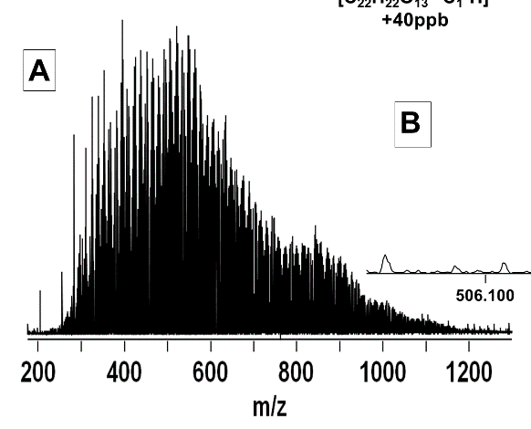
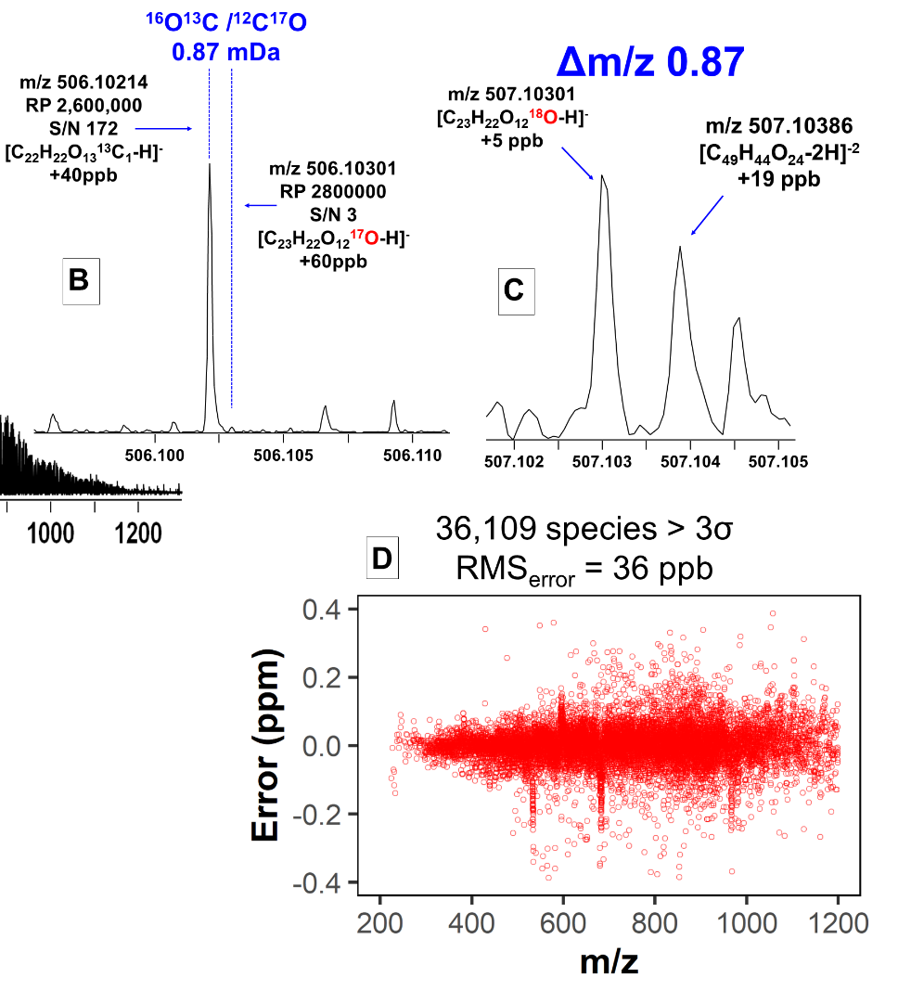
Highest-Magnetic-Field Ion Cyclotron Resonance
Reveals Hidden Complexity of Natural Organic Matter
William Bahureksa¹, Thomas Borch¹, Robert B. Young², Chad R. Weisbrod³, Greg T. Blakney³, and Amy M. McKenna^{1,3}
Colorado State University; 2. New Mexico State University; 3. National High Magnetic Field Laboratory
Funding Grants: G.S. Boebinger (NSF DMR-1644779; DMR-2128556); T. Borch (NSF DEB-2114868; USDA AFRI No. 2021-67019-34608)
Fourier transform ion-cyclotron resonance mass spectrometry (FT-ICR MS) is the only technique that can resolve the molecular complexity of natural organic matter and confidently assign thousands of detected elemental compositions. Active research on natural organic matter presently includes complex analyses of glacial thaw and permafrost, as well as the detection of emerging contaminants in food, water, and soil.
FT-ICR MS instruments that use lower magnetic fields (7-15 tesla) typically enable researchers to identify from a single complex mixture roughly 10,000 different molecules by their elemental formulas. In this work, MagLab users leverage the improved performance (higher dynamic range, resolving power, and mass measurement accuracy) of a custom built, 21 tesla hybrid linear ion trap/FT-ICR mass spectrometer to resolve and identify more than 36,000 species in one of the most commonly used reference standards for NOM, Suwanee River Fulvic Acid. The mass resolving power of five-million-to-one for molecules with m/z ~ 200 enables resolution of isobaric overlaps across the sample molecular weight range, a capability only achievable by 21T FT-ICR MS. For the first time, researchers resolve and identify ¹⁸O and ¹⁷O isotopologues that differ in mass from other species by as little as 0.87 mDa (roughly the mass of an electron).
The root-mean-square (rms) mass error for the 36,000 assigned species is 36 parts-per-billion, which is the most accurate measurement to date on a mixture this complex. The unique capabilities of the MagLab’s 21T FT-ICR mass analyzer provide unparalleled insight into the molecular complexity of natural organic matter. These users are providing the molecular catalogue of this highly utilized reference standard to scientists worldwide via the Open Science Framework.
Figure (A) Broadband 21 T FT-ICR mass spectrum of Suwanee River Fulvic Acid, a Natural Organic Matter reference standard. (B) Mass-scale zoom inset that highlights the need for resolving power sufficient to separate species that differ in mass by 0.87 mDa (roughly the mass of an electron) to enable – for the first time - the identification and detection of the ¹³C peak of an O_{x} compound from the ¹⁷O isotope of another oxygen species. (C) Mass-scale zoom inset that highlights the resolving power requirement to identify ¹⁸O isotopes for the first time in an NOM mass spectrum. (D) Mass measurement accuracy versus mass-to-charge ratio (m/z) for more than 36,000 assigned species, approximately five times the number of species able to be assigned using commercial mass spectrometry instruments.
Facilities and instrumentation used: ICR Facility: MagLab’s 21 T hybrid linear ion trap FT-ICR MS.
Citation: Bahureksa, W.; Borch, T.; Young, R.B.; Weisbrod, C.; Blakney, G.T.; McKenna, A.M., Improved Dynamic Range, Resolving Power, and Sensitivity Achievable with FT-ICR Mass Spectrometry at 21 T Reveals the Hidden Complexity of Natural Organic Matter, Analytical Chemistry, 94 (32), 11382-11389 (2022) doi.org/10.1021/acs.analchem.2c02377 - Data Set
Notes:
Figure 1. A) Broadband 21 T FT-ICR mass spectrum of an NOM reference standard that shows the molecular weight distribution spanning from 200-1200 Da. B) Mass-scale zoom inset that highlights the need for resolving power sufficient to separate species that differ in mass by 0.87 mDa (roughly the mass of an electron) that enables identification and detection of the ¹³C peak of an O_{x} compound from the ¹⁷O isotope of another oxygen species for the first time. C) Mass-scale zoom inset that highlights the resolving power requirement to identify ¹⁸O isotopes for the first time in an NOM mass spectrum. D) Mass measurement accuracy versus mass-to-charge ratio (m/z) for more than 36,000 assigned species, approximately five times the number of species assigned from commercial instruments.
How to compress files size:
On PowerPoint, you can save the attached image (Right click on an image -> Select “Save as picture” -> Then you save the image as PNG). PNG is the image compression without losing the image quality. You replace the original image with the PNG one on PowerPoint. This should reduce the PowerPoint file size.
One thing to be careful about is that you should enlarge your image a bit on PowerPoint before saving so is to avoid losing much resolution.
■ INTRODUCTION
Fourier transform ion-cyclotron resonance mass spectrometry
(FT-ICR MS) is the only mass analyzer that can resolve the
molecular complexity of natural organic matter at the level of
elemental composition assignment, and has been applied to a
wide range of natural systems (e.g., crude oil, petroleum,
weathered oil, biofuels, permafrost, glacial thaw, emerging
contaminants, food, and pyrogenic, dissolved, soil, and other
natural organic matter).1−8 However, experimental conditions
including ionization source configuration, ion accumulation
and transfer optics, detection cell geometry, excitation/
detection parameters, and magnetic field strength present
challenges for comparison of complex organic mixtures
composition assignment between FT-ICR mass analyzers
worldwide.

Slide 2
Highest-Magnetic-Field Ion Cyclotron Resonance
Reveals Hidden Complexity of Natural Organic Matter
William Bahureksa¹, Thomas Borch¹, Robert B. Young², Chad R. Weisbrod³, Greg T. Blakney³, and Amy M. McKenna^{1,3}
Colorado State University; 2. New Mexico State University; 3. National High Magnetic Field Laboratory
Funding Grants: G.S. Boebinger (NSF DMR-1644779; DMR-2128556); T. Borch (NSF DEB-2114868; USDA AFRI No. 2021-67019-34608)
What is the finding? Natural organic matter (NOM) is among the most complex of chemical mixtures on the planet. Understanding the composition of NOM is important because NOM plays a key role in the global cycling of organic molecules. In order to understand how the environment is changing, researchers must first sufficiently separate the molecules in NOM from one another in order to identify each individual compound. One single water sample contains tens of thousands of NOM molecules, and the MagLab’s 21T FT-ICR MS is the best instrument in the world to successfully address and resolve the complexity of these highly complex mixtures.
Why is this important? Understanding the role of natural organic matter in nutrient cycling, in climate change, and resulting sea level rise requires knowing the types of molecules present in complex chemical mixtures. NOM is so complex that only advanced instrumentation can separate the separate molecules in the mixture in way such that each molecule can be identified. Reference NOM materials provide a way for researchers to compare various environmental observations to a known mixture and Suwanee River Fulvic Acid is one of the most widely used NOM. Via the implementation of FAIR data standards, this collaboration is providing a molecular catalog of Suwanee River Fulvic Acid to the global NOM research community that can be compared to results from other mass analyzers and NOM samples.
Why did this research need the MagLab?
The MagLab’s 21T FT-ICR mass analyzer is a one-of-a kind instrument that has been optimized to be the highest performing mass analyzer in the world. This “molecular microscope” is utilized by researchers worldwide as it is the only one of its kind in the world. Previous studies on the same sample by commercial instruments result in the identification of only a fraction of the species (~3000-4000 compounds) compared to 36,000 compounds identified using the 21T FT-ICR MS.
Figure (A) Broadband 21 T FT-ICR mass spectrum of Suwanee River Fulvic Acid, a Natural Organic Matter reference standard. (B) Mass-scale zoom inset that highlights the need for resolving power sufficient to separate species that differ in mass by 0.87 mDa (roughly the mass of an electron) to enable – for the first time - the identification and detection of the ¹³C peak of an O_{x} compound from the ¹⁷O isotope of another oxygen species. (C) Mass-scale zoom inset that highlights the resolving power requirement to identify ¹⁸O isotopes for the first time in an NOM mass spectrum. (D) Mass measurement accuracy versus mass-to-charge ratio (m/z) for more than 36,000 assigned species, approximately five times the number of species able to be assigned using commercial mass spectrometry instruments.
Facilities and instrumentation used: ICR Facility: MagLab’s 21 T hybrid linear ion trap FT-ICR MS.
Citation: Bahureksa, W.; Borch, T.; Young, R.B.; Weisbrod, C.; Blakney, G.T.; McKenna, A.M., Improved Dynamic Range, Resolving Power, and Sensitivity Achievable with FT-ICR Mass Spectrometry at 21 T Reveals the Hidden Complexity of Natural Organic Matter, Analytical Chemistry, 94 (32), 11382-11389 (2022) doi.org/10.1021/acs.analchem.2c02377 - Data Set
Notes:
How to compress files size:
On PowerPoint, you can save the attached image (Right click on an image -> Select “Save as picture” -> Then you save the image as PNG). PNG is the image compression without losing the image quality. You replace the original image with the PNG one on PowerPoint. This should reduce the PowerPoint file size.
One thing to be careful about is that you should enlarge your image a bit on PowerPoint before saving so is to avoid losing much resolution.

