Slide 1
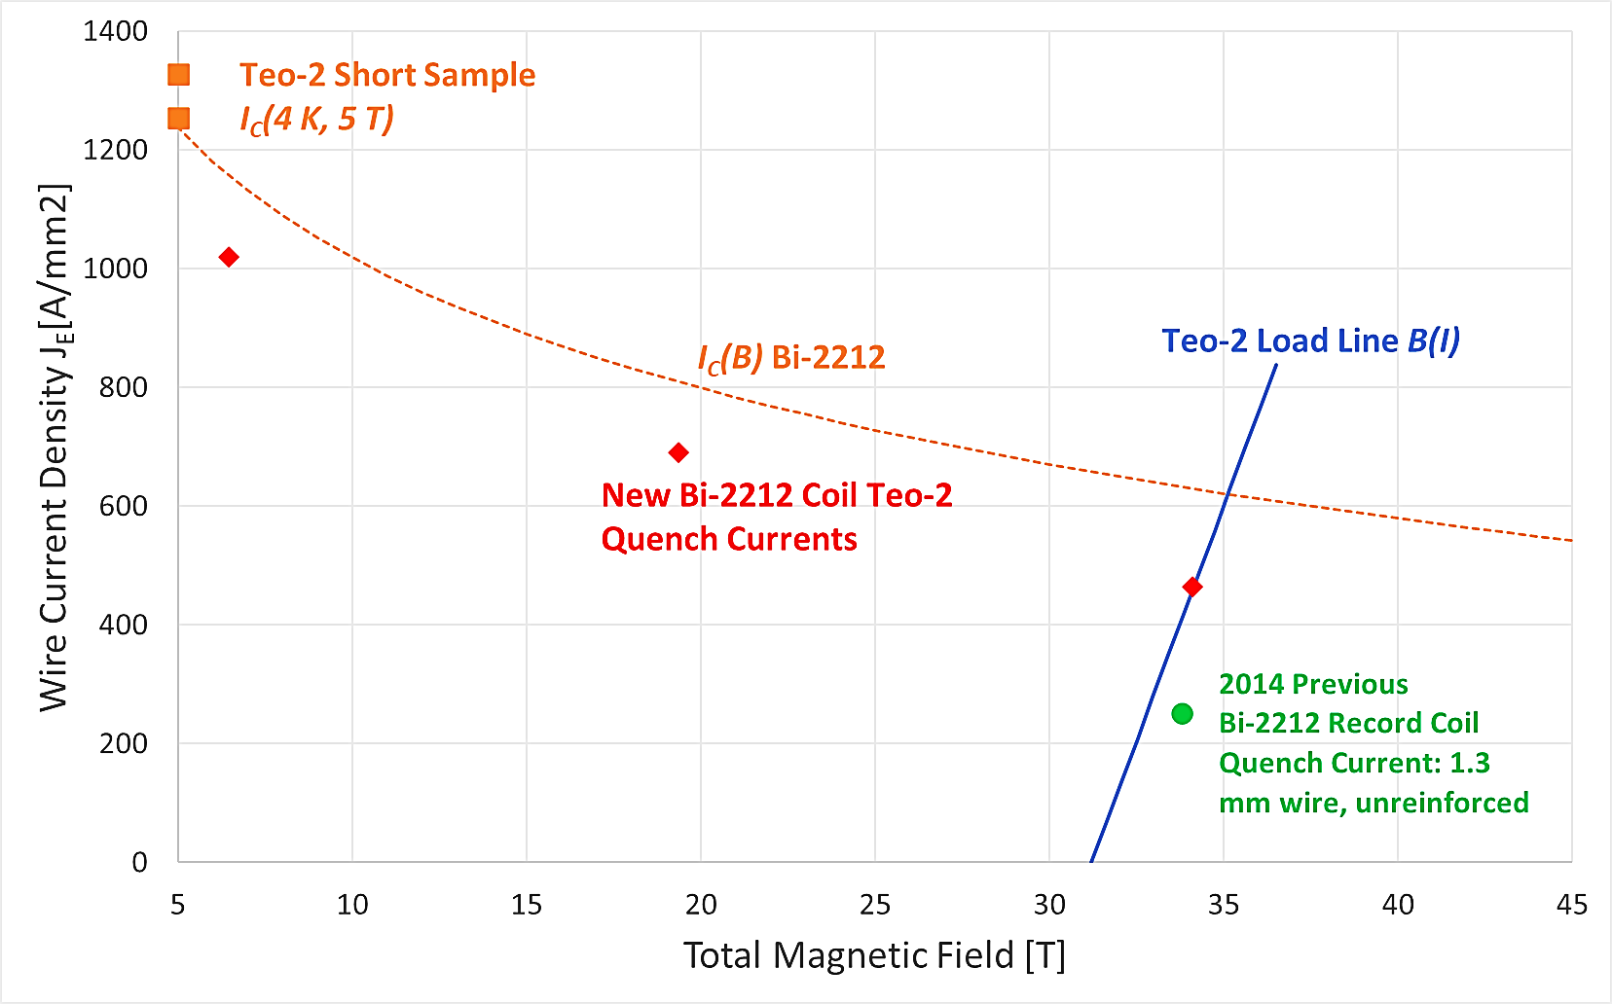
Operation of High Temperature Superconducting Bi-2212 Test Coils up to 34T
Youngjae Kim¹, Daniel Davis¹, Ulf Trociewitz¹, Shaon Barua¹, Emma Martin¹, Lance Cooley¹, David Larbalestier¹,
1. Applied Superconductivity Center, National High Magnetic Field Laboratory, Florida State University
Funding Grants: D.C. Larbalestier (US DOE-OHEP DE-SC0010421); G.S. Boebinger (NSF DMR-2128556); Florida State University Office of the Vice President for Research special allocation for Bi-2212 commercialization
The high-temperature superconductor (HTS) called Bi-2212 (after its chemical formula, Bi₂Sr₂Ca₁Cu₂O_{8+x}) is unique among commercial HTS materials because the conductor is formed, not as a tape, but as a round wire that contains many superconducting filaments. This macroscopically isotropic wire can then be twisted for low AC-losses and can furthermore be easily formed into cables. Bi-2212 wire is reliably produced in long lengths that exceed one kilometer and that are now featuring the ability to carry superconducting current densities, J_{E} (4K, 5T), as high as 1200 to 1400A/mm².
The small “Teo” test coils use less than 50m of Bi-2212 wire, thus providing an efficient way to test Bi-2212 conductor and magnet technologies that include reinforcement, insulation, and epoxy materials. Teo test coils are typically 80mm tall and < 38mm diameter in order to fit into the MagLab’s 31T resistive magnet. A recent set of Teo test coils produced a peak field of 34T when energized inside the 31T resistive magnet. The Bi-2212 wire current density (J_{E}) of 464A/mm² that was achieved in the Teo test coils would be sufficient to produce larger HTS research magnets in the commercially-attractive 25T range. Furthermore, the Teo test coils supported a peak hoop stress between 237MPa and 273MPa, well over the breaking stress of the bare Bi-2212 wire, which demonstrates a capability to reliably reinforce Bi-2212 wires when wound into coils. The coils were ramped at rates of up to 3200A/s with no degradation to the quench current after high ramp rates.
This robust operation of multiple Teo test coils in fields exceeding 30T is an important demonstration to MagLab collaborators, including the US-DOE Magnet Development Program developing 16T dipole magnets using HTS, Princeton Plasma Physics Laboratory pursuing fusion ohmic heating solenoids, as well as MagLab commercial partners Cryomagnetics and Oxford Instruments developing compact 25T HTS magnets.
Figure 1: Current density measured in short samples of Bi-2212 wire
(orange) and in Teo test coils (red). The blue line indicates the total
magnetic field experienced by the recent Teo test coil for a given
current density. The red arrow indicates the achievement of 34.1T.
New Bi-2212 Teo Test Coil
Quench Currents
High Strength Bands
34.1 T
MPa
55
50
45
40
Figure 2: A cross-section of the Teo test coil made from Bi-2212 round wire, depicted as circles in the figure. The stresses in the Bi-2122 wire, indicated by the color coding, are reduced by the reinforcing presence of high-strength overbanding material.
35
30
Facilities and instrumentation used: Coil testing performed in the Applied Superconductivity Center (ASC) OX-3 15T LTS magnet and
the DC Field Facility’s 31T, 50mm bore resistive magnet. Over-pressure heat treatment performed in the ASC 50-bar “Deltech” furnace.
Modelling using the ASC COMSOL multi-physics and high-performance work-station at ASC.
Citation: [1] E. S. Bosque, Y. Kim, U. P. Trociewitz, C. L. English, and D. C. Larbalestier, “System and Method to Manage High Stresses in Bi-2212 Wire Wound
Compact Superconducting Magnets,” Appl.No. 16390512, Dec. 26, 2019 https://patentscope.wipo.int/search/en/detail.jsf?docId=WO2019245646
25
20
17.7
Notes:
How to compress files size:
On PowerPoint, you can save the attached image (Right click on an image -> Select “Save as picture” -> Then you save the image as PNG). PNG is the image compression without losing the image quality. You replace the original image with the PNG one on PowerPoint. This should reduce the PowerPoint file size.
One thing to be careful about is that you should enlarge your image a bit on PowerPoint before saving so is to avoid losing much resolution.

Slide 2
Operation of High Temperature Superconducting Bi-2212 Test Coils up to 34T
Youngjae Kim¹, Daniel Davis¹, Ulf Trociewitz¹, Shaon Barua¹, Emma Martin¹, Lance Cooley¹, David Larbalestier¹,
1. Applied Superconductivity Center, National High Magnetic Field Laboratory, Florida State University
Funding Grants: D.C. Larbalestier (US DOE-OHEP DE-SC0010421); G.S. Boebinger (NSF DMR-2128556); Florida State University Office of the Vice President for Research special allocation for Bi-2212 commercialization
What is the finding? A set of Bi-2212 superconducting test coils produced a peak field of 34T at a wire current density (J_{E}) of 464A/mm², supporting a peak hoop stress up to 270MPa, well over the breaking stress of the bare wire. The coils were ramped at rates of up to 3200A/s with no performance degradation after high ramp rates.
Why is this important? Compact ultra-high-field (>25T) magnets will generate stresses of 200MPa to 500MPa, well beyond the strength of any unreinforced superconductor. Fast current ramp-rates will enable rapid sample testing in future 25T-class HTS research magnets and will be required for future higher field accelerator magnets and compact fusion ohmic heating magnets.
Why did this research need the MagLab? The MagLab’s Applied Superconductivity Center has made significant advances in magnet technology development of Bi-2212 round wire, including over-pressure heat treatment in our unique magnet-sized furnaces and internal coil reinforcement^{[1]} allowing magnets to reach the full potential of the high current densities available at fields well in excess of 30T. The MagLab’s 31T DC resistive magnet enables small test coils to be pushed to their limits under conditions replicating the intended application of commercial compact ultra-high field research magnets.
H(teslas)
MPa
High Strength Bands
34
55
33
50
32
31
45
30
40
29
35
28
30
27
26
25
Facilities and instrumentation used: Coil testing performed in the Applied
Superconductivity Center (ASC) OX-3 15T LTS magnet and the DC Field Facility’s
31T, 50mm bore resistive magnet. Over-pressure heat treatment performed in the
ASC 50-bar “Deltech” furnace. Modelling using the ASC COMSOL multi-physics
and high-performance work-station at ASC.
Citation: [1] E. S. Bosque, Y. Kim, U. P. Trociewitz, C. L. English, and D. C. Larbalestier,
“System and Method to Manage High Stresses in Bi-2212 Wire Wound
Compact Superconducting Magnets,” Appl.No. 16390512, Dec. 26, 2019
https://patentscope.wipo.int/search/en/detail.jsf?docId=WO2019245646
25
20
17.7
Co-wind
Figure 1: One-quarter cross section of
the Teo test coil created from round
Bi-2212 wire (denoted by circles),
showing the magnetic field distribution.
Figure 2: Stresses in the Bi-2122 wire, reduced by the reinforcing presence of high-strength bands.
Figure 3: Photo of the Bi-2212 “Teo” test coil after the 50-bar, 890C heat treatment
Notes:
How to compress files size:
On PowerPoint, you can save the attached image (Right click on an image -> Select “Save as picture” -> Then you save the image as PNG). PNG is the image compression without losing the image quality. You replace the original image with the PNG one on PowerPoint. This should reduce the PowerPoint file size.
One thing to be careful about is that you should enlarge your image a bit on PowerPoint before saving so is to avoid losing much resolution.

