Slide 1
MagLab at the 2023 Aspire Summer Institute
Kawana Johnson, Center for Integrating Research and Learning, National MagLab
Funding: G.S. Boebinger (NSF DMR-2128556); NSF Eddie Bernice Johnson INCLUDES Aspire Alliance
In June, Dr. Kawana Johnson was invited to serve as a facilitator for the weeklong virtual 2023 Aspire Summer Institute (ASI). This Institute trains faculty and leaders from STEM departments and professional societies from across the US.
During the workshop, participants were given the opportunity to retreat, reflect and practice skills to better support campus diversity, equity and inclusion efforts through the development of key skills. Participants were supported in growing their capacity for creating and sustaining change efforts related to recruitment and retention of diverse engineering faculty and students.
As a facilitator, Dr. Johnson led discussions on three major areas: equity-focused institutional changes that support the advancement of diverse faculty; developing and sustaining an infrastructure that facilitates impactful mentorship of junior faculty in support of career advancement; and professional development that equips all engineering faculty and institutional leaders with skills to implement inclusive practices and to support career advancement.
Dr. Johnson’s expertise in program development, mentoring, and facilitation were important in assisting the group in planning activities and refining goals. The knowledge gained as a result of this work will influence Dr. Johnson’s understanding of how best to support the culture at the MagLab while developing programs designed to build a diverse STEM workforce.
Aspire by the Numbers
1850+ Participants engaged. 1300+ inclusive practices and professional development activities.
175 Organizational partners.
127 Colleges and universities engaged in Aspire.
71 Fellows supported in the Iaspire Leadership Academy.
58 Four-year institutions across 4 cohorts in Institutional Change.
6 Regional Collaboratives with 21 four-year institutions and 17 two-year institutions.
Facilities and instrumentation used: Center for Integrating Research and Learning (CIRL)
Citation: Johnson, K. (2023, June 12-16). Inclusive professional framework for faculty [Facilitated sessions]. Summer 2023 Aspire Summer Institute, Virtual. https://sites.google.com/wisc.edu/aspire-summer-institute-2023/ | This no-cost virtual institute is sponsored by the NSF Eddie Bernice Johnson INCLUDES Aspire Alliance.
Notes:
How to compress files size:
On PowerPoint, you can save the attached image (Right click on an image -> Select “Save as picture” -> Then you save the image as PNG). PNG is the image compression without losing the image quality. You replace the original image with the PNG one on PowerPoint. This should reduce the PowerPoint file size.
One thing to be careful about is that you should enlarge your image a bit on PowerPoint before saving so is to avoid losing much resolution.

Slide 2
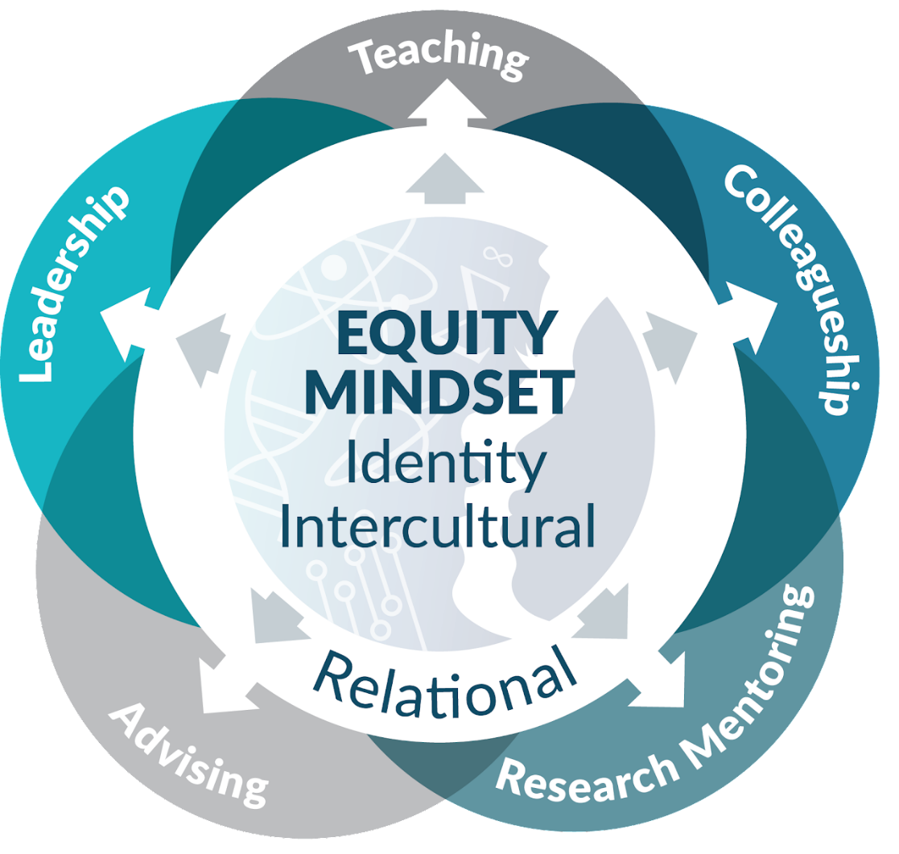
MagLab at the 2023 Aspire Summer Institute
Kawana Johnson, Center for Integrating Research and Learning, National MagLab
Funding: G.S. Boebinger (NSF DMR-2128556); NSF Eddie Bernice Johnson INCLUDES Aspire Alliance
What is the Inclusive Professional Framework (IPF)?
The Aspire Summer Institute used the Inclusive Professional Framework (IPF) to engage faculty and faculty developers in the development of an equity mindset. The IPF identifies three core domains - Identity, Intercultural, and Relational - which underlie inclusive practices in higher education. During the ASI, faculty learn and practice a set of skills in the three domains that can be applied to inclusive practices across multiple faculty roles such as advising, teaching, research mentoring, collegiality, and leadership. These skills also contribute to personal health and well-being as well as a broader inclusive climate within the institution.
Why is it important?
The skills that Dr. Johnson facilitated are universal skills for MagLab faculty as well:
Advising: Develop skills to advising students, formally or informally -- a key role that many faculty play in addition to engaging students in classroom or research settings.
Teaching: Build confidence using strategies to make your content, activities, language, and classroom logistics inclusive for all students.
Research Mentoring: Deepen understanding of how to communicate effectively across difference to set faculty and mentee(s) up for a mutually beneficial and productive mentoring relationship.
Collegiality & Leadership: Learn how to derail systems of privilege and interrupt bias, act as an ally, and advocate for excellence and diversity in professional settings as both colleague and leader.
Inclusive environments in STEM departments and at higher education institutions foster underrepresented minority faculty and student success and persistence, thereby building a more diverse and innovative STEM workforce. The MagLab can benefit from Dr. Johnson’s experience with ASI to reach their goals of building a more diverse STEM workforce.
Why did this program need the MagLab?
Dr. Johnson’s experience as a trained facilitator through the Center for the Improvement of Mentored Experiences in Research (CIMAR) provides an ideal opportunity to share knowledge designed to guide program participants in developing activities and refining goals.
Inclusive Professional Framework for Faculty
Facilities and instrumentation used: Center for Integrating Research and Learning (CIRL)
Citation: Johnson, K. (2023, June 12-16). Inclusive professional framework for faculty [Facilitated sessions]. Summer 2023 Aspire Summer Institute, Virtual. https://sites.google.com/wisc.edu/aspire-summer-institute-2023/ | This no-cost virtual institute is sponsored by the NSF Eddie Bernice Johnson INCLUDES Aspire Alliance.
Notes:
How to compress files size:
On PowerPoint, you can save the attached image (Right click on an image -> Select “Save as picture” -> Then you save the image as PNG). PNG is the image compression without losing the image quality. You replace the original image with the PNG one on PowerPoint. This should reduce the PowerPoint file size.
One thing to be careful about is that you should enlarge your image a bit on PowerPoint before saving so is to avoid losing much resolution.

