Slide 1
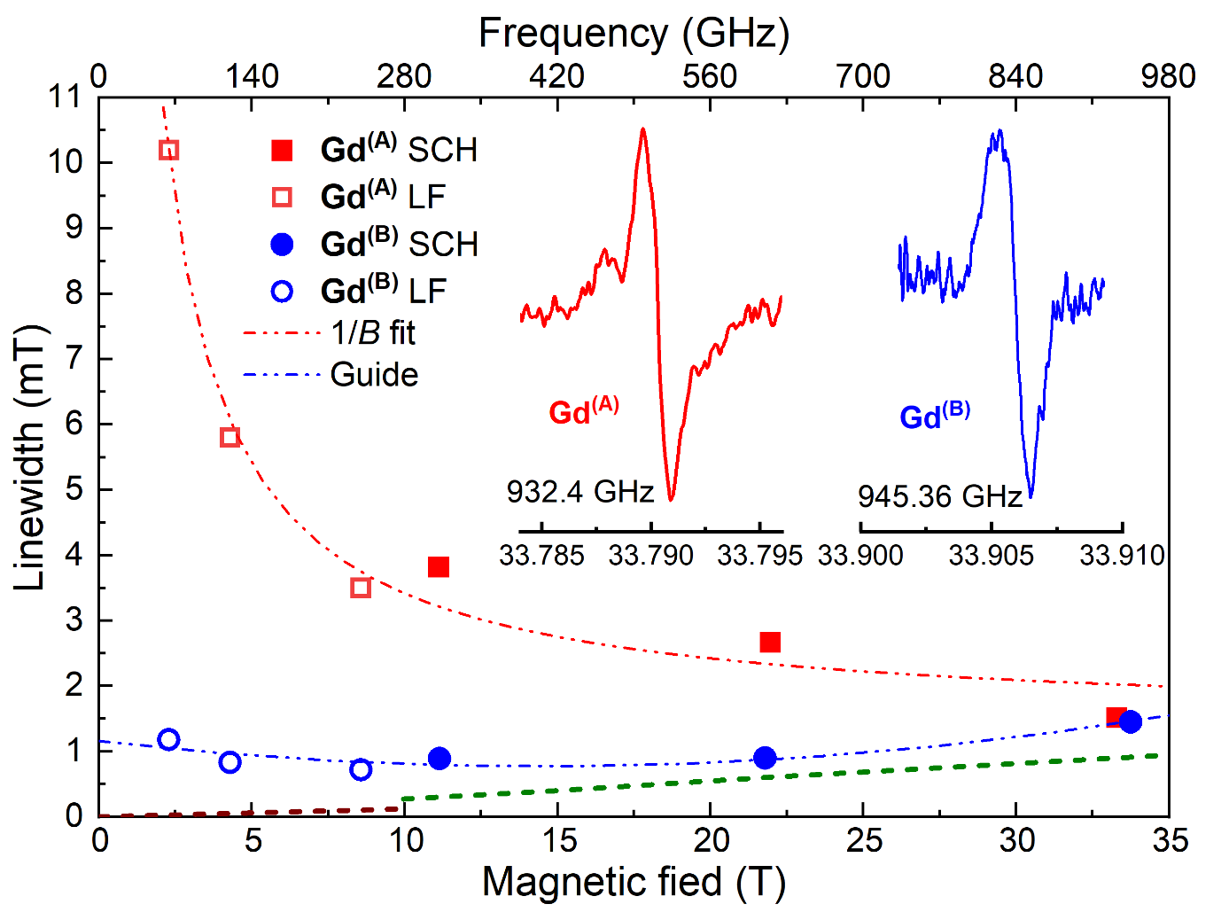
Terahertz EPR Spectroscopy in the High-Homogeneity 36T Series-Connected Hybrid Magnet
T. Dubroca¹, X. Wang^{1,2}, F. Mentink-Vigier¹, B. Trociewitz¹, M. Starck³, D. Parker³, S. Hill^{1,4}, J. Krzystek¹, M.S. Sherwin⁵
1. NHMFL FSU; 2. Cal State University East Bay Chemistry; 3. University of Durham Chemistry, UK; 4. FSU Physics; 5. UCSB Physics
Funding Grants: G.S. Boebinger (NSF DMR-2128556); S. Hill (NSF CHE-2203405); M.S. Sherwin (NSF MCB-2028560)
MagLab scientists have developed instrumentation for performing ultra-high-resolution Electron Paramagnetic Resonance (EPR) in the high-homogeneity 36 T series-connected hybrid (SCH) magnet. In order to demonstrate this unique new capability, experiments were carried out on a series of Gd^{III} molecular compounds that are of interest as so-called “spin-labels”. Spin labels can be attached to large biomolecules so that EPR can then be used to report on structural and dynamical properties that cannot be determined by any other method. The larger magnetic moments of electrons - compared to nuclei - enables distances between spin-labels to be determined that exceed those able to be measured by NMR by an order of magnitude, providing access to structural details of intrinsically disordered proteins that are unobtainable from NMR, X-ray, and cryo-electron microscopy techniques. Meanwhile, the higher Larmor frequencies of electrons probe much faster dynamics, roughly three orders of magnitude faster than NMR probes.
In analogy to NMR of certain quadrupolar nuclei (nuclei with half-integer nuclear spin, I > ½), the EPR spectrum of Gd^{III} (with electronic spin, S = ⁷/₂) exhibits a sharp central component with a linewidth that decreases (∝ 1/B) with increasing magnetic field, B. It is this property that makes Gd^{III} labels ideal for high-resolution biological EPR studies at very high magnetic fields. However, this also requires a magnet with higher homogeneity, that is, the magnetic field variation across the sample must be less than the EPR linewidth. As such, these experiments require the SCH magnet.
The figure shows results for two Gd^{III} spin-labels. The expected 1/B narrowing of the linewidth is found in one case, whereas a weak increase is seen above ~15T for the other sample. In both cases, the SCH spectrometer enables resolution of the exceptionally narrow EPR lines (~1mT width) at the highest magnetic fields, paving the way towards use of Gd^{III} spin-labels in ultra-high resolution biostructural studies.
Figure. High field EPR linewidth variation with field/frequency, measured in the SCH and a lower-field (LF) spectrometer, for two Gd^{III} spin-labels on large biomolecules (Gd^{(A)} = Gd[DTPA], Gd^{(B)} = Gd[sTPATCN]-SL, see citation). Dashed lines at bottom represent the respective spectrometer resolutions. Representative ultra-high-resolution EPR spectra are shown in the inset.
Facilities and instrumentation used: EMR and DC Field Facilities, 15/17 Tesla Transmission Spectrometer and 36 Tesla Series Connected Hybrid Magnet.
Citation: Dubroca, T.; Wang, X.; Mentink-Vigier, F.; Trociewitz, B.; Starck, M.; Parker, D.; Sherwin, M.S.; Hill, S.; Krzystek, J., Terahertz EPR spectroscopy using a 36-tesla high-homogeneity series-connected hybrid magnet, Journal of Magnetic Resonance, 353, 107480 (2023) doi.org/10.1016/j.jmr.2023.107480

Slide 2
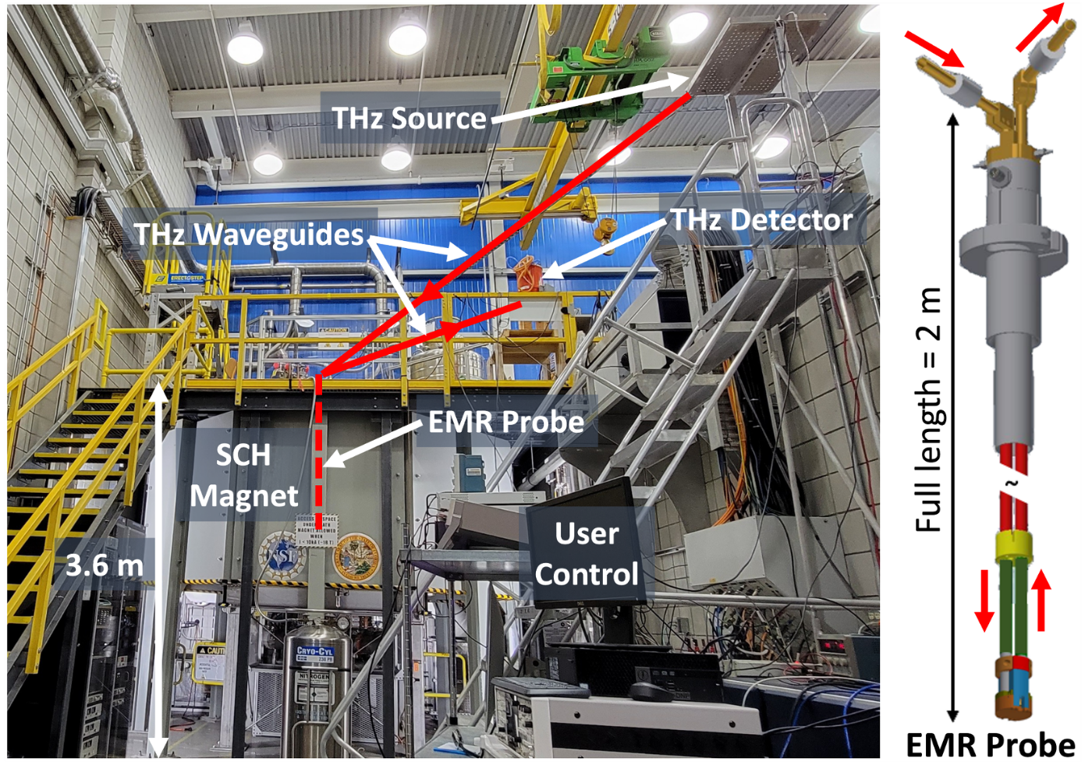
Terahertz EPR Spectroscopy in the High-Homogeneity 36T Series-Connected Hybrid Magnet
T. Dubroca¹, X. Wang^{1,2}, F. Mentink-Vigier¹, B. Trociewitz¹, M. Starck³, D. Parker³, S. Hill^{1,4}, J. Krzystek¹, M.S. Sherwin⁵
1. NHMFL FSU; 2. Cal State University East Bay Chemistry; 3. University of Durham Chemistry, UK; 4. FSU Physics; 5. UCSB Physics
Funding Grants: G.S. Boebinger (NSF DMR-2128556); S. Hill (NSF CHE-2203405); M.S. Sherwin (NSF MCB-2028560)
What is the finding? MagLab scientists have developed new instrumentation for performing electron paramagnetic resonance (EPR) experiments in the MagLab’s flagship 36T series-connected hybrid (SCH) magnet. Measurements were performed by a user collaboration on two compounds containing the rare-earth element gadolinium, revealing exceptionally high-resolution EPR spectra at the highest magnetic fields.
Why is this important? The gadolinium compounds under investigation are of interest as magnetic tags that can be attached to large biological molecules such as proteins, so that EPR measurements can then be used to study their structure and function, providing details on length- and frequency-scales that exceed those obtainable by nuclear magnetic resonance (NMR). The exceptionally high-resolution spectra obtained in this investigation demonstrate the potential utility of gadolinium tags for deployment in biomolecular EPR studies at very high magnetic fields.
Why did this research need the MagLab? The 36T SCH is the only magnet in the world that is capable of providing the high-resolution EPR results obtained in this study. First of all, in order to resolve features in the spectra that span just 1/1000th of a tesla [1 millitesla (mT)], the magnet itself must be able to generate magnetic fields that are both temporally stable and uniform over the volume (~1cm³) of the sample, with variations of less than 1mT. While the MagLab supports other magnets that can generate 36T, only the SCH possesses the required stability and uniformity. In addition, one of the studied gadolinium compounds shows a pronounced increase in spectral resolution upon increasing the magnetic field. Consequently, realization of the optimum resolution is only possible at the highest magnetic fields, for which the new state-of-the-art is the 36T achievable in the SCH.
EPR Probe
EPR Probe
Figure. (left) Photograph of the EPR spectrometer at the SCH magnet, highlighting key components in the setup. Radiation in the terahertz (THz) frequency range is transported via waveguides from the source to the EPR probe (shown right) within the bore of the SCH magnet, then back to a detector. The source, detector and researchers are all kept at a safe distance from the magnet when energized.
Facilities and instrumentation used: EMR and DC Field Facilities, 15/17 Tesla Transmission Spectrometer and 36 Tesla Series Connected Hybrid Magnet.
Citation: Citation: Dubroca, T.; Wang, X.; Mentink-Vigier, F.; Trociewitz, B.; Starck, M.; Parker, D.; Sherwin, M.S.; Hill, S.; Krzystek, J., Terahertz EPR spectroscopy using a 36-tesla high-homogeneity series-connected hybrid magnet, Journal of Magnetic Resonance, 353, 107480 (2023) doi.org/10.1016/j.jmr.2023.107480

