Slide 1
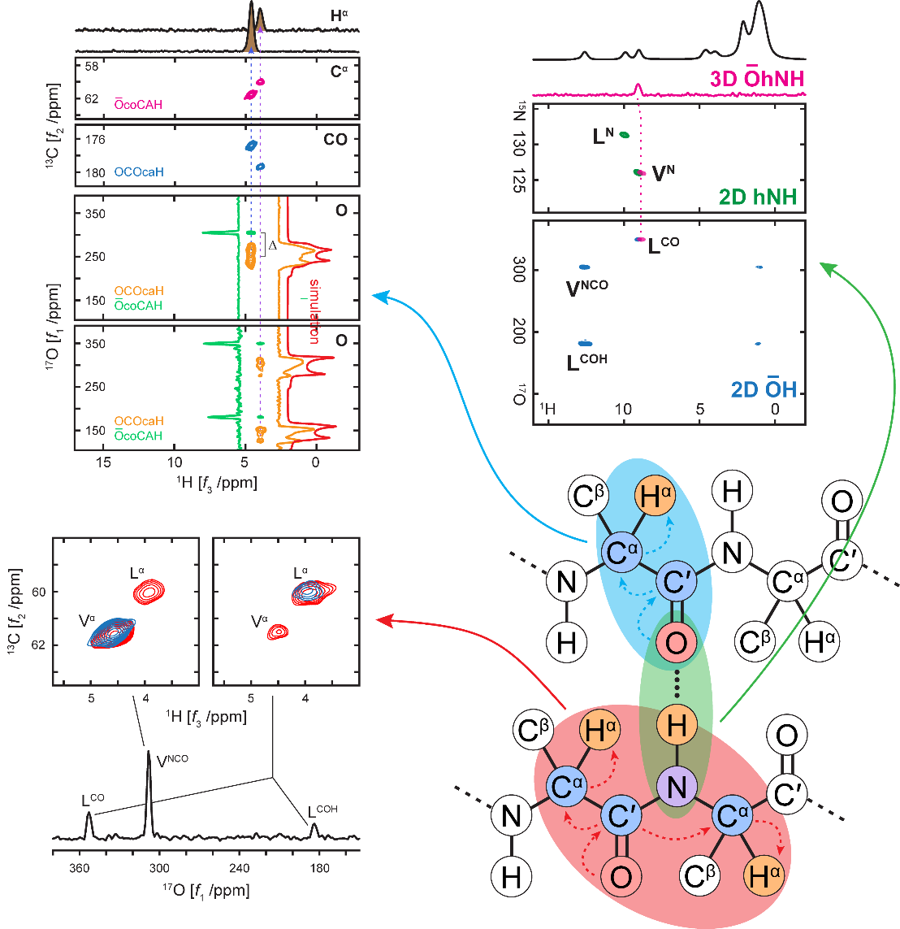
Integration of ¹⁷O for Solid-State NMR Studies of Peptides and Proteins
Ivan Hung¹, Eric G. Keeler², Wenping Mao¹, Peter L. Gor’kov¹, Robert G. Griffin², Zhehong Gan¹
1. National High Magnetic Field Laboratory; 2. Massachusetts Institute of Technology.
Funding Grants: G.S. Boebinger (NSF DMR-1644779, NSF DMR-2128556); R.G. Griffin (NIH AG058504, GM132997, GM132079)
Nuclear magnetic resonance (NMR) spectroscopy is a powerful technique for obtaining molecular-level information on structure and dynamics in biomolecules like peptides and proteins. For the most important elements in biomolecules (i.e., H, C, N, and O), most NMR observations are carried out with “NMR friendly” nuclei like ¹H, ¹³C, and ¹⁵N, which all have a nuclear spin of I = 1/2. By comparison, the remaining key element, oxygen, is rarely studied with NMR because its only NMR-active isotope, ¹⁷O, has very low natural abundance (0.037%) and a nuclear spin I = 5/2. Any nucleus with I > 1/2 belongs to a special category known as quadrupolar nuclei, which often have large quadrupolar interactions that broaden peaks and make it difficult to obtain NMR spectra with high signal-to-noise and high resolution.
We have developed a suite of NMR methods and new NMR instrumentation to overcome issues of sensitivity and resolution in ¹⁷O NMR, with a focus on detecting the ¹⁷O signal indirectly via protons (¹H). The strong ¹H NMR signal at a high magnetic field, in combination with ultrafast magic-angle spinning (MAS) and high-resolution, multiple-quantum MAS (MQMAS) NMR methods for quadrupolar nuclei, allow for two- and three-dimensional experiments that enable the measurement of ¹⁷O chemical shifts and quadrupolar interactions; determination of internuclear connections between ¹⁷O and ¹H, ¹³C, and ¹⁵N; and characterization of hydrogen bonds in biomolecules, as demonstrated with a model peptide (Figure).[1,2]
This work expands the NMR toolkit for biomolecules to ¹⁷O, opening new opportunities to study oxygen environments in proteins, and expanding our understanding of the roles of hydrogen bonds in 3D protein structure, including protein folding, conformational changes, bonding to water and other molecules, and protein-protein intermolecular interactions.
Figure: 2D and 3D NMR spectra, demonstrating through-bond correlations between ¹H, ¹³C, and ¹⁷O
(blue/top left);
through-space intra-
and inter-residue
O-C^{α} correlations
(red/bottom left);
¹H, ¹⁵N, and ¹⁷O
correlations
highlighting
hydrogen bonds
(green/top right)
within a [U-¹³C, ¹⁵N,
70%-¹⁷O] enriched N-acetyl-L-valyl-L-leucine peptide.
Facilities and instrumentation used: NMR/MRI Facility: NHMFL 18.8 T/800 MHz and a 0.75 mm ultra-fast magic-angle spinning probe built in-house at MagLab.
Citations: [1] Hung, I.; Mao, W.; Keeler, E.G.; Griffin, R.G.; Gor'kov, P.L.; Gan, Z., Characterization of peptide O⋅⋅⋅⋅⋅⋅N hydrogen bonds via ¹H-detected ¹⁵N/¹⁷O solid-state NMR spectroscopy, Chemical Communications, 59 (21), 3111-3113 (2023) doi.org/10.1039/d2cc07004a;
[2] Hung, I.; Keeler, E.G.; Mao, W.; Gor'kov, P.L.; Griffin, R.G.; Gan, Z., Residue-Specific High-Resolution ¹⁷O Solid-State Nuclear Magnetic Resonance of Peptides: Multidimensional Indirect ¹H Detection and Magic-Angle Spinning, Journal of Physical Chemistry Letters, 13 (28), 6549-6558 (2022) doi.org/10.1021/acs.jpclett.2c01777
Notes:
How to compress files size:
On PowerPoint, you can save the attached image (Right click on an image -> Select “Save as picture” -> Then you save the image as PNG). PNG is the image compression without losing the image quality. You replace the original image with the PNG one on PowerPoint. This should reduce the PowerPoint file size.
One thing to be careful about is that you should enlarge your image a bit on PowerPoint before saving so is to avoid losing much resolution.

Slide 2
Integration of ¹⁷O for Solid-State NMR Studies of Peptides and Proteins
Ivan Hung¹, Eric G. Keeler², Wenping Mao¹, Peter L. Gor’kov¹, Robert G. Griffin², Zhehong Gan¹
1. National High Magnetic Field Laboratory; 2. Massachusetts Institute of Technology.
Funding Grants: G.S. Boebinger (NSF DMR-1644779, NSF DMR-2128556); R.G. Griffin (NIH AG058504, GM132997, GM132079)
What is the finding? MagLab users and researchers have developed an experimental protocol and state-of-the-art nuclear magnetic resonance (NMR) instrumentation that integrates ¹⁷O into the solid-state NMR toolkit for investigating biomolecules like peptides, proteins, and enzymes. The addition of ¹⁷O represents the last “piece of the puzzle”, which alongside of NMR of nuclei like ¹H, ¹³C and ¹⁵N, enables the structural characterization of biomolecules.
Why is this important? The elements oxygen, hydrogen, carbon, and nitrogen together form the peptide backbones of proteins. Oxygen NMR can help scientists study and understand the structural environments of oxygen atoms, including chemical bonds formed with other molecules and proteins. Unfortunately, oxygen has only only one NMR-active isotope, ¹⁷O, which has low natural abundance (0.037%). Furthermore, ¹⁷O has a nuclear spin of I = 5/2, meaning it is a quadrupolar nucleus (I > ½); this can result in interactions that produce very broad peaks in ¹⁷O solid-state NMR spectra. These two factors make NMR experiments on ¹⁷O much more difficult than those on more “NMR friendly” nuclei with I = 1/2, like ¹H, ¹³C, and ¹⁵N. Our new protocol uses a special device called an ultrafast magic-angle spinning NMR probe, which was built in-house at the MagLab (Figure) and allows detection of ¹⁷O indirectly via protons (¹H). The strong ¹H NMR signal helps to overcome the issues of poor sensitivity and low resolution, enabling the addition of ¹⁷O to the NMR toolkit for biomolecules. Special peptides enriched with ¹⁷O, ¹³C and ¹⁵N were necessary for this study, and produced by the MIT group using an efficient synthetic labeling method.
Why did this research need the MagLab? This work utilizes an 18.8T magnetic field and a special magic-angle spinning NMR probe (Figure) built at the MagLab that can spin the NMR sample container up to ~100kHz (i.e., it rotates 100,000 times per second. The high magnetic field and ultrafast sample spinning are critical for enhancing both the ¹H NMR signal and resolution, which, in turn, is crucial for indirect ¹⁷O detection.
Figure: (above) ¹⁷O is now added to the NMR toolkit, along with ¹H, ¹³C and ¹⁵N, to characterize biomolecules like peptides, proteins, and enzymes.
(right) A 0.75 mm ultra-fast magic-angle spinning probe, built at the MagLab, enabled this advance.
Facilities and instrumentation used: NMR/MRI Facility: NHMFL 18.8 T/800 MHz and a 0.75 mm ultra-fast magic-angle spinning probe built in-house at MagLab.
Citations: [1] Hung, I.; Mao, W.; Keeler, E.G.; Griffin, R.G.; Gor'kov, P.L.; Gan, Z., Characterization of peptide O⋅⋅⋅⋅⋅⋅N hydrogen bonds via ¹H-detected ¹⁵N/¹⁷O solid-state NMR spectroscopy, Chemical Communications, 59 (21), 3111-3113 (2023) doi.org/10.1039/d2cc07004a;
[2] Hung, I.; Keeler, E.G.; Mao, W.; Gor'kov, P.L.; Griffin, R.G.; Gan, Z., Residue-Specific High-Resolution ¹⁷O Solid-State Nuclear Magnetic Resonance of Peptides: Multidimensional Indirect ¹H Detection and Magic-Angle Spinning, Journal of Physical Chemistry Letters, 13 (28), 6549-6558 (2022) doi.org/10.1021/acs.jpclett.2c01777
Notes:
How to compress files size:
On PowerPoint, you can save the attached image (Right click on an image -> Select “Save as picture” -> Then you save the image as PNG). PNG is the image compression without losing the image quality. You replace the original image with the PNG one on PowerPoint. This should reduce the PowerPoint file size.
One thing to be careful about is that you should enlarge your image a bit on PowerPoint before saving so is to avoid losing much resolution.

