Slide 1
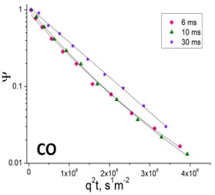
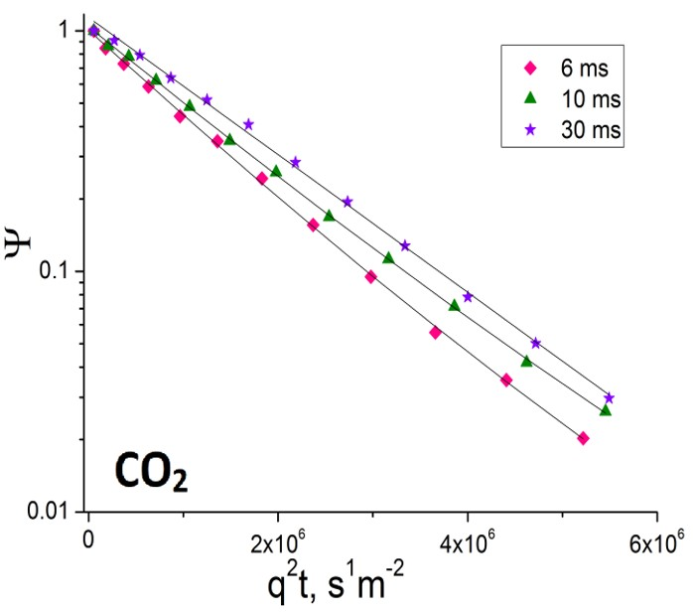
Disentangling Kinetics of CO Oxidation and Mass Transport in Nanoporous Gold
using Pulsed Field Gradient NMR
Marcus Bäumer¹, Stefan Wild¹, Amineh Baniani³, Thomas Risse², Evan M. Forman³, Sergey Vasenkov³
1. University of Bremen; 2. Freie Universität Berlin; 3. University of Florida;
Funding Grants: G.S. Boebinger (NSF DMR-2128556, DMR-1157490); M. Bäumer and T. Risse (German Research Foundation, BA 1710/29-2 and RI 1025/3-2)
Nanoporous gold, which has pores in the mesopore size range, is a promising candidate for catalytic oxidation of carbon monoxide (CO) to carbon dioxide (CO₂). A fundamental understanding of molecular diffusion in nanoporous gold is of crucial importance to assess its potential applications for catalysis.
In this experiment, MagLab users employed pulsed field gradient (PFG) NMR spectroscopy at a high magnetic field (17.6T) to quantify self-diffusion of carbon monoxide and carbon dioxide in beds of nanoporous gold particles. Diffusion measurements were performed via ¹³C detection over a broad range of diffusion times to measure displacements both smaller and larger than the relevant dimension of the nanoporous gold particles (see Figure). The high magnetic field was needed to achieve sufficiently large signal-to-noise to determine diffusion rates. For displacements smaller than the particle size (short diffusion times), two populations are resolved for each studied sorbate: (1) molecules that diffuse inside the particles, and (2) molecules that diffuse in the gas phase outside the particles. These observed species have two different diffusivities, and the ratio between these diffusivities is defined as the tortuosity factor.
The tortuosity factor quantifies how much harder it is for gas to diffuse inside the particles compared to outside the particles. Measuring tortuosity factors enables contributions from mass transport to be disentangled from the kinetics of surface reactions (i.e. microkinetics). This high-magnetic-field technique was able to determine the rate constant and turnover frequency for low-temperature CO oxidation without the ambiguities arising in prior measurements from potential transport limitations. Based on these results, it was possible to predict the optimum catalyst particle size, the size that minimizes the diffusion limitations on the desired reactions, answering the question: which size of nanoporous gold particles is best for use as a catalyst?
Figure: ¹³C pulsed-field gradient NMR attenuation curves, measured for gas diffusion inside a bed of nanoporous gold particles that are equilibrated with 15 bar of carbon monoxide (CO, at left) or carbon dioxide (CO₂ at right). The measurements were performed at 296K for the different diffusion times indicated and at the high magnetic field of 17.6T, which realized the higher signal-to-noise necessary to unambiguously identify the optimum particle size for nanoporous gold to catalytically oxidize carbon monoxide to carbon dioxide.
Facilities and instrumentation used: AMRIS, 750 MHz/89 mm Bruker Avance III HD
Citation: Baniani, A.; Wild, S.; Forman, E.; Risse, T.; Vasenkov, S.; Baumer, M., Disentangling catalysis and mass transport: Using diffusion measurements by pulsed field gradient NMR to reveal the microkinetics of CO oxidation over nanoporous gold, Journal of Catalysis, 413, 1123--1131 (2022) doi.org/10.1016/j.jcat.2022.08.020

Slide 2
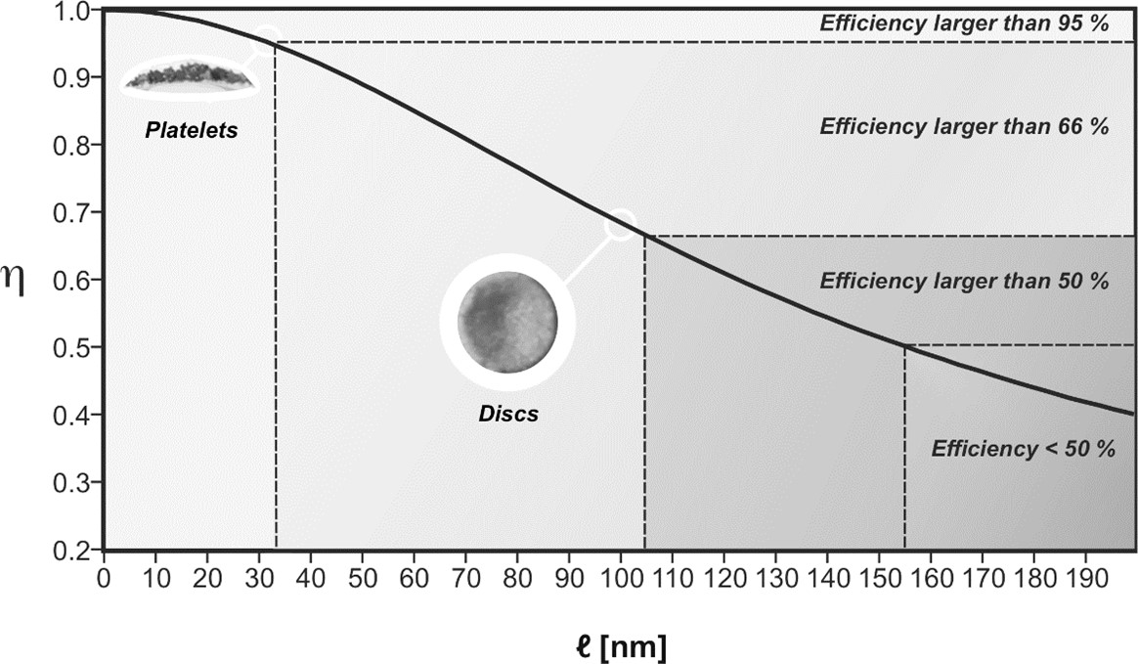
Disentangling Kinetics of CO Oxidation and Mass Transport in Nanoporous Gold
using Pulsed Field Gradient NMR
Marcus Bäumer¹, Stefan Wild¹, Amineh Baniani³, Thomas Risse², Evan M. Forman³, Sergey Vasenkov³
1. University of Bremen; 2. Freie Universität Berlin; 3. University of Florida;
Funding Grants: G.S. Boebinger (NSF DMR-2128556, DMR-1157490); M. Bäumer and T. Risse (German Research Foundation, BA 1710/29-2 and RI 1025/3-2)
What is the finding? For the first time, researchers were able to measure true conversion rates of gas molecules in a porous metallic material. The system investigated, nanoporous gold, is an interesting heterogeneous catalyst that has been found to efficiently catalyze oxidation reactions at room temperature. Taking CO conversion to CO₂ as an example for which the mass transport of CO and CO₂ can be straightforwardly studied by pulsed field gradient (PFG) NMR spectroscopy, MagLab users were able to experimentally assess the impediment created by the pore system present in the nanoporous gold on the transport of gas molecules to the catalytic sites for conversion.
Why is this important? The conversion of CO into CO₂ is important for cleaning up exhaust gases from power plants and refineries. Knowledge of gas transport rates in nanoporous gold particles allows us to predict more efficient shapes and sizes of the catalyst where transport limitations can be minimized. Making a first attempt in this direction, we broke up larger (~104µm) nanoporous gold discs into smaller (~33µm) platelets (Figure). The reduction of the catalyst lateral size (L) resulted in an increase in catalytic conversion of CO to CO₂ by about 50% which, in agreement with predictions, corresponds to an improvement of the effectiveness factor, η, a measure of the normalized reaction rate, to almost 100% (Figure). This makes the catalyst much more effective in industrial applications, helping to reduce waste and improve efficiency.
Why did this research need the MagLab? Gas diffusion measurements by pulsed-field-gradient NMR in mesoporous catalysts require high magnetic fields to achieve sufficiently large signal-to-noise ratios in these dilute gases.
L(µm)
Figure: Effectiveness factor (η) of nanoporous gold catalysts exhibiting different shapes and characteristic lengths (L).
Facilities and instrumentation used: AMRIS, 750 MHz/89 mm Bruker Avance III HD
Citation: Baniani, A.; Wild, S.; Forman, E.; Risse, T.; Vasenkov, S.; Baumer, M., Disentangling catalysis and mass transport: Using diffusion measurements by pulsed field gradient NMR to reveal the microkinetics of CO oxidation over nanoporous gold, Journal of Catalysis, 413, 1123--1131 (2022) doi.org/10.1016/j.jcat.2022.08.020

