Slide 1
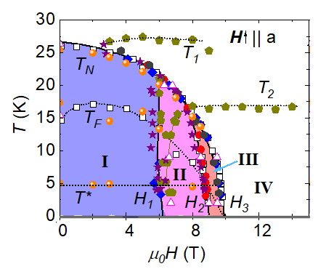
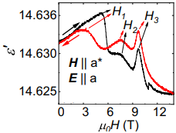
Potential spin liquid system explored with pulsed magnetic fields
Shengzhi Zhang¹, Sangyun Lee¹, Andrew J. Woods², William K. Peria¹, Sean M. Thomas², Roman Movshovich², Eric Brosha², Qing Huang³,
Haidong Zhou³, Vivien S. Zapf¹, and Minseong Lee¹
1. NHMFL and Los Alamos National Lab 2.Los Alamos National Lab 3. University of Tennessee, Knoxville
Funding Grants: G.S. Boebinger (NSF DMR-2128556); US DOE Quantum Science Center; LANL LDRD; H. D. Zhou (NSF DMR-2003117); W.K.Peria (Seaborg)
In quantum spin liquids, the electron spins do not freeze into classical ordering patterns. Instead of the spins form quantum superpositions of different spin states. In certain spin liquids, quasiparticles can emerge that are fractionalized patterns of spins. These emergent quasiparticles can be used to store and manipulate quantum information.
In this collaboration, researchers utilized a variety of magnetic, structural, and electrical measurements to explore a Co-based Kitaev honeycomb system. The short duration of pulsed magnetic fields were needed to create highly sensitive measurements of the electric polarization, which is a symmetry-sensitive probe that can distinguish different magnetic orders, as well as the magnetocaloric effect, which detects phase transitions by measuring magnetic entropy changes.
These experiments identify regions the temperature versus magnetic field phase diagram in which different spin ordering states exist and where spin liquid behavior exists. In one region, there is no bulk electric polarization, even though the dielectric constant (Fig 1a) shows strong electric dipoles forming in response to magnetic ordering. By symmetry, this is incompatible with the so-called “triple Q” magnetic state and favors another (“zig zag” state) at zero field. The phase diagram (Fig 1b) shows many magnetic ordering states, as well as a proposed quantum spin liquid (labeled “III” in Fig 1b).
It is important to identify new spin liquid candidates, because they can potentially host topological quasiparticles. These quasiparticles could enable resilient quantum computing that avoids problems that plague existing approaches, such as sensitivity to the environment.
a)
b)
Fig 1 Physical properties of the the spin liquid compound with spins on a honeycomb lattice, Na₂Co₂TeO_{6.} a) Dielectric constant vs magnetic field showing electric dipoles emerging at magnetic phase transitions, but no net polarization, which constrains the symmetry of the phases. b) Phase diagram in temperature (T)-field (H) space showing regions of spin ordering and possible spin liquid behavior.
Facilities and instrumentation used: NHMFL Pulsed Field Facility
Citation: Zhang, S.; Lee, S.; Woods, A.J.; Peria, W.K.; Thomas, S.M.; Movshovich, R.; Brosha, E.; Huang, Q.; Zhou, H.; Zapf, V.; Lee, M., Electronic and magnetic phase diagrams of the Kitaev quantum spin liquid candidate Na2Co2TeO6Na2Co2TeO6, Physical Review B, 108, 064421 (2023) doi.org/10.1103/PhysRevB.108.064421

Slide 2
Potential spin liquid system explored with pulsed magnetic fields
Shengzhi Zhang¹, Sangyun Lee¹, Andrew J. Woods², William K. Peria¹, Sean M. Thomas², Roman Movshovich², Eric Brosha², Qing Huang³,
Haidong Zhou³, Vivien S. Zapf¹, and Minseong Lee¹
1. NHMFL and Los Alamos National Lab 2.Los Alamos National Lab 3. University of Tennessee, Knoxville
Funding Grants: G.S. Boebinger (NSF DMR-2128556); US DOE Quantum Science Center; LANL LDRD; H. D. Zhou (NSF DMR-2003117); W.K.Peria (Seaborg)
What is the finding? MagLab users mapped out the regions in temperature and magnetic field in which different spin patterns form in Na₂Co₂TeO₆. This compound is a candidate for spin liquid behavior that is expected to be manifested by the cobalt spins. A wide range of measurements in magnetic fields nailed down the different phases and the region of phase space (labeled “III” in the Figure) that might be the sought-after spin liquid state.
Why is this important? Spin liquids are magnets in which the individual spins on each atom do not freeze into static patterns, but instead form a quantum fluctuating state, known as a quantum spin liquid. These spin liquids may show excitations, called ‘quasiparticles’, that are patterns of spins that may be suitable for the storage and manipulation of quantum information. If so, they may offer advantages over other approaches to quantum computing. However, finding and identifying spin liquid states remains a grand challenge.
Why did this research need the MagLab? Perhaps counterintuitively, the short duration of pulsed magnetic fields can be a critically important enabler to realize highly sensitive measurements. In particular, electric polarization can be measured with higher sensitivity in rapidly changing fields, which enables symmetries of the magnetic order to be probed. Magnetocaloric measurements, valuable for detecting phase transitions by measuring changes in magnetic entropy, are also improved by rapidly changing magnetic fields. As such, this experiment is an example where the material did not demand high magnetic fields. Instead, this experiment required unique MagLab techniques that use pulsed magnetic fields in order to achieve sufficiently high sensitivity to map the many phase transitions in the complex phase diagram of this candidate quantum spin liquid material.
Na₂Co₂TeO₆
Phase diagram of the spin liquid candidate compound Na2Co2TeO6 that features electron spins on a honeycomb lattice. The temperature (T) and magnetic field (H) phase diagram is shown with regions of different patterns of spin ordering, as well as a possible spin liquid stage, labeled “III” in the diagram.
Facilities and instrumentation used: NHMFL Pulsed Field Facility
Citation: Zhang, S.; Lee, S.; Woods, A.J.; Peria, W.K.; Thomas, S.M.; Movshovich, R.; Brosha, E.; Huang, Q.; Zhou, H.; Zapf, V.; Lee, M., Electronic and magnetic phase diagrams of the Kitaev quantum spin liquid candidate Na2Co2TeO6Na2Co2TeO6, Physical Review B, 108, 064421 (2023) doi.org/10.1103/PhysRevB.108.064421
Notes:
How to compress files size:
On PowerPoint, you can save the attached image (Right click on an image -> Select “Save as picture” -> Then you save the image as PNG). PNG is the image compression without losing the image quality. You replace the original image with the PNG one on PowerPoint. This should reduce the PowerPoint file size.
One thing to be careful about is that you should enlarge your image a bit on PowerPoint before saving so is to avoid losing much resolution.

