Slide 1
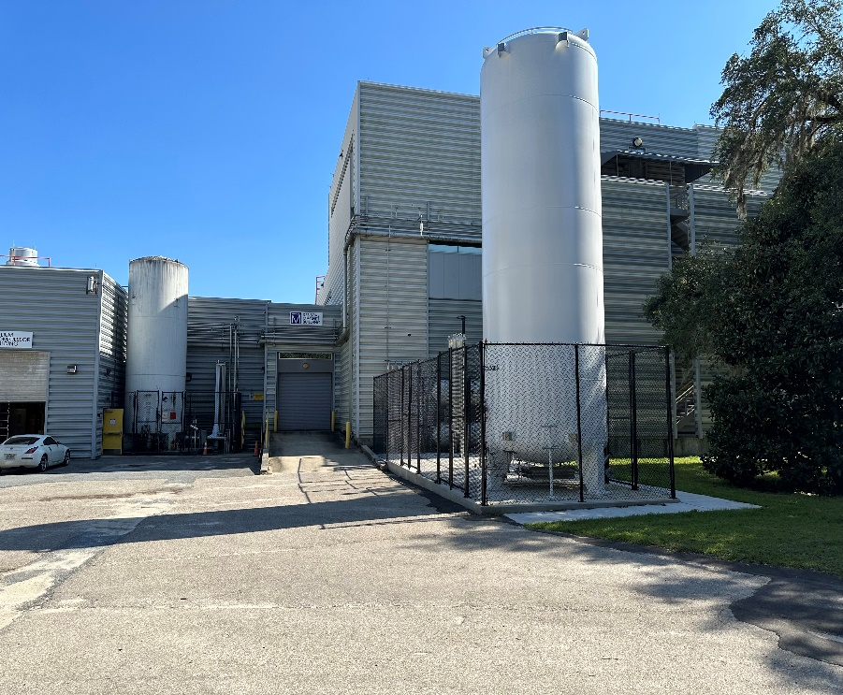
Installation of a Second LN₂ Tank at the MagLab’s DC Field Facility
M. Vanderlaan¹, T. Hunter¹, J. G. Kynoch¹, T. P. Murphy¹, A. J. Brown¹
National High Magnetic Field Laboratory, FSU
Funding Grants: G.S. Boebinger (NSF DMR-2128556)
What is the development?
The MagLab has installed a second liquid nitrogen (LN₂) tank at the DC Field Facility.
Why is this important?
Having an uninterrupted supply of LN₂ is critical for magnet operations, liquid helium production and research throughout the MagLab. The installation of the new tank will double the capacity of LN₂ storage, provide redundancy should a failure occur with one of the tanks, and prevent interruption of Hybrid Magnet Operations, liquid helium production, and DC User Programs when routine servicing is required.
What is the implementation?
The new LN₂ tank was set in place on a new concrete pad. Personnel are now installing vacuum jacketed plumbing to connect the new tank to the existing LN₂ system. Once the new tank is operational, the old tank can be moved and refurbished without interruption to MagLab operations. The old tank will be disconnected, moved to the new pad, and refurbished by replacing aging piping and valves, as well as by adding additional isolation points to enable more flexible operations and safety lockouts. The new tank will be operational in 2024.
Work planning ensured all work was safely completed?
MagLab Operations, Maintenance, and Safety teams worked closely with the external Contractor to develop a safe work plan to mitigate hazards and minimize the possibility for a safety incident during this work. Through careful planning and the use of the MagLab’s Integrated Safety Management program, the scope of work was defined for each stage of the project, hazards were identified, and controls were put in place such that the work performed to date has been performed safely. Continuous monitoring of work practices is designed to maintain safety throughout the completion of the project.
Lowering the New LN2 Tank into place
New LN2 Tank
Old LN2 Tank (to be moved
to be adjacent to new tank)
MagLab entities involved: Facilities, Operations, as well as Environmental, Health, and Safety departments.
Notes:
How to compress files size:
On PowerPoint, you can save the attached image (Right click on an image -> Select “Save as picture” -> Then you save the image as PNG). PNG is the image compression without losing the image quality. You replace the original image with the PNG one on PowerPoint. This should reduce the PowerPoint file size.
One thing to be careful about is that you should enlarge your image a bit on PowerPoint before saving so is to avoid losing much resolution.
The audience for slide 1 is fellow scientists outside your field of specialization and NSF program managers. Emphasize user involvement and uniqueness of the MagLab where appropriate.
Text should be 3 (or 4) paragraphs, with an empty line between paragraphs. No smaller than Arial 12 pt for main text and 11 pt for the two blue footnotes below. Guidance for paragraphs is given below: (Do not include the words “introduction”, “experiment”, or “so what” in your highlight!)
Paragraph 1: Introduction: a sentence or two on the general context of this work, comprehensible by non-experts, that will generate interest and a desire to read more.
Paragraph 2: Experimental description (enough detail to capture the excitement of the result, the nature of the collaboration, the capability of the MagLab facilities that enabled the success). The text should be aimed at other scientists who are not experts in your field. In particular, avoid jargon. Also, spell out (and define) all acronyms.
Paragraph 3: So what? What area of research has been advanced ? What longer term basic research and/or applications might result ?

