Slide 1


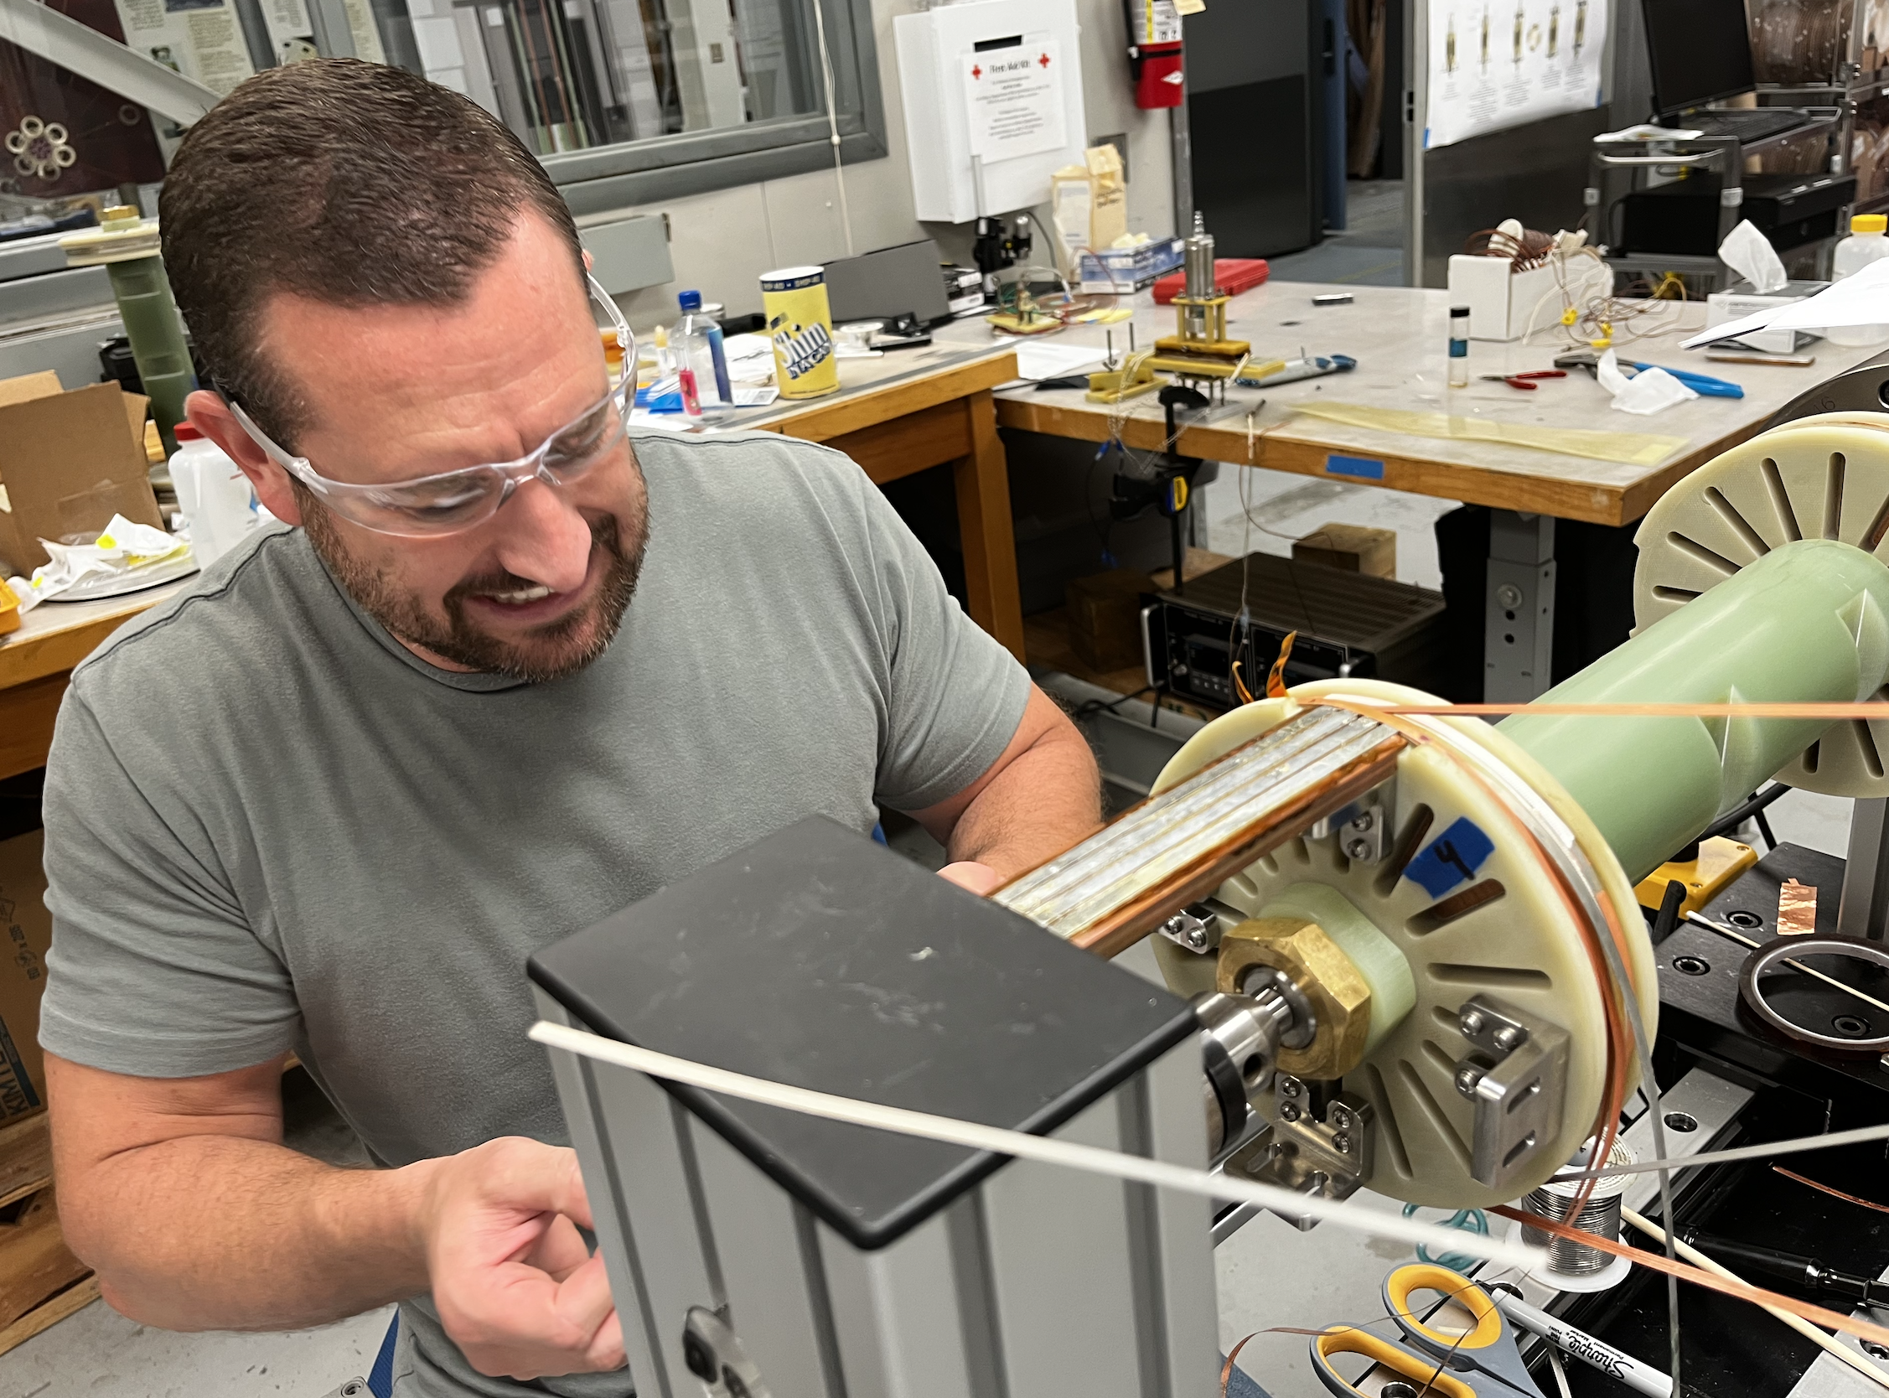
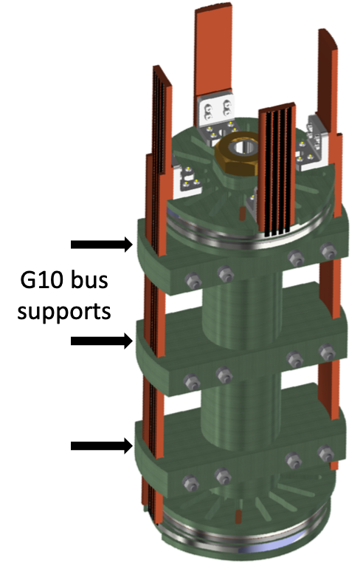
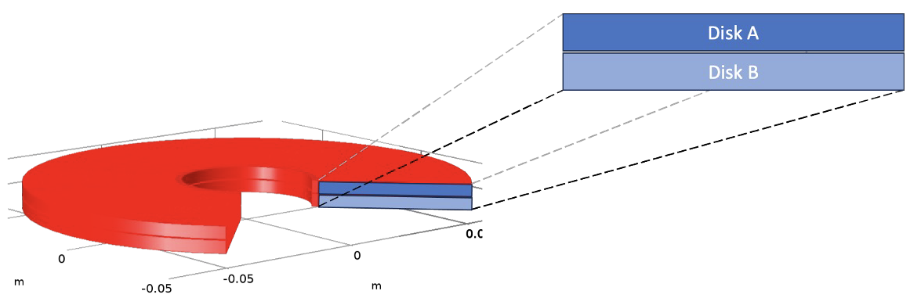
High-Magnetic-Field Quality Assurance of High-Temperature-Superconducting Modules
E. Bosque, D. Abraimov, H. Bai, M. Bird, K. Cantrell, I. Dixon, A. Gavrilin, S. Gundlach, J. Jaroszynski, B. Jarvis, K. Kim, W. Marshall, T. Painter
National High Magnetic Field Laboratory
Funding Grants: G.S. Boebinger (DMR-1644779, DMR-1938789, DMR-2131790, DMR-2128556) and the State of Florida
The National High Magnetic Field Laboratory (MagLab) is presently engaged in a five-year project to design a 40T all-superconducting magnet using Rare Earth – Barium – Copper – Oxygen (REBCO) superconducting tape. This tape is wound into double layer coils, called “double layer pancake modules” because their geometrical dimensions resemble those of a pancake. These modules are then stacked and interconnected to form larger test coils and, eventually, the final high-field user magnet.
The REBCO tape must be characterized by measuring the superconducting critical current (I_{c}) as a function of temperature, magnetic field applied to the tape, and the angle at which the magnetic field is applied to the tape. The REBCO tape is then assigned to specific pancake modules in a test coil stack according to its performance during characterization. The pancake modules are then wound, stacked to form the test coil, compressed, interconnected via joints and attachment of coil terminations, and covered with diagnostic instrumentation. During this multi-step winding and stacking of the pancake modules, REBCO tapes may be damaged and, until now, there have been no intermediate quality assurance procedures between the characterization of the REBCO tape and the expensive and time-consuming testing of the full test coil.
To mitigate the risk of installing an underperforming pancake module into the expensive full test coil, an intermediate testing protocol has been developed to test REBCO-wound double pancake modules individually at 4.2K to ensure that the modules are not damaged after winding.
The individual modules are tested in sets of two in a background 6T magnetic field provided by a superconducting coil while cooled in liquid helium. Modules are offset from the midplane of the background field to expose the modules to high radial fields, allowing the REBCO to be tested nearer its I_{c}. In this way, the individual modules can be tested beyond 70% of their I_{c} as a means to verify they are acceptable for insertion into the full test coil.
  Figure right: MS&T Technician Brent Jarvis connecting a pancake module to the Dual Rig for Pancake Module Testing
Figure above: Fully assembled Dual Rig for Pancake Module Testing
Figure above: Cross section of a double layer pancake module as analyzed via 2-D axisymmetric numerical modeling.
Image credits: Ernesto Bosque, MagLab
Facilities: HTS Winding Shop, Cell 4 of the DC Magnet Facility, and the 6T LTS testbed Petten magnet.
Citation: Kolb-Bond, D.; Bird, M.D.; Dixon, I.R.; Painter, T.A.; Lu, J.; Kim, K.L.; Kim, K.; Walsh, R.P.; Grilli, F.,
Screening current rotation effects: SCIF & strain I REBCO magnets, Superconductor Science and Technology, 34, 095004 (2021) doi.org/10.1088/1361-6668/ac1525
Notes:
How to compress files size:
On PowerPoint, you can save the attached image (Right click on an image -> Select “Save as picture” -> Then you save the image as PNG). PNG is the image compression without losing the image quality. You replace the original image with the PNG one on PowerPoint. This should reduce the PowerPoint file size.
One thing to be careful about is that you should enlarge your image a bit on PowerPoint before saving so is to avoid losing much resolution.

Slide 2
High-Magnetic-Field Quality Assurance of High-Temperature-Superconducting Modules
E. Bosque, D. Abraimov, H. Bai, M. Bird, K. Cantrell, I. Dixon, A. Gavrilin, S. Gundlach, J. Jaroszynski, B. Jarvis, K. Kim, W. Marshall, T. Painter
National High Magnetic Field Laboratory
Funding Grants: G.S. Boebinger (DMR-1644779, DMR-1938789, DMR-2131790, DMR-2128556) and the State of Florida
  Figure right: MS&T Technician Brent Jarvis connecting a pancake module to the Dual Rig for Pancake Module Testing
What is the finding? High-temperature superconducting (HTS) user magnets at the MagLab are presently designed to use Rare Earth – Barium – Copper – Oxygen (REBCO) tape that has been wound into double layer coils, called “double layer pancake modules” because their geometrical dimensions resemble those of a pancake. These modules are then stacked and interconnected to form larger test coils and, eventually, the final high-field user magnet. In the work reported here, MagLab engineers and technicians developed a method for testing individual REBCO-wound double pancake modules to high operating currents, necessary to learn whether each module is suitable for inclusion in the final high-field magnet.
Why is this important? Test coils can include as many as a couple dozen pancake modules. The construction and assembly of these test coils is extremely labor intensive. Indeed, it can take four months or more to fabricate and test a test coil. Furthermore, testing consumes hundreds of liters of expensive liquid helium. If one underperforming pancake module is installed in the test coil, the entire test coil must be disassembled, the bad module replaced, and the entire coil retested. During the retest, the coil will still be limited by its lowest performing module, which could lead to yet another expensive round of disassembly, replacement, reassembly, and retesting. By testing individual pancake modules, a much higher degree of confidence is obtained that the larger-sized test coils will operate as intended.
Why did this research need the MagLab? Development of HTS magnets requires a team of technical experts that span the full range of analysis, design, fabrication and testing. The team of thirty engineers and technicians in the MagLab’s Magnet Science and Technology group, combined with the many materials experts at the MagLab’s Applied Superconductivity Center, provide a full spectrum of critical expertise that is only available at the MagLab.
Figure above: Fully assembled Dual Rig for Pancake Module Testing
Figure above: Cross section of a double layer pancake module as analyzed via 2-D axisymmetric numerical modeling.
Image credits: Ernesto Bosque, MagLab
Facilities: HTS Winding Shop, Cell 4 of the DC Magnet Facility, and the 6T LTS testbed Petten magnet.
Citation: Kolb-Bond, D.; Bird, M.D.; Dixon, I.R.; Painter, T.A.; Lu, J.; Kim, K.L.; Kim, K.; Walsh, R.P.; Grilli, F.,
Screening current rotation effects: SCIF & strain I REBCO magnets, Superconductor Science and Technology, 34, 095004 (2021) doi.org/10.1088/1361-6668/ac1525

