Slide 1
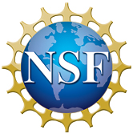
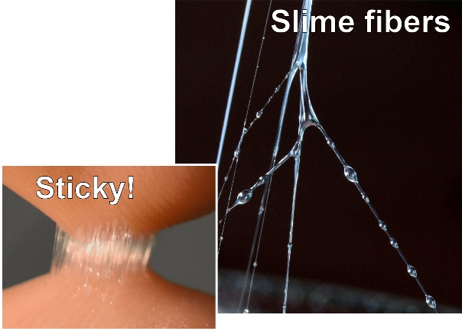
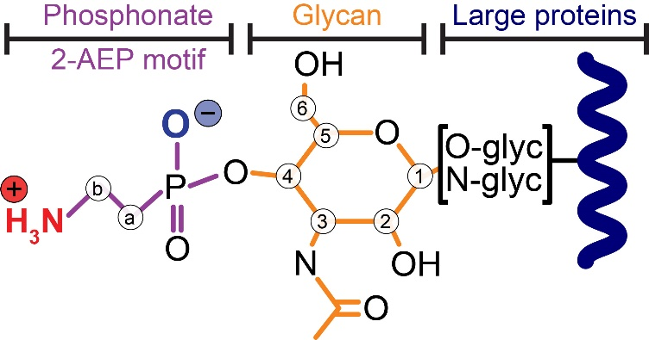
Inside Velvet Worm Slime: Rare Protein Modification for Fast Fiber Formation
Alexandre Poulhazan¹, Alexander Baer², Gagan Daliaho³, Frederic Mentink-Vigier⁴, Alexandre A. Arnold¹, Darren C. Browne⁵, Lars Hering², Stephanie Archer-Hartmann⁶, Lauren E. Pepi⁶, Parastoo Azadi⁶, Stephan Schmidt⁷, Georg Mayer¹, Isabelle Marcotte^{1,}*, Matthew J. Harrington^{3,}*
1. Université du Québec à Montréal; 2. University of Kassel; 3. McGill University; 4. National High Magnetic Field Laboratory; 5. University of the West Indies; 6. Complex Carbohydrate Research Center, University of Georgia; 7. Heinrich-Heine-Universität Düsseldorf
Funding Grants: G.S. Boebinger (NSF DMR-1644779, NSF DMR-2128556); F. Mentink-Vigier (NIH-GM122698); P. Azadi (NIH-R24GM137782, NSF DMR-1933525)
Velvet worms eject a sticky and fiber-forming slime for both prey capture and defense. The struggling of the victim to escape the slime network causes the formation of stiff fibers, which results in effective immobilization.
This natural phenomenon of fiber formation is inspiring for biomaterials research. Induced only by a simple mechanical trigger and the resulting shear forces, the slime instantly turns from a fluid to load-bearing fibers outside of the organism under ambient conditions. Additionally, fibers can be dissolved, and new fibers made from the solution. Understanding the molecular principles underlying these phenomena can aid in the design of sustainable methods for fabricating advanced polymers.
MagLab users identified a unique post-translational modification of high-molecular weight proteins, a modification that impacts their features and, as a result, the abilities of slime to rapidly assemble into fibers with enhanced toughness. In particular, the MagLab‘s magic-angle-spinning, dynamic nuclear polarization (MAS-DNP) facility, combined with mass spectrometry, enabled the discovery of the precise structure of a rare phosphonoglycan moiety that is linked to large fiber core building proteins – a striking NMR result that did not require any complicated isotopic enrichment of the samples! Surprisingly, most of the slime’s phosphorus is represented in this 2-aminoethyl phosphonate (2-AEP) motif, a chemical moiety that is extremely rare in nature, and especially in land animals.
2-AEP is zwitterionic at the slime‘s native pH – this adds charges to the proteins. Thus, researchers assume increased electrostatic protein-protein interactions enable the faster assembly and advanced mechanical properties of fibers. It is anticipated that these findings will help further unravel mechanisms of natural fiber formation and lend insight into future ways to produce polymeric materials.
¹³C atoms surrounding the 2-AEP motif
¹H-³¹P cross polarization
¹H-³¹P-¹³C double cross polarization
Figure: (top left) The sticky slime fibers from a velvet worm. (top right) Schematic representation of the phosphonoglycans that decorate the slime proteins, detected by dynamic nuclear polarization solid-state NMR. (bottom) ¹H-³¹P MAS-DNP NMR spectrum showing the predominance of phosphonates in slimes and ¹H-³¹P-¹³C DNP MAS NMR “double cross polarization” spectrum showing the proximities of key P and C sites.
Facilities used: 600 MHz MAS Dynamic Nuclear Polarization Solid-State NMR instrument.
Citation: Poulhazan, A.; Baer, A.; Daliaho, G.; Mentink-Vigier, F.; Arnold, A.A.; Browne, D.C.; Hering, L.; Archer-Hartmann, S.; Pepi, L.E.; Azadi, P.; Schmidt, S.; Mayer, G.; Marcotte, I.; Harrington, M.J., Peculiar Phosphonate Modifications of Velvet Worm Slime Revealed by Advanced Nuclear Magnetic Resonance and Mass Spectrometry, Journal of the American Chemical Society, 145 (38), 20749-20754 (2023) doi.org/10.1021/jacs.3c06798

Slide 2
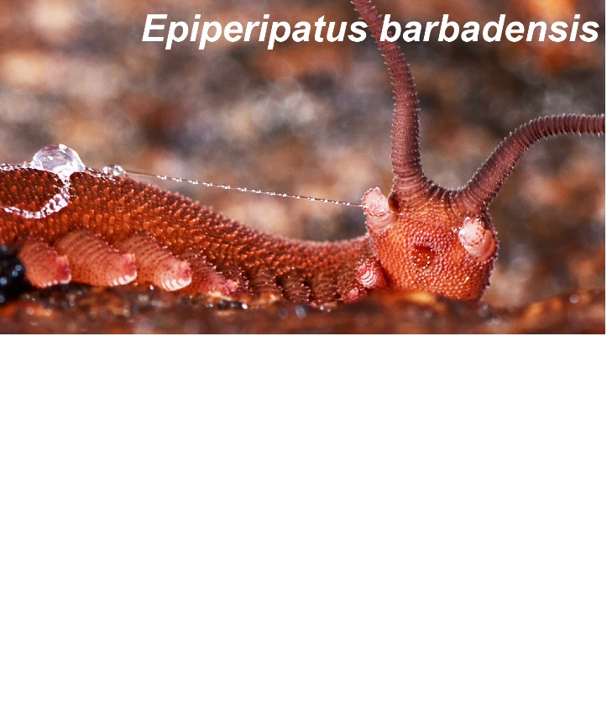
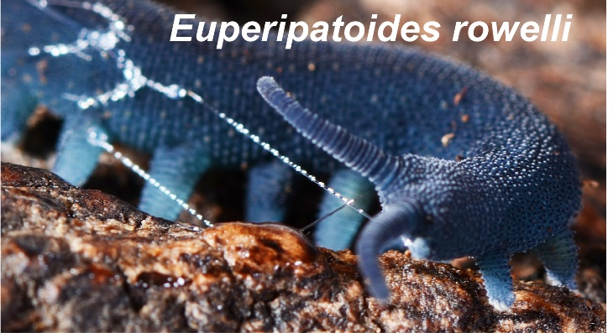
Inside Velvet Worm Slime: Rare Protein Modification for Fast Fiber Formation
Alexandre Poulhazan¹, Alexander Baer², Gagan Daliaho³, Frederic Mentink-Vigier⁴, Alexandre A. Arnold¹, Darren C. Browne⁵, Lars Hering², Stephanie Archer-Hartmann⁶, Lauren E. Pepi⁶, Parastoo Azadi⁶, Stephan Schmidt⁷, Georg Mayer¹, Isabelle Marcotte^{1,}*, Matthew J. Harrington^{3,}*
1. Université du Québec à Montréal; 2. University of Kassel; 3. McGill University; 4. National High Magnetic Field Laboratory; 5. University of the West Indies; 6. Complex Carbohydrate Research Center, University of Georgia; 7. Heinrich-Heine-Universität Düsseldorf
Funding Grants: G.S. Boebinger (NSF DMR-1644779, NSF DMR-2128556); F. Mentink-Vigier (NIH-GM122698); P. Azadi (NIH-R24GM137782, NSF DMR-1933525)
What is the finding? MagLab users discovered an extremely unusual protein modification that involves a very rare phosphonate group and a sugar molecule that exist in large proteins created by velvet worms. These proteins float freely in fluid, but self assemble into strong fibers if they are brought close together.
Why is this important? Velvet worms shoot out a sticky and fiber-forming slime for both catching prey and defending themselves. The more the victim struggles to escape the slime, the stronger the network of fibers becomes. Just by touching and drawing the slime, a strong fiber is formed instantly – and yet, these fibers are recyclable by adding water. This naturally occurring instance of fiber formation is highly inspiring, since understanding their assembly principles can help in the design of sustainable methods for fabricating new and advanced polymeric materials.
The protein modification is “zwitterionic” (i.e., an even number of positive and negative charges) and therefore changes the distribution of charges in the large proteins. This most likely allows the protein to self assemble into fibers because of strong electrostatic interactions and is also responsible for easy recycling of the fibers via dissolution in water. Since the properties of the fibers can be changed by altering chemical groups on the proteins (i.e., protein modifications), these experiments can provide much insight into the mechanism underlying the formation of fibers.
Why did this research need the MagLab? The MagLab’s unique Dynamic Nuclear Polarization, Nuclear Magnetic Resonance (DNP-NMR) user facilities and in-house expertise enabled the decoding of the chemical structures of phosphonate and sugar molecules, uncovering another secret of nature.
Figure: The two species of velvet worms, Epiperipatus barbadensis (top) and Euperipatoides rowelli (bottom) that produce adhesive slimes. The slime is shot through their own “slime cannons” to trap their prey and defend themselves. Researchers used a special high-magnetic-field technique known as DNP-NMR to understand the molecular structure of this unusual slime that forms strong fibers simply in response to the struggling of the velvet worm’s victim – or “simple application of mechanical motion under ambient conditions”.
Facilities used: 600 MHz MAS Dynamic Nuclear Polarization Solid-State NMR instrument.
Citation: Poulhazan, A.; Baer, A.; Daliaho, G.; Mentink-Vigier, F.; Arnold, A.A.; Browne, D.C.; Hering, L.; Archer-Hartmann, S.; Pepi, L.E.; Azadi, P.; Schmidt, S.; Mayer, G.; Marcotte, I.; Harrington, M.J., Peculiar Phosphonate Modifications of Velvet Worm Slime Revealed by Advanced Nuclear Magnetic Resonance and Mass Spectrometry, Journal of the American Chemical Society, 145 (38), 20749-20754 (2023) doi.org/10.1021/jacs.3c06798

