Slide 1


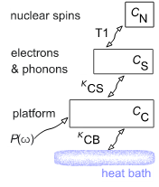
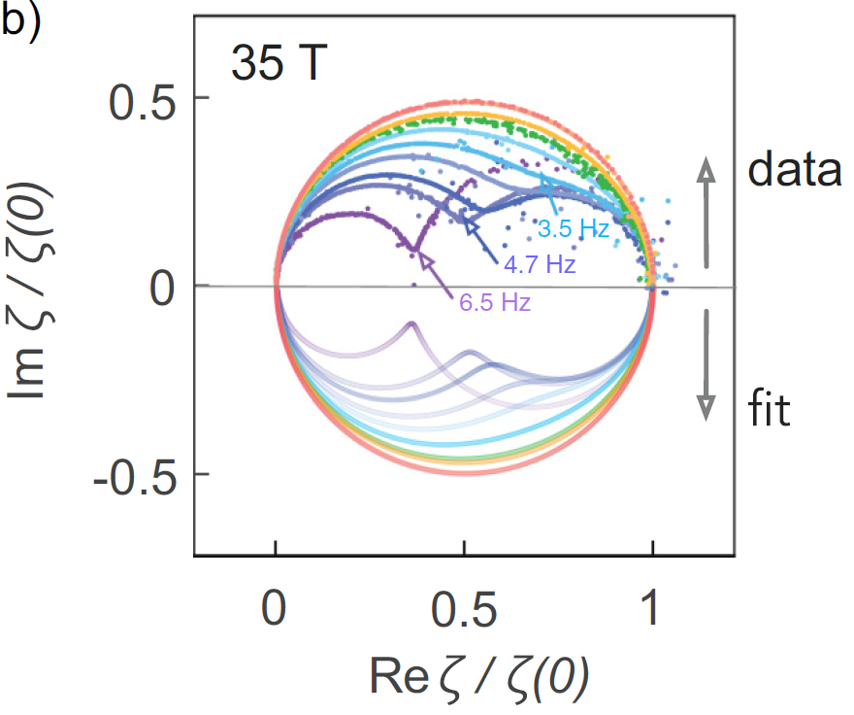
Thermal Impedance Spectroscopy: A New Tool to Study Thermodynamics of Metals
A. Kansili¹, A. Bangura², R.D. McDonald³, B.J. Ramshaw⁴ , A. Rydh¹ and A. Shehter³
University of Stockholm; 2. MagLab-Florida State University; 3. MagLab-Los Alamos National Laboratory; 4. Cornell University
Funding Grants: G.S. Boebinger (NSF DMR-2128556); Ramshaw (NSF DMR-1752784); Shekhter (DOE PHY-1607611); Ryhd (SRC, Grant No. 2021-04360)
Unlike transport measurements, which constitute significant fraction of user experiments at the MagLab, specific heat measurements are slow. Very slow. This is because they require waiting for thermal equilibrium between the sample and the thermometer to set in. This waiting time is determined by the macroscopic size of the sample and calorimeter platform, rather than by microscopic timescales as is the case for transport measurements. So far, the specific heat measurements at the MagLab used large calorimeters with time constants of tens of seconds, which in practice means each specific heat measurement takes fraction of an hour. Whether user’s magnet time is measured in hours or megawatts, the specific heat measurements are a significant challenge.
This experimental roadblock has been recently broken by introducing ultra-fast nanocalorimeters -- which have millisecond time constants at cryogenic temperatures. This 4+ order of magnitude change in the timescale of the measurement are a complete game changer and, for the first time, open a practical use of specific heat as a technique available for users, The specific heat can now be measured at the fastest field-sweep rates, continuously as the field and angle is swept. Just like an electrical transport measurement,
Typically, when a breakthrough improvement of a technique occurs, it opens entirely new uses not possible or even imagined before. Use of nanocalorimeters is not an exception. MagLab scientists imagined, tested and put to good scientific use an entirely new technique -- “thermal impedance spectroscopy” (TISP) – that is enabled by ultrafast nanocalorimeters. It provides, for the first time, a way to measure nuclear spin-lattice relaxation rates without use and restrictions of nuclear magnetic resonance (NMR) techniques. In metals, thermal impedance spectroscopy provides two independent way to measure electronic density of states – in the same measurement – through electronic specific heat and through nuclear spin-lattice relaxation rate.
Fig. 1: Thermal circuit of the calorimeter-sample assembly: noting thermal couplings between the sample’s nuclear spins (C_{N}), the sample’s electrons and phonons (C_{S}), and calorimeter (C_{C}).
Fig. 2: Measured thermal impedance of the calorimeter-sample assembly (the dense sets of data points that form seemingly solid lines in the upper half of the figure) as measured at various frequencies, compared to the fits to the data (lower half of the figure) that determine the temperature and magnetic field dependence of the six parameters denoted in Fig.1.
Fig. 3: Experimental values of heat capacity showing the ability of TISP to measure the heat capacity of the electrons and phonons separately from the nuclear heat capacity.
Facilities and instrumentation used: DC-Field Facility, Cell 12
Citation: A. Khansili, A. Bangura, R. McDonald, B.J. Ramshaw, A. Rydh, A. Shehter,
Calorimetric measurement of nuclear spin-lattice relaxation rate in metals, Physical Review B, 107, 195145 (2023) doi.org/10.1103/PhysRevB.107.195145

Slide 2
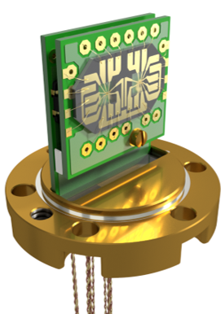
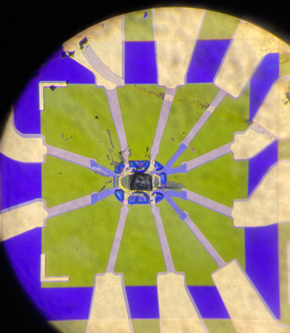

Thermal Impedance Spectroscopy: A New Tool to Study Thermodynamics of Materials
A. Kansili¹, A. Bangura², R.D. McDonald³, B.J. Ramshaw⁴ , A. Rydh¹ and A. Shekhter³
University of Stockholm; 2. MagLab-Florida State University; 3. MagLab-Los Alamos National Laboratory; 4. Cornell University
Funding Grants: G.S. Boebinger (NSF DMR-2128556); Ramshaw (NSF DMR-1752784); Shekhter (DOE PHY-1607611); Ryhd (SRC, Grant No. 2021-04360)
What is the finding? This collaboration of developed thermal impedance spectroscopy, a new technique that extends ac calorimetry techniques to greatly enhance the ability of scientists to measure specific heat in astonishingly small samples that weigh as little as one microgram. A well-known material, elemental indium, was chosen to demonstrate the unique ability of this technique to simultaneously extract the different components of the heat capacity - a fundamental property of all materials that probes low-energy excitations. This ability to separate different components of the specific heat will assist in the search for and study of novel phenomena of quantum materials in high magnetic fields...and zero fields too!
Why is this important? Scientific exploration of materials is driven by our desire to discover new phenomena or find phenomena that have been predicted theoretically. Once identified, more detailed and better-quality experimental data are required to allow a better understanding of phenomena that, to date, defy theoretical explanation. Thermodynamic quantities like heat capacity and nuclear relaxation times are the gold standard for providing evidence of new states of electronic matter and for constraining theoretical models about those new states. Yet specific heat has traditionally been a very difficult measurement that requires large samples (oftentimes, samples that weigh several milligrams) in order to have a chance of achieving a sufficiently large signal to noise ratio.
Why did this research need the MagLab? The MagLab provided high-quality magnetic fields with low-noise ripple as well as the custom high-magnetic-field probes that enabled this highly sensitivity new technique to be developed. The sensitivity of the sensor used for this experiment can detect minute thermal changes in the sample – a remarkable achievement in the center of a magnet that has 38MW of electrical power and thousands of liters of cooling water coursing through it.
Left: Rendering of the nanocalorimeter wire-bonded to a printed circuit board mounted in a vacuum cell (shown without its lid). The vacuum cell is required to thermally isolate the nanocalorimeter from the rest of the experimental cryostat. The cryostat allows the scientists to cool the sample down to 0.3 K inside the 35T magnetic field.
Below: A photograph of the extremely small indium sample (dark rectangle in the middle of the image) mounted on the calorimeter. The calorimeter is fabricated in a clean room allowing the fine electrical leads and custom thermometer to be deposited on a fragile membrane that is only 150nm thick...0.15% of the thickness of a human hair!
100μm
100μm
Image Credit: Troy Brumm & Ali Bangura, NHMFL
Facilities and instrumentation used: DC-Field Facility, Cell 12
Citation: A. Khansili, A. Bangura, R. McDonald, B.J. Ramshaw, A. Rydh, A. Shehter,
Calorimetric measurement of nuclear spin-lattice relaxation rate in metals, Physical Review B, 107, 195145 (2023) doi.org/10.1103/PhysRevB.107.195145

