Slide 1
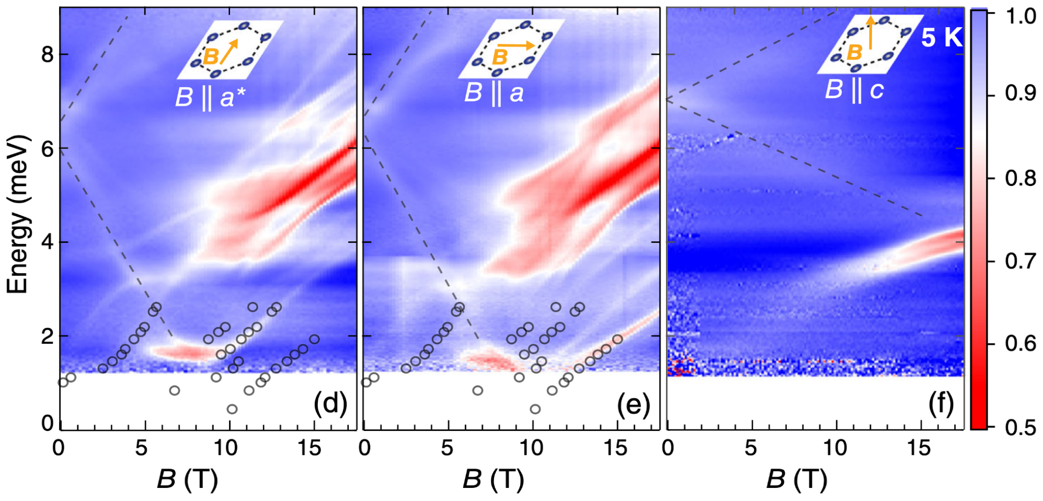
Disorder-Enriched Magnetic Excitations in a Heisenberg-Kitaev Quantum Magnet, Na₂Co₂TeO₆
L. Xiang¹, R. Dhakal², M. Ozerov¹, Y. Jiang³, B. S. Mou², A. Ozarowski¹, Q. Huang⁴, H. Zhou⁴, J. Fang⁵, S. M. Winter², Z. Jiang⁵, D. Smirnov¹
1. NHMFL, FSU; 2. Wake Forest University; 3. Anhui University; 4. University of Tennessee; 5. Georgia Tech.
Funding Grants: G.S. Boebinger (NSF DMR-2128556); D. Smirnov (DOE DE-FG02-07ER46451); H. Zhou (DOE DE- SC0020254); Z. Jiang (DOE DE-SC0023455)
Quantum spin liquids represent an intriguing phase of matter that can arise in magnetic materials with certain structures, where quantum fluctuations impede the formation of long-range magnetic order, even at the lowest temperatures. Kitaev’s spin-½ honeycomb model has attracted a lot of interest as it predicts exotic features that could be utilized in future quantum computing schemes. The compound Na₂Co₂TeO₆ has emerged as a potential Kitaev spin-liquid candidate in which the magnetic interactions between the low-energy effective spin-½ degrees of freedom associated with the cobalt (Co) atoms are highly directional. It is this property and the trigonal symmetry of the lattice that is central to the Kitaev physics.
In this highly collaborative experimental and theoretical study, involving researchers from China and multiple US universities, a combination of far-infrared transmission and high-field electron paramagnetic resonance (EPR) spectroscopy has been employed to investigate the low-temperature magnetic excitations of Na₂Co₂TeO₆ across a wide range of energies (0.2−15 meV) and magnetic fields (≤ 17.5T); the work combines capabilities from two MagLab facilities, the Electron Magnetic Resonance and DC Field facilities. The measurements reveal extremely rich spectra with a surprisingly large number of modes. Theoretical calculations find that disorder associated with the partial occupancy of sodium (Na) sites within the lattice plays a crucial role in generating these modes.
This comprehensive study has resulted in a detailed understanding of the magnetic excitations in Na₂Co₂TeO₆, revealing the key role of disorder associated with the sodium atoms immediately surrounding the cobalt spins. More generally, the work emphasizes the importance of understanding (and possibly controlling) disorder in the spin environment in the search for materials hosting Kitaev physics with potential for future practical applications.
(a)
(b)
Figure: Normalized far-infrared transmission (see color legend) measured on a single-crystal of Na₂Co₂TeO₆ at T = 5K, with the applied magnetic field B∥a* (panel a) and B∥a (panel b). Black circles are excitation modes extracted from the EPR spectra measured on powdered samples at T = 5K. Dashed lines are guides to some of the weaker excitation modes.
Facilities and instrumentation used: Joint EMR/DC-Field Facility Operation (15/17 T Transmission EPR Spectrometer and FTIR Spectrometer in SCM3).
Citation: Xiang, L.; Dhakal, R.; Ozerov, M.; Jiang, Y.; Mou, B.S.; Ozarowski, A.; Huang, Q.; Zhou, H.; Fang, J.; Winter, S.M.; Jiang, Z.; Smirnov, D.,
Disorder-Enriched Magnetic Excitations in a Heisenberg-Kitaev Quantum Magnet Na2Co2TeO6, Physical Review Letters, 131, 076701 (2023) doi.org/10.1103/PhysRevLett.131.076701

Slide 2
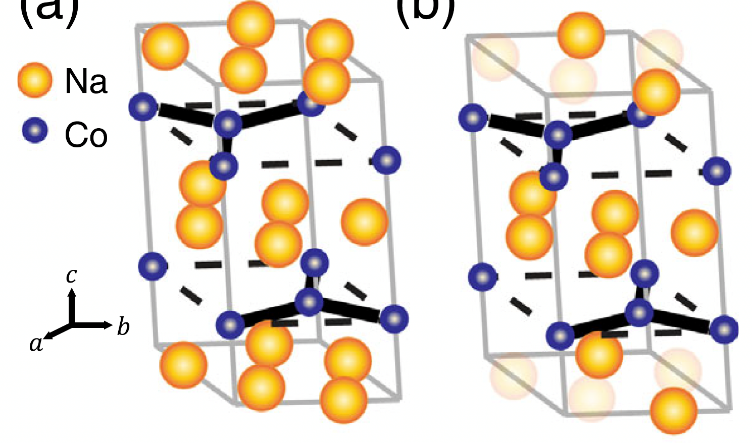
Disorder-Enriched Magnetic Excitations in a Heisenberg-Kitaev Quantum Magnet, Na₂Co₂TeO₆
L. Xiang¹, R. Dhakal², M. Ozerov¹, Y. Jiang³, B. S. Mou², A. Ozarowski¹, Q. Huang⁴, H. Zhou⁴, J. Fang⁵, S. M. Winter², Z. Jiang⁵, D. Smirnov¹
1. MagLab / Florida State University; 2. Wake Forest University; 3. Anhui University; 4. University of Tennessee; 5. Georgia Institute of Technology
Funding Grants: G.S. Boebinger (NSF DMR-2128556); D. Smirnov (DOE DE-FG02-07ER46451); H. Zhou (DOE DE- SC0020254); Z. Jiang (DOE DE-SC0023455)
What is the finding? This collaboration studied an enigmatic magnetic material, Na₂Co₂TeO₆, that is thought to host exotic magnetic excitations that could be utilized in future quantum computing schemes. Through detailed theoretical analysis of the evolution of the magnetic excitation spectrum across a wide range of applied magnetic field, researchers reveals the crucial role of microscopic disorder in the crystals that strongly affects the resulting macroscopic magnetic properties.
Why is this important? This comprehensive study has resulted in a detailed understanding of the magnetic excitations in Na₂Co₂TeO₆, revealing the key role of disorder associated with the sodium atoms immediately surrounding the cobalt spins (see Figure). Understanding the role of disorder more generally (and how to control it) in this class of materials is an important prerequisite for development of future information technologies.
Why did this research need the MagLab? Measuring the precise nature of the magnetic excitations associated with the Na₂Co₂TeO₆ compound over a wide range of magnetic fields and frequencies was essential to diagnosing the role of disorder in these complex quantum magnetic materials. In particular, cooperation between the MagLab’s Electron Magnetic Resonance (EMR) facility and DC Field facility provided unrivaled experimental insights by bringing to bear the combined capabilities of high-field electron paramagnetic resonance (EPR) and far-infrared magnetospectroscopy (FIRMS) that are available at the MagLab.
(a)
(b)
Figure (a) Average crystal structure of Na₂Co₂TeO₆ with each Na site ²/₃ occupied; Te and O atoms have been omitted for clarity. (b) Representative structure showing Na-occupation disorder, i.e., ²/₃ of the sites are occupied while ¹/₃ are vacant. The thick black lines denote nearest-neighbor Co spin-spin interactions.
Facilities and instrumentation used: Joint EMR/DC-Field Facility Operation (15/17 T Transmission EPR Spectrometer and FTIR Spectrometer in SCM3).
Citation: Xiang, L.; Dhakal, R.; Ozerov, M.; Jiang, Y.; Mou, B.S.; Ozarowski, A.; Huang, Q.; Zhou, H.; Fang, J.; Winter, S.M.; Jiang, Z.; Smirnov, D.,
Disorder-Enriched Magnetic Excitations in a Heisenberg-Kitaev Quantum Magnet Na2Co2TeO6, Physical Review Letters, 131, 076701 (2023) doi.org/10.1103/PhysRevLett.131.076701

