Slide 1
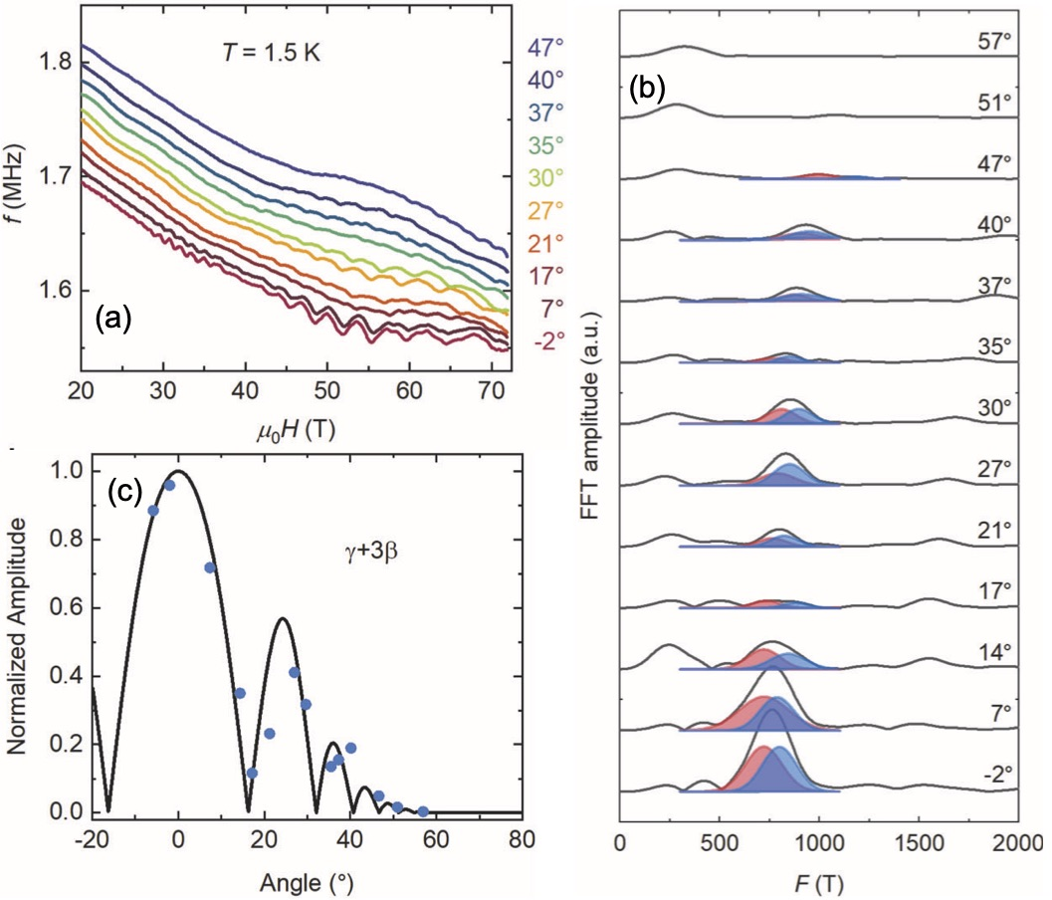
Using 75T pulsed magnetic fields to detect Chern pockets with large orbital moments in CsV₃Sb₅
Kuan-Wen Chen¹, Guoxin Zheng¹, Dechen Zhang¹, Aaron Chan¹, Yuan Zhu¹, Kaila Jenkins¹, Fanghang Yu², Mengzhu Shi², Jianjun Ying², Ziji Xiang^{1,2,} Xianhui Chen², Ziqiang Wang³, John Singleton⁴ & Lu Li¹
¹Department of Physics, University of Michigan, ²CAS Key Laboratory of Strongly-coupled Quantum Matter Physics,
³Department of Physics, Boston College, ⁴National High Magnetic Field Laboratory at Los Alamos National Laboratory
Funding Grants: G.S. Boebinger (NSF DMR-2128556); J. Singleton (DOE Science of 100 T); Lu Li (DOE DE-SC0020184; NSF DMR1707620 and 2004288)
The kagome metal CsV₃Sb₅ has attracted considerable attention because it is thought to host small Chern Fermi pockets that possess spontaneous orbital currents and large orbital magnetic moments. Unfortunately, the pockets align antiferromagnetically, so that it has, until now, proven impossible to detect their presence definitively. However, in this MagLab user collaboration, the Chern pockets are revealed via magnetic breakdown, an effect in which large magnetic fields cause quasiparticles to tunnel between different Fermi-surface sections.
Magnetic breakdown orbits between the Chern pockets (labeled β) and a conventional Fermi-surface section (ɣ) give rise to Shubnikov-de Haas (SdH) oscillations in the conductivity, detected here as the frequency f of a proximity-detector oscillator (Fig. a). Fig. (a) also reveals that the SdH oscillations vary in amplitude with the angle of the CsV₃Sb₅ crystal in the magnetic field. The variation is even more visible in the Fourier transform of the SdH oscillations, as Fig. (b) shows for the ɣ+2β (red) and ɣ+3β (blue) breakdown orbits.
Such an angle-dependent amplitude variation of magnetic quantum oscillations (Fig. c) is known as the spin-zero effect; normally, it is caused by the Zeeman splitting of the Landau levels. By contrast, here it is due to Chern pockets with oppositely directed large orbital moments. Such Berry-curvature-generated orbital moments are almost always concealed. In CsV₃Sb₅, however, magnetic breakdown in intense pulsed magnetic fields allows them to be visibly manifested in SdH oscillations, a remarkable example of the interplay between electronic correlations and more conventional electronic bands in quantum materials.
Facilities and instrumentation used: 65T and 75T pulsed magnets, proximity-detector oscillator, and 3D printed rotator at the NHMFL Pulsed-Field Facility, Los Alamos.
Citation: Chen, K.; Zheng, G.; Zhang, D.; Chan, A.; Zhu, Y.; Jenkins, K.; Yu, F.; Shi, M.; Ying, J.; Xiang, Z.; Chen, X.; Wang, Z.; Singleton, J.; Li, L., Magnetic breakdown and spin-zero effect in quantum oscillations in kagome metal CsV3Sb5, Communications Materials, 4, 96 (2023) doi.org/10.1038/s43246-023-00422-y

Slide 2
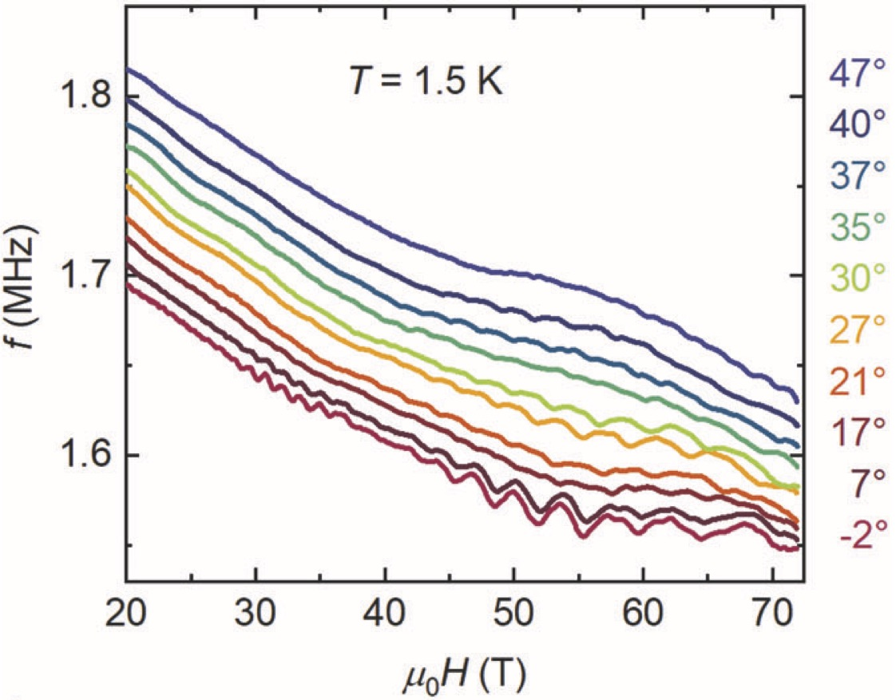
Using 75T pulsed magnetic fields to detect Chern pockets with large orbital moments in CsV₃Sb₅
Kuan-Wen Chen¹, Guoxin Zheng¹, Dechen Zhang¹, Aaron Chan¹, Yuan Zhu¹, Kaila Jenkins¹, Fanghang Yu², Mengzhu Shi², Jianjun Ying², Ziji Xiang^{1,2,} Xianhui Chen², Ziqiang Wang³, John Singleton⁴ & Lu Li¹
¹Department of Physics, University of Michigan, ²CAS Key Laboratory of Strongly-coupled Quantum Matter Physics,
³Department of Physics, Boston College, ⁴National High Magnetic Field Laboratory at Los Alamos National Laboratory
Funding Grants: G.S. Boebinger (NSF DMR-2128556); J. Singleton (DOE Science of 100 T); Lu Li (DOE DE-SC0020184; NSF DMR1707620 and 2004288)
What is the finding? A newly discovered metal, CsV₃Sb₅, has been studied in pulsed magnetic fields of up to 75T. The experiment recorded the electrical conductivity of CsV₃Sb₅ via its effect on the frequency f of a proximal oscillator. For each field pulse, a tiny crystal of CsV₃Sb₅ was rotated to different precise angles (Figure; the angles are indicated to the right). Wiggles are seen in the frequency, and their amplitude varies with the crystal’s angle in a distinctive way.
Why is this important? The angular variation of the wiggles is due to the presence of Chern pockets in CsV₃Sb₅. Without any external energy being supplied, Chern pockets generate circulating currents that act like tiny coils, each producing a magnetic field. Chern pockets are a key indicator of a quantum mechanical property known as topology. However, it is almost impossible to detect them, because ones with oppositely circulating currents pair up, cancelling out their magnetic fields. In this work, the problem is overcome by using high fields to generate the characteristic wiggles. This is an important measurement, because topology promises to be invaluable in future electronic devices that will work on completely new quantum principles.
Why did this research need the MagLab? Measuring conductivity in high fields is the most reliable way of detecting consequences of topology such as the wiggles seen here. Characterizing the wiggles needs a precise knowledge of the crystal’s angle in the field, which required a special 3D printed rotator only available at the MagLab. At larger angles, the wiggles are pushed to higher fields, and so many magnet pulses up to 75T are essential to do a complete characterization.
Facilities and instrumentation used: 65T and 75T pulsed magnets, proximity-detector oscillator, and 3D printed rotator at the NHMFL Pulsed-Field Facility, Los Alamos.
Citation: Chen, K.; Zheng, G.; Zhang, D.; Chan, A.; Zhu, Y.; Jenkins, K.; Yu, F.; Shi, M.; Ying, J.; Xiang, Z.; Chen, X.; Wang, Z.; Singleton, J.; Li, L., Magnetic breakdown and spin-zero effect in quantum oscillations in kagome metal CsV3Sb5, Communications Materials, 4, 96 (2023) doi.org/10.1038/s43246-023-00422-y

