Slide 1
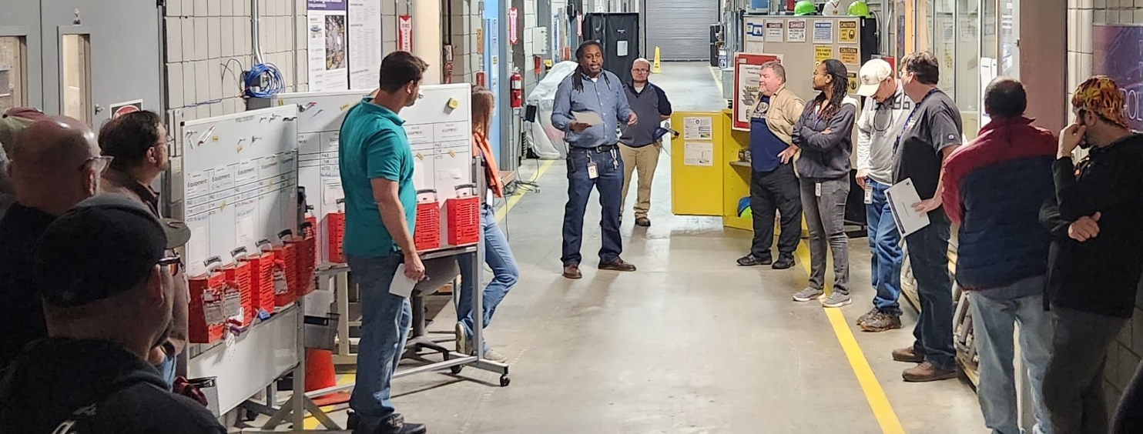
Behavior-Based Safety Toolbox
MagLab Safety Department
National High Magnetic Field Laboratory
Funding Grants: G.S. Boebinger (NSF DMR-2128556)
What is the development? The routine use of daily work briefings and human-behavior-based safety tools have allowed the MagLab to build a stronger and more resilient safety culture.
Why is this important? During the MagLab’s annual Winter shutdown, many complex maintenance projects needed to be performed simultaneously. These projects included many outside contractors who were new to the MagLab and whose work needed to coordinate closely with MagLab workers to safely meet deadlines. It was, thus, especially important for all employees and contractors to have the knowledge, understanding, and encouragement to use of human-behavior-based safety tools.
What is the implementation? Integrated Safety Management (ISM) along with other tools such as the “One Safety Question” (How do I know that I will be safe if I perform this job?) are implemented to ensure that workers know what is protecting them and what are the safe boundaries within which they can perform their work. Human-behavior-based tools include safety toolbox talks that replace acquiescence and silent consent with the insistence that workers demonstrate comfort in speaking up if they feel unsafe or uncertain. Other safety processes include the use of Task Hazard Analyses, Hierarchy of Controls, and a respected and well-exercised Stop Work policy. These tools are discussed and implemented daily to help guide our employees' actions in the safe performance of their tasks.
Safety Empowerment using Human behavior-based Safety tools. By empowering each employee regardless of job title or seniority, the MagLab enjoys a more open atmosphere when discussing safety and concerns. Operations, Maintenance, Safety, and Contractor personnel communicated daily at morning job meetings and worked closely to develop safe work plans to mitigate hazards and ensure that no incidents occurred. Things that went right the previous day and things that could be improved upon were all discussed at these daily meetings.
Facilities: The MagLab’s Facilities, Operations, and the Environmental, Health, and Safety departments.
Notes:
Paragraph 1: Introduction: a sentence or two on the general context of this work, comprehensible by non-experts, that will generate interest and a desire to read more.
Paragraph 2: Experimental description (enough detail to capture the excitement of the result, the nature of the collaboration, the capability of the MagLab facilities that enabled the success). The text should be aimed at other scientists who are not experts in your field. In particular, avoid jargon. Also, spell out (and define) all acronyms.
Paragraph 3: So what? What area of research has been advanced ? What longer term basic research and/or applications might result ?

