Slide 1
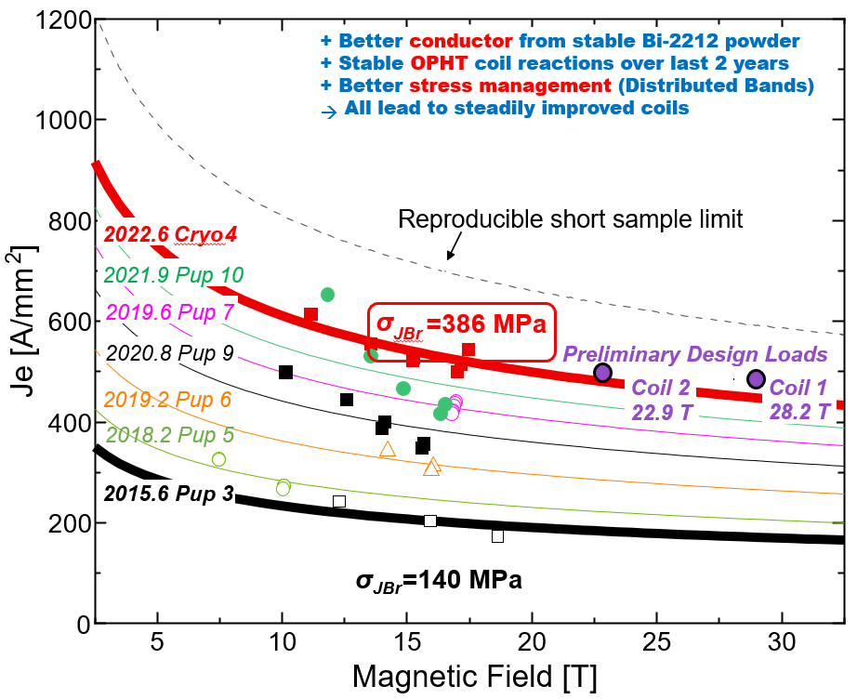
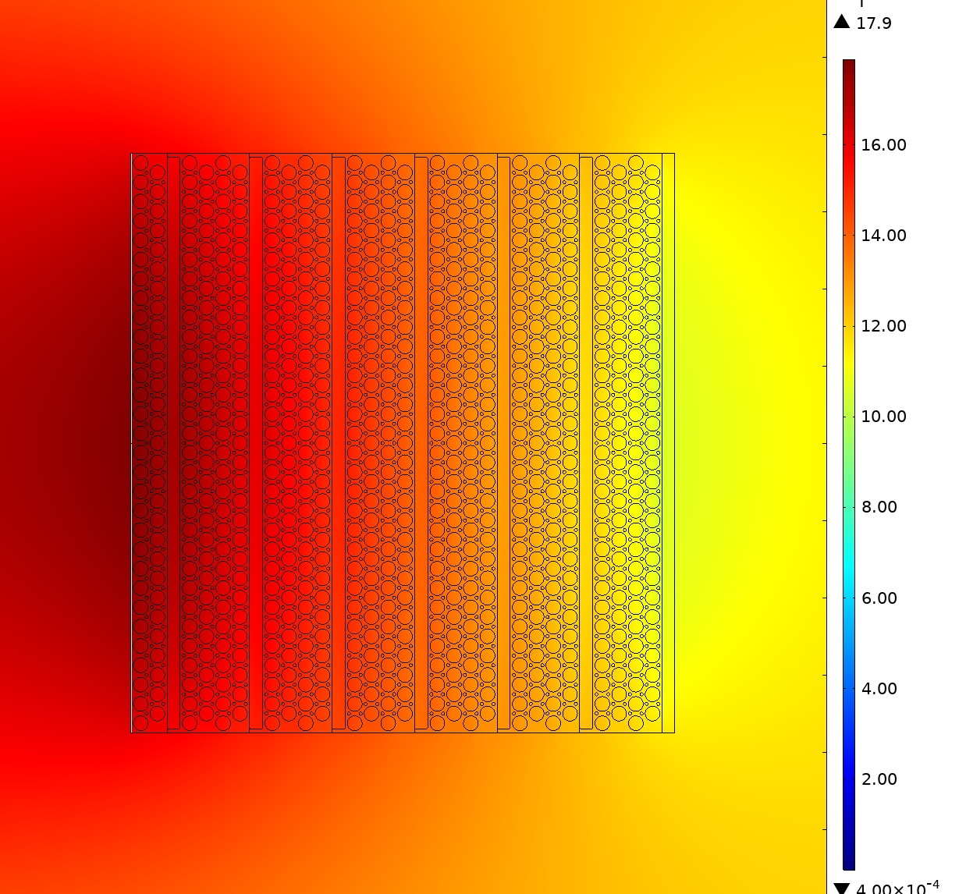
An R&D Milestone for Bi-2212 High Temperature Superconducting Magnets
D.S. Davis^{1,2}, Y. Kim^{1,2}, U.P. Trociewitz^{1,2}, L.D. Cooley^{1,2}, D.C. Larbalestier^{1,2}, S. Minter³
1. Florida State University; 2. Applied Superconductivity Center - MagLab; 3. Cryomagnetics LLC.
Funding Grants: S. Minter, US DOE flow through (PO#35917), D.C. Larbalestier (DE-SC0010421), G.S. Boebinger (NSF DMR-2128556)
There is growing interest in Bi-2212 (Bi₂Sr₂Ca₁Cu₂O_{8+x}) conductor in the R&D community as well as in industry and recently an additional manufacturer has joined the scene making Bi-2212 wire. Bi-2212 is unique among commercial high temperature superconductors (HTS) as it is the only one available in multifilament, round wire, architecture and thus does not suffer from screening current effects. Macroscopically it performs isotropically, i.e. no difference in properties upon changing the orientation of an applied magnetic field. Bi-2212 can be internally twisted to reduce charging losses, just like Nb-Ti and Nb₃Sn. Also, Bi-2212 can be cabled easily and it is regularly produced on length scales exceeding a kilometer with reproducible performance over long lengths.
High field HTS magnets require reinforcement to operate reliably under high loads. To evaluate a specific reinforcement scheme laid out by numerical modeling, a thick 26 layer, 30 turn coil was made with 200m of 1mm diameter Bi-2212 wire (coil ID = 44.6mm, OD = 115, h = 40.3mm). The coil was tested in a background of 12T from a 160mm large bore superconducting magnet.
At a quench current density J_{e} of 573A/mm², a combined peak field of 17.9T was reached, and the coil withstood a source stress of 386MPa, which is about twice the breaking stress of unreinforced Bi-2212 wire. This performance is a significant improvement over coils made previously. The coil operated stably at 70% of short sample transport and in low cycle fatigue testing (25 cycles). During quenching, a matrix current density in the Ag sheath of the conductor of 726A/mm² was maintained without coil degradation. With this performance, the coil reaches a milestone for the MagLab’s collaboration with Cryomagnetics LLC. It also represents significant progress toward the design requirements of a planned 28T NMR magnet as it approaches the expected stress level of ~400MPa in that magnet.
(a)
Figure: (a) A coil made with Bi-2212 strand after heat-treatment. (b) Schematic cross section and field map of the Bi-2212 coil. The arrows point to the locations of the reinforcement layers embedded in the coil. (c) The improvement of Bi-2212 current density, Je(B), over time. Almost three times the source stress could be mitigated in the most recent coil “Cryo-4” (red line) compared with the initial “Pup-3” test coil (black line at bottom). The preliminary design loads for a planned 28T NMR magnet system (purple) are close to the present-day Cryo-4 performance.
(c)
(b)
Reinforcement Layers
HTS 430 A (12 T LTS) B_{peak} = 17.9 T
Facilities and instrumentation used: Applied Superconductivity Center’s 14T, 160mm large bore superconducting magnet, ASC high-speed data acquisition system.
Citation: E. Bosque, Y. Kim, U.P. Trociewitz, C.L. English, D.C. Larbalestier, System and Method to Manage High Stresses in Bi-2212 Wire Wound Compact Superconducting Magnets, U.S. non-provisional patent application, FSU Ref. no. 18-063, 2019.

Slide 2
An R&D Milestone for Bi-2212 High Temperature Superconducting Magnets
D.S. Davis^{1,2}, Y. Kim^{1,2}, U.P. Trociewitz^{1,2}, L.D. Cooley^{1,2}, D.C. Larbalestier^{1,2}, S. Minter³
1. Florida State University; 2. Applied Superconductivity Center - MagLab; 3. Cryomagnetics LLC.
Funding Grants: S. Minter, US DOE flow through (PO#35917), D.C. Larbalestier (DE-SC0010421), G.S. Boebinger (NSF DMR-2128556)
What is the finding? A 17.9T total magnetic field was achieved in an all super-conducting magnet that contained a large coil of Bi-2212 (Bi₂Sr₂Ca₁Cu₂O_{8+x}), a high temperature superconductor (HTS) with promising commercial applications. The Bi-2212 coil generated 5.9T in a 12T background field.
Why is this important? Bi-2212 is unique among commercial HTS conductors as it is the only one available in multifilament, round wire, architecture. Its behavior is similar to Nb-Ti and Nb₃Sn, the two superconductors that are common in low to mid-field commercial magnet systems. Bi-2212 can be cabled easily, and high-performance wire is regularly produced at lengths exceeding 1km. High field HTS magnets require mechanical reinforcement to operate reliably under high loads. To evaluate a specific reinforcement scheme laid out by numerical modeling, a coil was wound with that reinforcement and operated at high fields.
The coil withstood about twice the breaking stress of unreinforced Bi-2212 wire. This coil’s performance is a significant improvement and represents a milestone for the MagLab’s collaboration with Cryomagnetics LLC. It furthermore approaches the expected mechanical stress level in a proposed next generation 28T NMR magnet magnet without significant degradation.
Why did this research need the MagLab? The ASC, which joined the MagLab in 2006, plays a central role in the development of superconducting technology. The ASC owns and operates a 14T, 160mm large bore all superconducting magnet. This system has a very flexible layout, and besides producing high background field, it can be used for magnet tests requiring currents ranging from several hundreds of Amperes to 10kA. It is ideal for testing out the next generation of high field magnets and their technologies. In addition, the ASC is currently the only place to operate high-pressure furnaces that are required for the necessary heat-treatment of large Bi-2212 coils.
Figure: (a) A coil made with Bi-2212 strand after heat-treatment. (b) Schematic cross section and field map of the Bi-2212 coil. The arrows point to the locations of the reinforcement layers embedded in the coil. (c) The improvement of Bi-2212 current density, Je(B), over time. Almost three times the source stress could be mitigated in the most recent coil “Cryo-4” (red line) compared with the initial “Pup-3” test coil (black line at bottom). The preliminary design loads for a planned 28T NMR magnet system (purple) are close to the present-day Cryo-4 performance.
(a)
(c)
(b)
Reinforcement Layers
HTS 430 A (12 T LTS) B_{peak} = 17.9 T
Facilities and instrumentation used: Applied Superconductivity Center’s 14T, 160mm large bore superconducting magnet, ASC high-speed data acquisition system.
Citation: E. Bosque, Y. Kim, U.P. Trociewitz, C.L. English, D.C. Larbalestier, System and Method to Manage High Stresses in Bi-2212 Wire Wound Compact Superconducting Magnets, U.S. non-provisional patent application, FSU Ref. no. 18-063, 2019.

