Slide 1
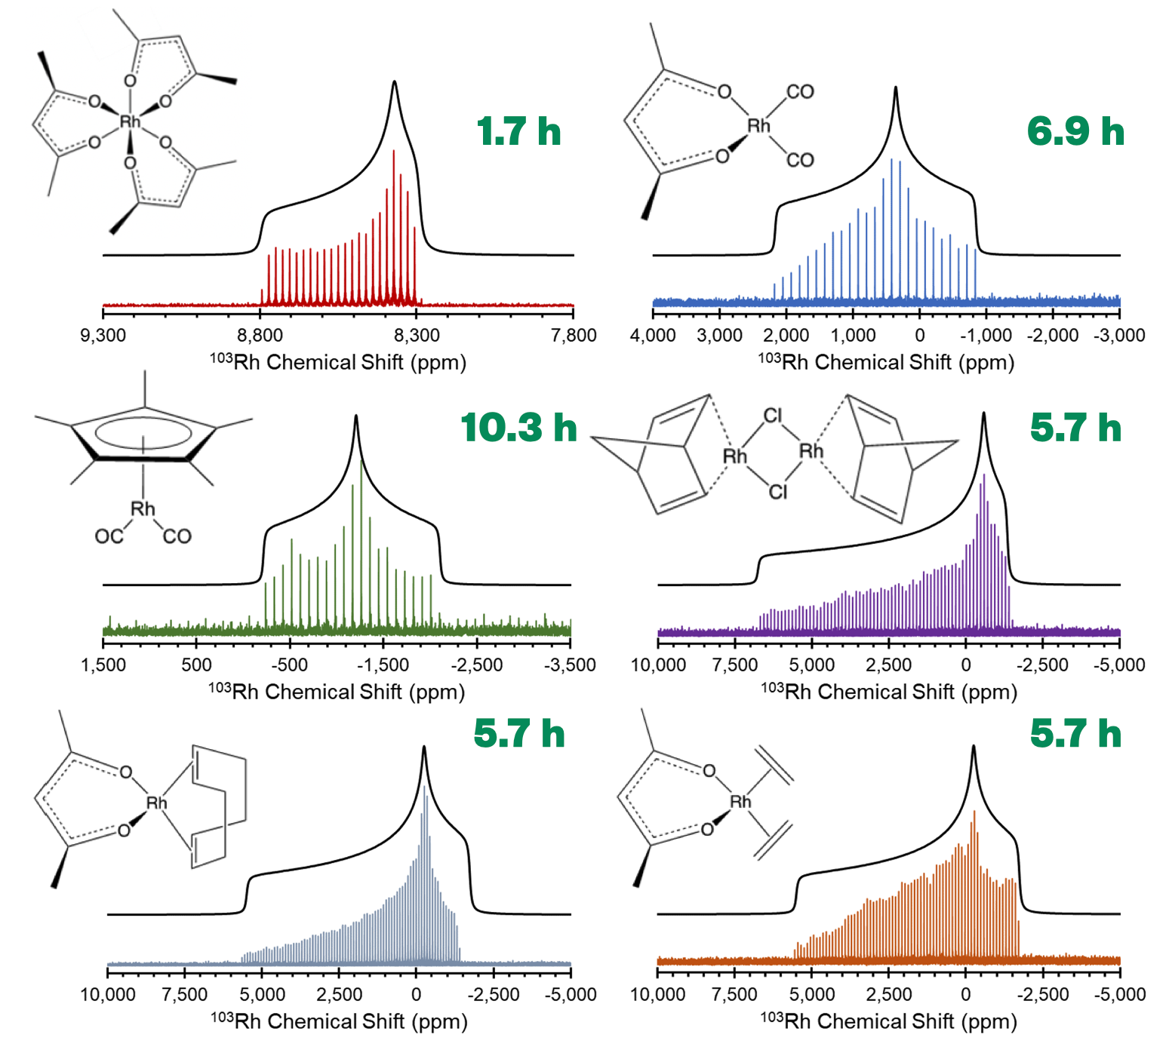
Unraveling the Mysteries of the Platinum Group Elements with ¹⁰³Rh Solid-State NMR Spectroscopy
Sean T. Holmes,^{1,2} Jasmin Schönzart,^{1,2} Adam B. Philips,³ James J. Kimball,^{1,2} Sara Termos,^{1,2} Adam R. Altenhof,^{1,2} Yijue Xu,² Christopher A. O'Keefe,⁴ Jochen Autschbach,^{3,*} and Robert W. Schurko^{1,2,*}
Florida State University; 2. National High Magnetic Field Laboratory; 3. University at Buffalo; 4. University of Windsor
Funding Grants: G.S. Boebinger (NSF DMR-1644779, NSF DMR-2128556); R.W. Schurko, J. Autschbach (DE-SC0022310); R.W. Schurko (NIH RM1 GM148766)
Rhodium, a member of the platinum group elements (PGEs), is one of the most costly and scarce elements; however, it is of great importance in numerous applications such as catalytic converters, fiberoptic cables, electronics, and medical devices. As such, there is ongoing research into finding replacement metals for Rh and other PGEs. It is hypothesized that the unique properties of inorganic and organometallic coordination compounds featuring PGEs arise from unique dative bonding (i.e., covalent bonding by donation of electrons from coordinating ligands).
¹⁰³Rh solid-state NMR (ssNMR) and density functional theory (DFT) calculations provide pathways to understanding the nature of dative bonding; however, both are wrought with challenges. ¹⁰³Rh, a spin-1/2 nucleus, is among the most unreceptive nuclides in the Periodic Table, largely due to its low gyromagnetic ratio and broad powder patterns. Furthermore, DFT calculations of ¹⁰³Rh chemical shifts require careful consideration of relativistic effects and exchange-correlation functionals.
In this work, MagLab users present the first ¹⁰³Rh ssNMR study of a series of inorganic and organometallic compounds. ¹⁰³Rh ssNMR spectra are obtained using ultra-wide line pulse sequences (i.e., ¹H-¹⁰³Rh broadband adiabatic inversion cross-polarization, BRAIN-CP) and high-field NMR platforms at the MagLab, which feature the 36T Series Connected Hybrid and 21.1T ultra-wide bore magnets, operating at ν₀(¹H) = 1.5GHz and 900MHz, respectively (ν₀(¹⁰³Rh) = 47.5 and 28.7MHz).
The ¹⁰³Rh ssNMR spectra provide unique spectral fingerprints for each complex, from which chemical shift tensors can be extracted, and compared to those obtained from DFT calculations. Then, with the aid of natural bond orbital (NBO) and natural localized molecular orbital (NLMO) analyses, users can gain insight into the nature of Rh-ligand bonding. Our new experimental and theoretical methods open the doors for the study of other PGEs and will aid in the rational design of new materials.
¹H-¹⁰³Rh{¹H} BRAIN-CP/WURST-CPMG NMR spectra of inorganic and organometallic coordination complexes at 21.1T (ν₀(¹H) = 900MHz; ν₀(¹⁰³Rh) = 28.7MHz). Total experimental times (in hours) are listed in green.
Facilities and instrumentation used: Solid-State NMR facility – 21.1T/900MHz/105mm solid-state NMR instrument; 36T/40mm Series Connected Hybrid Magnet (35.2T/1.5GHz) Citation: Holmes, S.; Schoenzart, J.; Philips, A.B.; Kimball, J.; Termos, S.; Altenhof, A.; Xu, Y.; O'Keefe, C.A.; Autschbach, J.; Schurko, R.W., Structure and bonding in rhodium coordination compounds: a 103Rh solid-state NMR and relativistic DFT study, Chemical Science, In, Press (2023) doi.org/10.1039/d3sc06026h

Slide 2
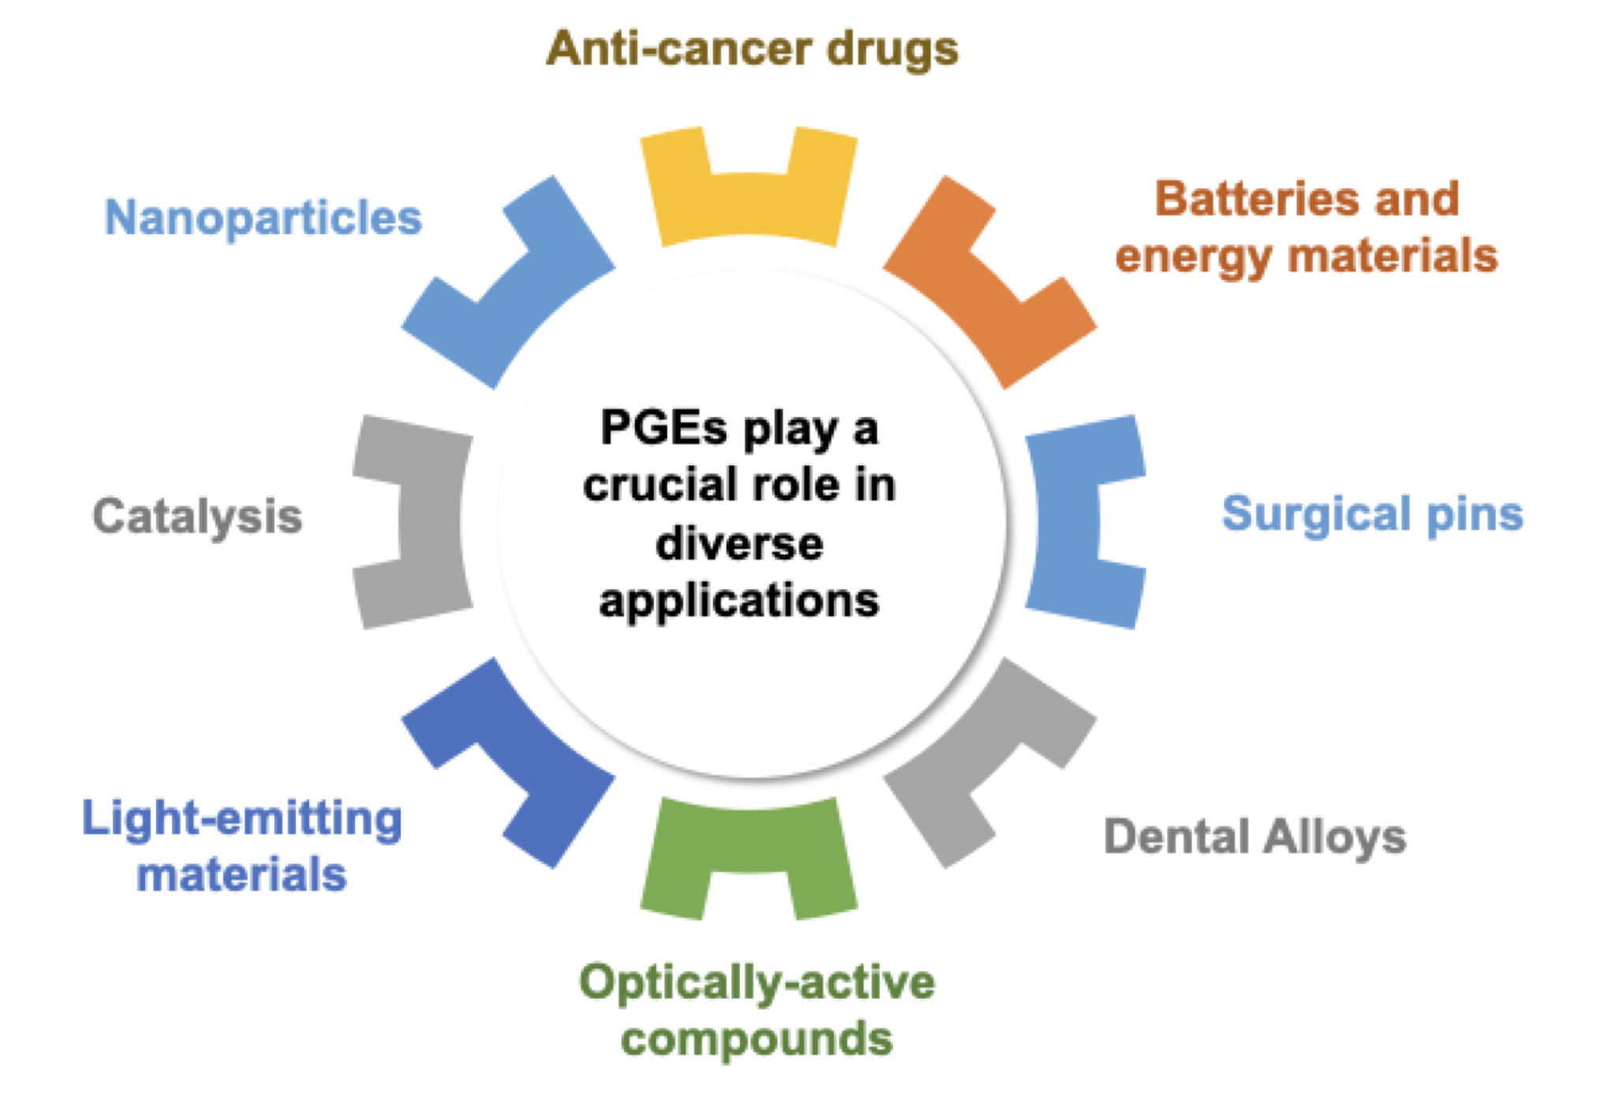
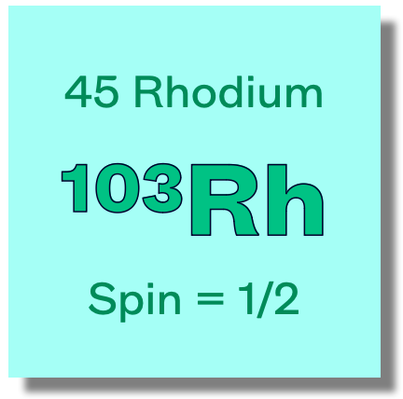
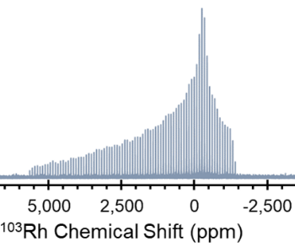
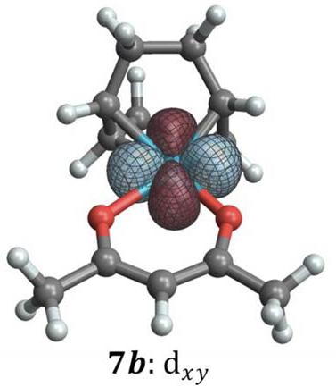
Unraveling the Mysteries of the Platinum Group Elements with ¹⁰³Rh Solid-State NMR Spectroscopy
Sean T. Holmes,^{1,2} Jasmin Schönzart,^{1,2} Adam B. Philips,³ James J. Kimball,^{1,2} Sara Termos,^{1,2} Adam R. Altenhof,^{1,2} Yijue Xu,² Christopher A. O'Keefe,⁴ Jochen Autschbach,^{3,*} and Robert W. Schurko^{1,2,*}
Florida State University; 2. National High Magnetic Field Laboratory; 3. University at Buffalo; 4. University of Windsor
Funding Grants: G.S. Boebinger (NSF DMR-1644779, NSF DMR-2128556); R.W. Schurko, J. Autschbach (DE-SC0022310); R.W. Schurko (NIH RM1 GM148766)
The platinum group elements (PGEs), which include ruthenium, rhodium, palladium, osmium, iridium, and platinum, are scarce and costly, and have problems associated with their use, including limited supply chains and environmental impacts – despite this, they play fundamental roles in materials used for light generation, solar energy capture, energy materials, nanoparticles, medical implants, coatings, and catalysis.
Rhodium (Rh) is used extensively in catalysis, including catalytic converters that decrease emissions from automobiles, and currently stands as the world’s most expensive metal, with demands exceeding fulfillment through recycling and new mining sources. Therefore, it is crucial to identify abundant and cheap alternatives to replace PGEs in technologically relevant materials. To accomplish this, researchers must understand the nature of chemical bonds in Rh compounds, which may lead to new strategies for replacing PGEs and designing new, advanced materials.
What is the finding? MagLab users have designed new techniques to acquire ¹⁰³Rh solid-state NMR (ssNMR) spectra of a wide array of Rh containing materials to study their molecular structures – a feat previously thought to be nearly impossible.
Why is this important? ¹⁰³Rh is very insensitive to NMR experiments, making ¹⁰³Rh ssNMR spectra difficult to acquire. However, with new methods, MagLab users can now reliably acquire such spectra, which in combination with quantum mechanical calculations, give deep insights into molecular structure and chemical bonding, and provide unique spectral fingerprints for each Rh-containing material.
Why did this research need the MagLab? The high fields of the 21.1T ultra-widebore NMR magnet and 36T Series Connected Hybrid magnets, in concert with our unique experimental probes, yield ¹⁰³Rh NMR signals of unprecedented quality!
Above: The platinum group elements, which are scarce and costly, play important roles in many different materials and applications.
At right: ¹⁰³Rh solid-state NMR spectra and quantum chemical computations offer insights into the molecular structure and chemical bonding in Rhodium-containing materials.
Density Functional Theory Calculations
Image Credit: Rob Schurko, NHMFL
Facilities and instrumentation used: Solid-State NMR facility – 21.1T/900MHz/105mm solid-state NMR instrument; 36T/40mm Series Connected Hybrid Magnet (35.2T/1.5GHz) Citation: Holmes, S.; Schoenzart, J.; Philips, A.B.; Kimball, J.; Termos, S.; Altenhof, A.; Xu, Y.; O'Keefe, C.A.; Autschbach, J.; Schurko, R.W., Structure and bonding in rhodium coordination compounds: a 103Rh solid-state NMR and relativistic DFT study, Chemical Science, In, Press (2023) doi.org/10.1039/d3sc06026h

