Slide 1
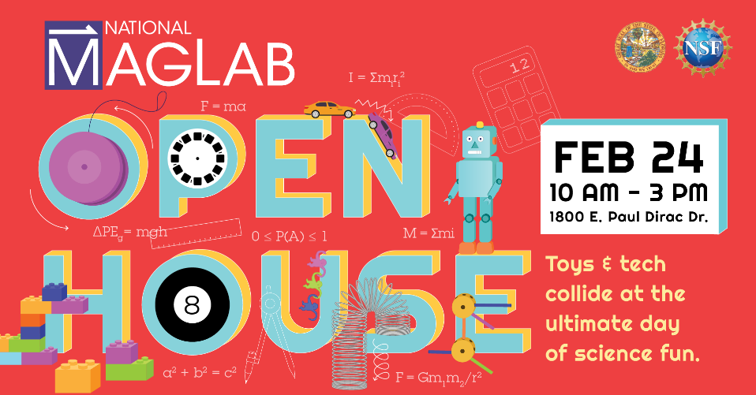
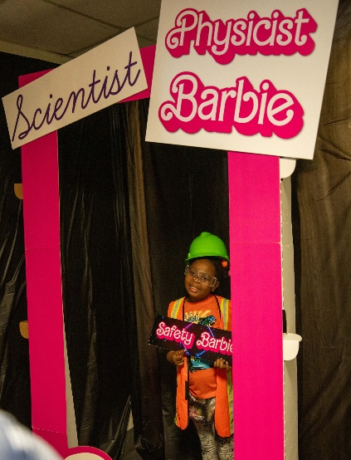
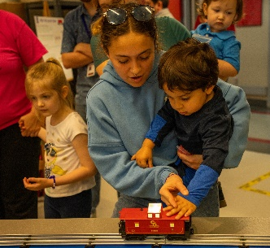
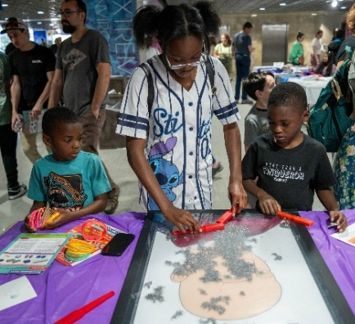
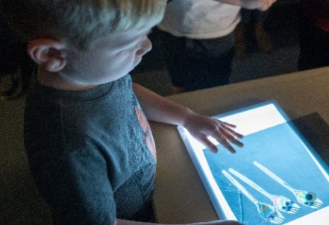
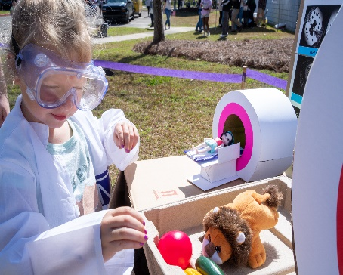
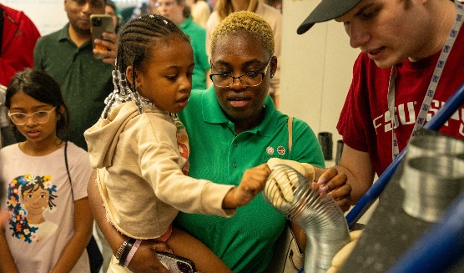
Thousands Play at the MagLab’s 2024 Annual Open House
National High Magnetic Field Laboratory, Florida State University
Funding Grants: G.S. Boebinger (NSF DMR-2128556)
What is the event? More than 8,500 visitors came from across the southeastern United States to play with the nearly 100 hands-on activities as we turned the lab into a Science ToyLand for Open House 2024! In addition to classic MagLab activities like the popular Quarter Shrinker, Potato Launcher, Human Levitator, and Cryogenic Ice Cream, the 2024 event invited visitors of all ages to come channel their inner child and explore the science of toys and the creative fun that comes from play. Special experiences included:
A giant PlayLab that offered pretend play spaces inspired by MagLab labs that give kids the chance to put on their lab coats and play the role of a researcher.
A classic Lite Brite that was used to explain the science of light.
Giant “Wooly Willie” magnetic toys - Fuzzy Faraday, Tousled Tesla & Coifed Conwell
An hourly experiment to see if the Junkyard Magnet could squish a squishmallow toy.
Barbie was the basis for learning about chemistry and painting with pink pigments (plus dressing up like a favorite Scientist Barbie, complete with posing in a Barbie Box!)
Visitors learned the physics of spinning tops and yo-yos, made Silly Putty, constructed Play Doh electrical circuits, watched cryogen-powered "Cold" Wheels cars, and looked through a working Lego microscope.
A special Lego-themed scavenger hunt took visitors around the MagLab to locate Lego pieces around the lab in order to complete a mystery MagLab-related build.
Why is it important? Events like the MagLab Open House provide an important pathway for people of all ages to connect with the MagLab by meeting our researchers, seeing our unique lab spaces, and enjoying the fun of hands-on science. Events excite and inspire young visitors and remind adults that science is important and worthy of continued support. The 2024 Open House visitor survey shows that about half of our Open House visitors had never been to the MagLab previously and that 90% agreed or strongly agreed that the event helped them better understand the science at the MagLab and how it benefits our community.
Why did this need the MagLab? The Open House is a one-of-a-kind annual event that brings the energy and fun of a science festival and places it inside a world-unique research laboratory. This combination of science festival and research laboratory succeeds each year through the enthusiastic participation of about 150 MagLab scientists, students and staff.
Facilities: The Open House features every FSU-based MagLab Facility and is run by the lab’s Public Affairs Team with immense support from the MagLab Facilities and Safety Groups

