Slide 1
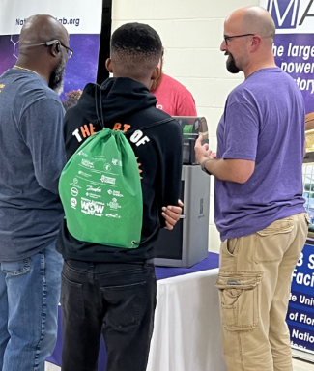
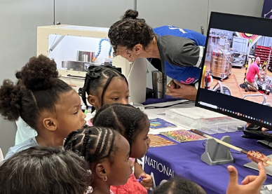
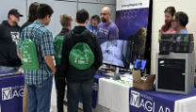
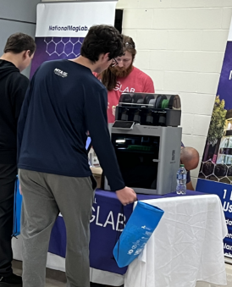
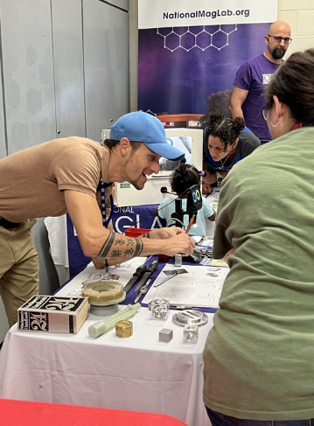
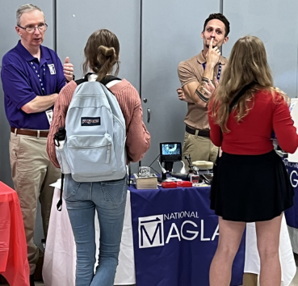
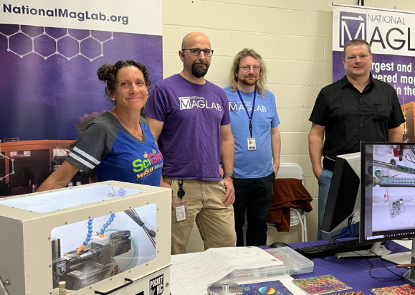
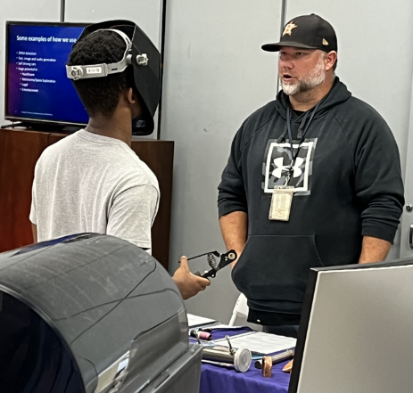
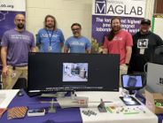
MagLab’s Center for Integrating Research & Learning (CIRL):
2023 North Florida Worlds of Work (WOW) Career Expo
K. W. Johnson¹
National High Magnetic Field Laboratory
Funding Grant: G.S. Boebinger (NSF DMR-2128556)
What is this event? One of the MagLab’s goals is to broaden participation in STEM. To showcase the many career paths in MagLab related STEM fields, Kawana Johnson organized a MagLab table to participate in the inaugural North Florida Worlds of Work (WOW) Career Expo, October 20-21, 2023 – the first Worlds of Work event in the State of Florida.¹ Over 3,000 ninth-grade students, 100 employers, teachers, and parents from the North Florida area converged on the campuses of Tallahassee Community College and Lively Technical College for this inaugural event! The purpose of WOW was to create awareness of the many high demand, high wage job opportunities that exist in North Florida early enough in high school such that students can plan their education pathway and graduate with a plan in place that puts them well on their way to college or career.
Why is this important? According to the National Science Board, there are millions of men and women who comprise the Skilled Technical Workforce. These are STEM careers that do not require a bachelor’s degree. ² This segment of the STEM workforce is a crucial, but often underappreciated part of the science and engineering enterprise. They are vital to our economic prosperity, our scientific and technological competitiveness, and our national security. Indeed, the Skilled Technical Workforce consists of more than 17 million workers who use science and engineering expertise and technical knowledge in their jobs.
Why did this program need the MagLab? Many students may be unaware of the diverse career opportunities available at the MagLab and the pathways to pursue them. Through this activity, the MagLab was able to provide students with exposure to various career options within a national laboratory setting while also showcasing some of our talented scientists, engineers, technicians, and machinists. This awareness helps students make informed decisions about their educational and career paths, improving retention and graduation rates.
Event Location: Tallahassee Community College & Lively Technical College
1 - https://www.northfloridaworldsofwork.com/
2 - https://ncses.nsf.gov/pubs/nsb20198/the-skilled-technical-workforce

