Slide 1
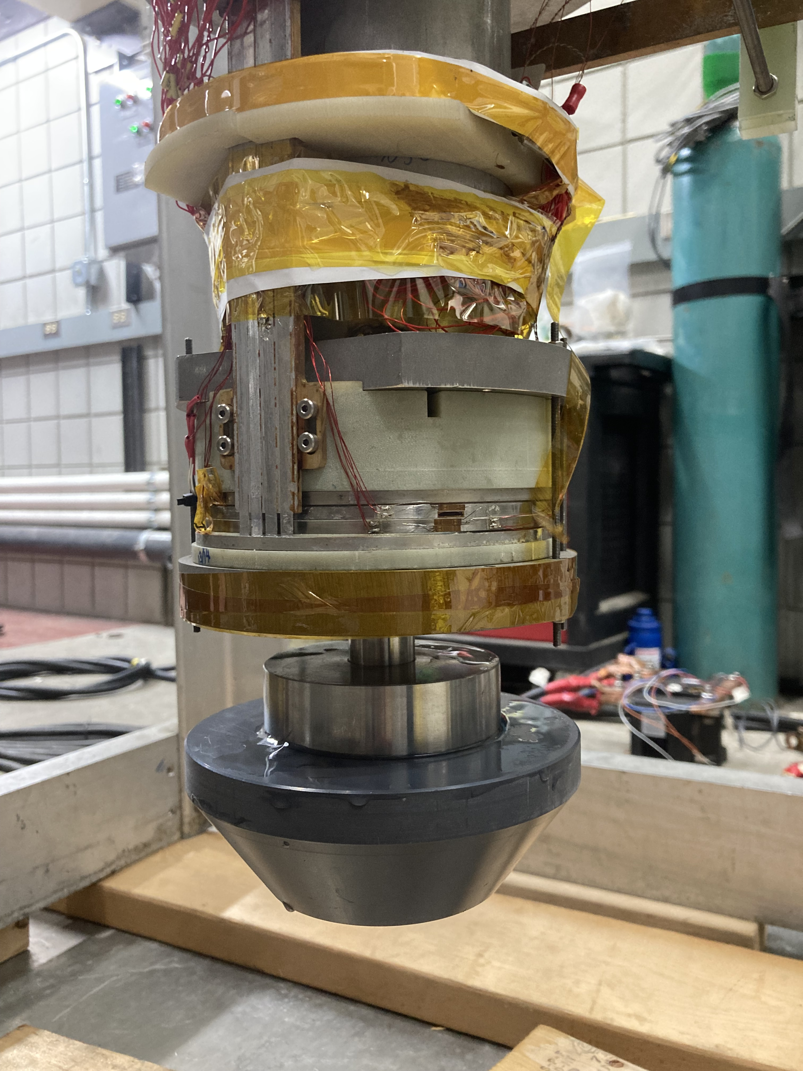
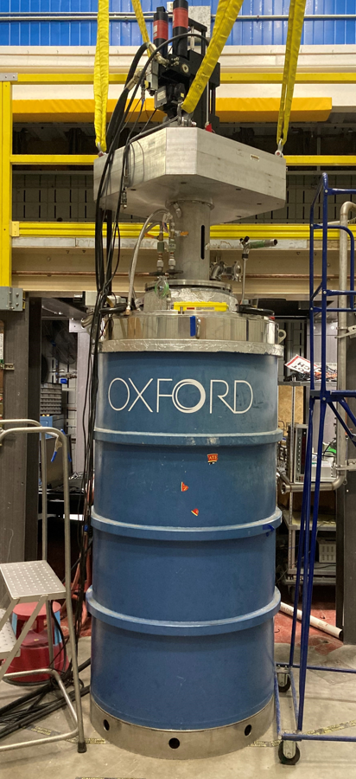
Simulating High-Magnetic-Field and High-Stress Conditions of Superconducting REBCO Coils
Iain Dixon¹, Todd Adkins¹, Yu Suetomi¹, Kwangmin Kim¹, Hongyu Bai¹
National High Magnetic Field Laboratory
Funding Grants: G.S. Boebinger (NSF DMR-2128556, DMR-1644779, DMR-1938789, DMR-2131790 )
Exploring the limits of material properties in high-temperature superconducting tapes is crucial for designing next-generation high-field magnet systems. This research delves into the challenges posed by the combined severe field and force conditions on REBCO (Rare Earth Barium Copper Oxide) tapes that will be experienced in the 40-tesla all-superconducting magnet. REBCO tapes experience large screening currents that tilt the coil tapes. This tilt weakens the tapes against axial forces, the limits of which must be verified.
The experimental approach, conducted at the National High Magnetic Field Laboratory (MagLab), measured the performance of a superconducting REBCO test coil in combined extreme magnetic field and force conditions experienced in a high-field magnet. By leveraging the unique facilities and expertise at the MagLab, the engineers developed a specialized test setup within an existing 12T superconducting magnet to subject test coils to cyclic compressive loads and high radial magnetic fields, simulating the worst-case conditions encountered by these REBCO tapes.
Two significant findings emerged: first, coils can withstand cyclic pressures of up to 80MPa while experiencing tape tilting deformations of up to a 10° angle, and second, coils subjected to hoop compression beyond strains of -0.4% can buckle. These findings not only advance the understanding of REBCO tape material limits but also have broader understanding of their use in the next-generation high-field magnets. By testing the boundaries of technology in this area, these tests pave the way for developing more efficient and powerful superconducting magnets with applications ranging from medical imaging to energy storage, fusion, and beyond.
Figure 1 (top): REBCO test coil (red arrow) attached to the load frame that is inserted to test facility at right.
Figure 2 (right): The MagLab’s unique facility simulates combined high-magnetic-field and high-stress conditions.
Facilities and instrumentation used: Magnet Science & Technology group, 12 T Oxford split magnet.
Citation: Dixon, I.R.; Bosque, E.; Buchholz, K.; Walsh, R.P.; Bai, H., REBCO Coils With Variable Co-Wind Dimensions Under Static and Cyclic Axial Pressure Loads at 77 K,
IEEE Transactions on Applied Superconductivity, 32 (6), 4 (2022) doi.org/10.1109/TASC.2022.3163084

Slide 2
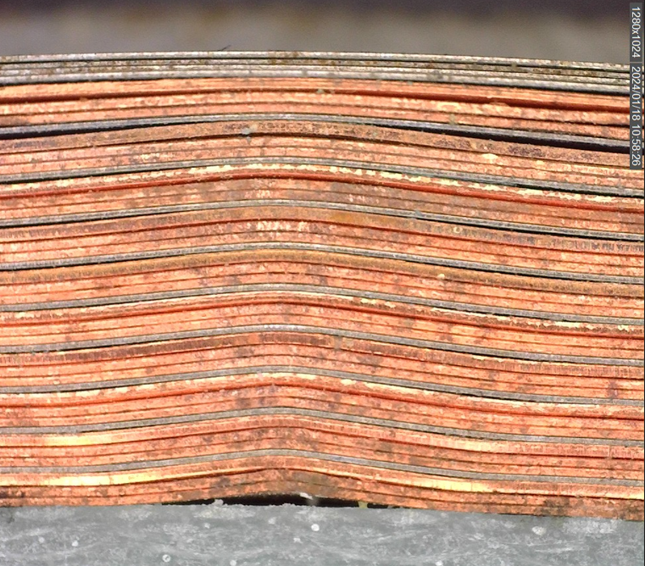
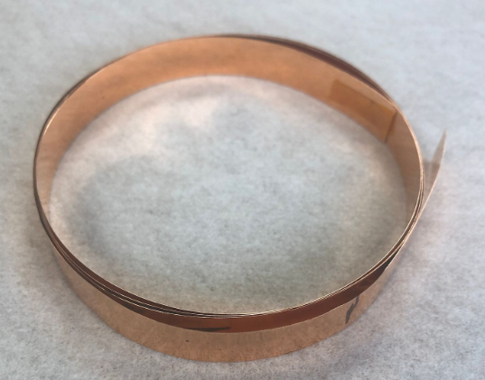
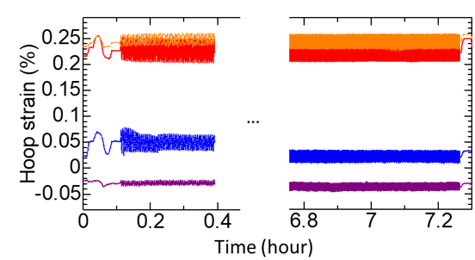
Simulating High-Magnetic-Field and High-Stress Conditions of Superconducting REBCO Coils
Iain Dixon¹, Todd Adkins¹, Yu Suetomi¹, Kwangmin Kim¹, Hongyu Bai¹
National High Magnetic Field Laboratory
Funding Grants: G.S. Boebinger (NSF DMR-2128556, DMR-1644779, DMR-1938789, DMR-2131790 )
What is the finding? Coils made with (Rare Earth Barium Copper Oxide) REBCO high-temperature superconductor have been tested under combined loads of cyclic axial pressure and electro-magnetic loads. The results of the tests show that coils can survive cyclic pressure of 80MPa with tapes deformed up to an angle of 10°. Additionally, it has been determined that coils in hoop compression with strains beyond -0.4% can buckle.
Why is this important? These data are provided to magnet engineers so they can complete the design of the 40T all-superconducting magnet with confidence. REBCO high-temperature superconducting tapes are very thin, approximately the thickness of a human hair, and about a quarter to half inch wide. These tapes are then wound into a coil much like a roll of ribbon - or a roll of tape - to be stacked and interconnected to form each of the stacks of coils that are nested together in the next-generation 40T magnet. It is in this stack of coils that extreme magnetic forces press against the thin side of the tapes when the magnet is energized. It is of utmost importance to know the limits of this tape under these magnetic loads to verify that the design forces predicted in the 40T magnet can be supported over the lifetime of the magnet. Finding the point at which the tapes will buckle will also be used to ensure these limits are not exceeded in the final design.
Why did this research need the MagLab? The MagLab has a unique test facility that has been used over the past 30 years to characterize the current carrying capacity of Nb₃Sn cabled conductors at different applied magnetic fields and tensile strains. The Oxford 12T split magnet with its hydraulic 250kN actuator was modified to also place coils into compression. This MagLab test facility is the only test facility in the world that can expose coils to extreme conditions of both axial pressure and circumferential/hoop strains.
Figure 1: Coil buckling at -0.4% strain
Figure 2: A short length of the 0.1 mm thick REBCO tape that is used to wind a coil.
Figure 3: Measured hoop strain showed negligible degradation over 20,000 cycles.
Facilities and instrumentation used: Magnet Science & Technology group, 12 T Oxford split magnet.
Citation: Dixon, I.R.; Bosque, E.; Buchholz, K.; Walsh, R.P.; Bai, H., REBCO Coils With Variable Co-Wind Dimensions Under Static and Cyclic Axial Pressure Loads at 77 K,
IEEE Transactions on Applied Superconductivity, 32 (6), 4 (2022) doi.org/10.1109/TASC.2022.3163084

