Slide 1
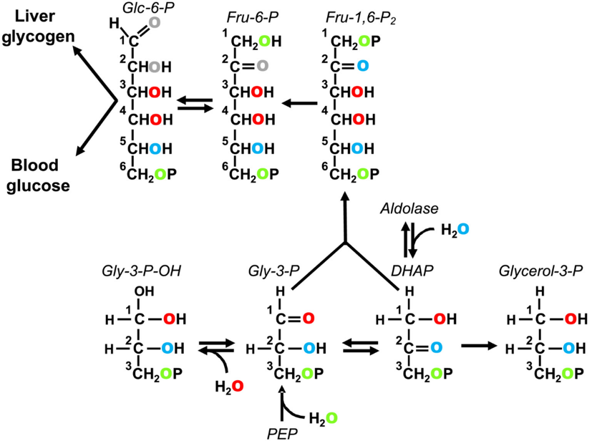
Enrichment of hepatic glycogen and plasma glucose from H₂¹⁸O informs gluconeogenic and indirect pathway fluxes in naturally feeding mice
Margarida Coelho¹, Rohit Mahar¹, Getachew D. Belew¹, Alejandra Torres¹, Cristina Barosa¹, et al.
University of Coimbra; 2. University of Florida
Funding Grants: G.S. Boebinger (NSF DMR-1644779); M. Merritt (NIH DK105346 and DK132254); M. Coelho (ESF PD/BD/135178/2017)
Deuterated water (²H₂O) is a widely used tracer of carbohydrate biosynthesis in both basic science and clinical research, but the significant kinetic isotope effects (KIE) of ²H can distort metabolic information and mediate toxicity. ¹⁸O-water (H₂¹⁸O) has no significant kinetic isotope effects and is incorporated into specific carbohydrate oxygens via well-defined mechanisms, but to date, it has not been evaluated in any animal model.
Here, mice were given H₂¹⁸O during overnight feeding, and ¹⁸O-enrichments of liver glycogen, triglyceride glycerol (TG), and blood glucose were quantified using ¹³C NMR spectroscopy. The ¹⁸O isotope causes a small shift in the ¹³C signal, compared to ¹⁶O, allowing fractional enrichments to be measured at levels of 1-2%. A very high signal to noise ratio is required to detect the small amount of shifted ¹³C signals and requires the use of a highly sensitive cryoprobe at 800 MHz to be feasible. Enrichment of oxygens 5 and 6 relative to body water informed indirect pathway contributions from the Krebs cycle and triose phosphate sources (shown in the figure to the right). Compared with mice fed normal chow, mice whose diet was supplemented with a fructose/glucose mix had significantly higher indirect pathway contributions from triose phosphate sources, consistent with fructose glycogenesis. Blood glucose and liver triglyceride glycerol ¹⁸O-enrichments were quantified by mass spectrometry. Blood glucose ¹⁸O-enrichment was significantly higher for high sugar versus control mice and was consistent with gluconeogenic fructose metabolism. Triglyceride glycerol ¹⁸O-enrichment was extensive for both Control and High sugar mice, indicating a high turnover of liver triglyceride, independent of diet. Thus, H₂¹⁸O informs hepatic carbohydrate biosynthesis in similar detail to ²H₂O but without kinetic isotope-associated risks that can skew data. This basic research may lead to more accurate analyses of metabolic pathways in the future.
Figure 1. Incorpor-ation of ¹⁸O from water into carbo-hydrate precursor metabolites at the level of phosphoe-nolpyruvate (PEP) and triose phos-phates. Exchange of dihydroxyace-tone phosphate (DHAP) with aldo-lase results in the incorporation of ¹⁸O into position 2 (blue). The rever-sible hydration of Gly-3-P to form an acetal (Gly-3-P-OH) results in the incorporation of ¹⁸O into position 1 of Gly-3-P (red).
Addition of water to PEP via enolase incorporates ¹⁸O into position 3 of Gly-3-P (green). Triose phosphate isomerase exchange and aldolase generate Fru-1,6-P₂ enriched in positions 1 and 6. The position 2 oxygen of fructose-6-phosphate (Fru-6-P) can undergo additional exchange with water via anomerization (shown in gray). Likewise, the position 1 oxygen of both glucose-6-phos-phate (Glc-6-P) and glucose can be exchanged with water via anomerization (also shown in gray)
Facilities and instrumentation used: AMRIS, Bruker Avance III 800MHz.
Citation: Coelho, M.; Mahar, R.; Belew, G.; Torres, A.; Barosa, C.; Cabral, F.; Viegas, I.; Gastaldelli, A.; Mendes, V.; Manadas, B.; Jones, J.G.; Merritt, M.E., Enrichment of hepatic glycogen and plasma glucose from H₂18O informs gluconeogenic and indirect pathway fluxes in naturally feeding mice, NMR in Biomedicine, epub, e4837 (2022) doi.org/10.1002/nbm.4837 - Data Set
Notes:
How to compress files size:
On PowerPoint, you can save the attached image (Right click on an image -> Select “Save as picture” -> Then you save the image as PNG). PNG is the image compression without losing the image quality. You replace the original image with the PNG one on PowerPoint. This should reduce the PowerPoint file size.
One thing to be careful about is that you should enlarge your image a bit on PowerPoint before saving so is to avoid losing much resolution.

Slide 2
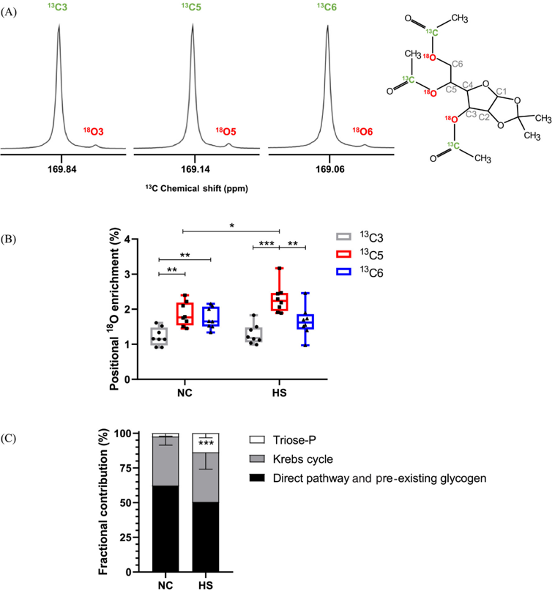
First use of ¹⁸O-water to study metabolic pathways in animals
Margarida Coelho¹, Rohit Mahar¹, Getachew D. Belew¹, Alejandra Torres¹, Cristina Barosa¹, et al.
University of Coimbra; 2. University of Florida
Funding Grants: G.S. Boebinger (NSF DMR-1644779); M. Merritt (NIH DK105346 and DK132254); M. Coelho (ESF PD/BD/135178/2017)
What is the finding? Deuterated water (²H₂O), which is composed of heavier hydrogen isotopes than ordinary water, is often used to ‘label’ glucose molecules for studying metabolic function of the liver. However, deuterated water causes some chemical reactions to occur at different rates than normal water, which can distort data gathered in this way. ¹⁸O-water (H₂¹⁸O) uses a heavier oxygen isotope instead and does not affect chemical reactions in the same way. Here, researchers demonstrated that ¹⁸O-water can be used to examine metabolic functions in much the same way as deuterated water, but without interfering with chemical reactions or resulting in distorted data
Why is this important? Beyond altering metabolic readings, deuterated water is toxic and can harm an organism. If ¹⁸O-water can replace deuterated water for this kind of screening, the process would become both more accurate and safer. This study marks the first time ¹⁸O-water has been used to assess metabolic pathways in animal models. While ¹⁸O-water is expensive and requires specialized equipment is to detect labeled molecules, this experiment is an important proof-of-concept that may pave the way for more advanced metabolic assessment techniques in the future.
Why did this research need the MagLab? ¹⁸O-water is not directly detectable by nuclear magnetic resonance (NMR) spectroscopy, however, ¹⁸O atoms do impact how glucose appears on NMR spectroscopy, but only very slightly. A novel chemical process was used here to magnify the effect of the ¹⁸O by nearly 100x, allowing it to be detected by the highly-sensitive 18.8T cryoprobe using NMR spectroscopy equipment provided by the MagLab.
Figure 2:
(A) illustrates how the ¹⁸O atom affects the glucose signal as read by ¹³C NMR spectroscopy.
(B) shows that the ¹⁸O labeling technique was able to differentiate between metabolic products from rats fed normal chow (NC) and those fed a high-sugar diet (HS).
(C) is a bar chart graphing the contribution of three different metabolic pathways towards the metabolic products detected in the two groups of rats.
Facilities and instrumentation used: AMRIS, Bruker Avance III 800MHz.
Citation: Coelho, M.; Mahar, R.; Belew, G.; Torres, A.; Barosa, C.; Cabral, F.; Viegas, I.; Gastaldelli, A.; Mendes, V.; Manadas, B.; Jones, J.G.; Merritt, M.E., Enrichment of hepatic glycogen and plasma glucose from H₂18O informs gluconeogenic and indirect pathway fluxes in naturally feeding mice, NMR in Biomedicine, epub, e4837 (2022) doi.org/10.1002/nbm.4837 - Data Set
Notes:
How to compress files size:
On PowerPoint, you can save the attached image (Right click on an image -> Select “Save as picture” -> Then you save the image as PNG). PNG is the image compression without losing the image quality. You replace the original image with the PNG one on PowerPoint. This should reduce the PowerPoint file size.
One thing to be careful about is that you should enlarge your image a bit on PowerPoint before saving so is to avoid losing much resolution.

