Slide 1
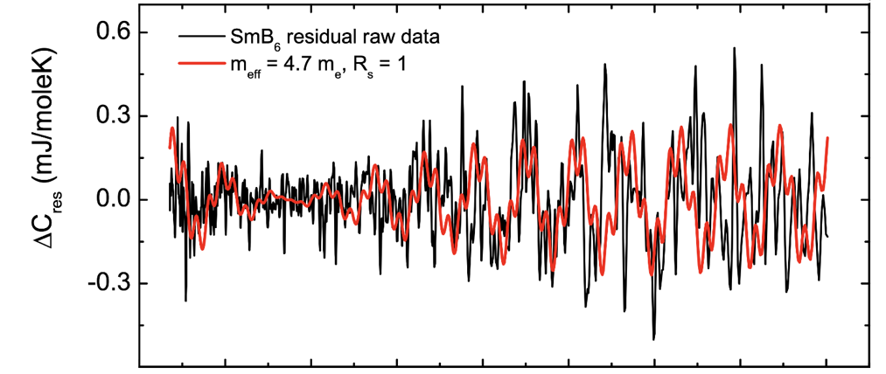
Magneto-Quantum Oscillations in the Specific Heat of a Topological Kondo Insulator
P.G Barre¹, A. Rydh², J. Palmer-Fortune³, S.T. Hannahs⁴, A.P. Ramirez¹, and N.A. Fortune⁴
UCSC; 2. Stockholm Univ.; 3. Smith College; 4. NHMFL
Funding Grants: G.S. Boebinger (NSF DMR-2128556); A.P. Ramirez (DOE DE-SC0017862)
Quantum oscillations have long been observed in metals where the electron orbits on the fermi surface are quantized by the magnetic field. These oscillations have been usually detected by changes in the magnetization as de Haas-van Alphen effect (dHvA) or in the resistance as Shubnikov-de Haas effect (SdH). It is surprising, however, to observe such oscillations which are characteristic of a metal in an insulator such as SmB₆. A debate has arisen in the community as to whether these magneto-quantum oscillations are an extrinsic effect arising from rare-earth impurities, defects, and/or aluminum inclusions or an intrinsic effect revealing the existence of charge-neutral excitations in the bulk insulator.
To address this question, we have measured the low temperature specific heat of both LaB₆ and SmB₆ using custom-built rotatable micro- and nano-calorimeters. The quantum oscillation frequency and size of the fermi surface were mapped as a function of angle so that we could obtain a complete picture. The frequency and amplitude of the oscillations has ruled out impurities and inclusions (extrinsic factors) for this effect, establishing the existence of charge neutral excitations in the bulk of the insulator (intrinsic factors) as the source of the quanum oscillations. In addition, application of the Lifshitz–Kosevich (L–K) theory to determine the effective mass (a measure of interaction strength) of these excitations results in an unexpectedly heavy mass of 4.7m_{e} as shown in the figure. At lower temperatures and other orientations this value can reach 6.6m_{e}. The MagLab’s unique combination of 31T resistive magnet and the 32T superconducting magnet with a dilution refrigerator, single-axis rotators along with staff expertise made it possible for us to calorimetrically investigate fermi liquid-like (metallic) excitations in an insulating system.
0.03 0.04 0.05 0.06 0.07
H⁻¹ (T⁻¹)
Residual specific heat vs inverse magnetic field (H⁻¹) at T=0.58K and Φ=45°. The red curve is a comparison of the data to a fit of the L-K model using an effective mass of 4.7m_{e} determined from the node in the oscillatory specific heat and the two frequencies of oscillation (341 tesla and 1399 tesla) identified from the Fourier power spectrum at this orientation.
Facilities and instrumentation used: DC field Facility. Heat capacity measurements in Cell 9 resistive and 32 tesla all superconducting magnet.
Citation: LaBarre, P.G.; Rydh, A.; Palmer-Fortune, J.; Frothingham, J.A.; Hannahs, S.T.; Ramirez, A.P.; Fortune, N.A., Magnetoquantum oscillations in the specific heat of a topological Kondo insulator, Journal of Physics-Condensed Matter, 34 (36), 36LT01 (2022) doi.org/10.1088/1361-648x/ac7d2b

Slide 2
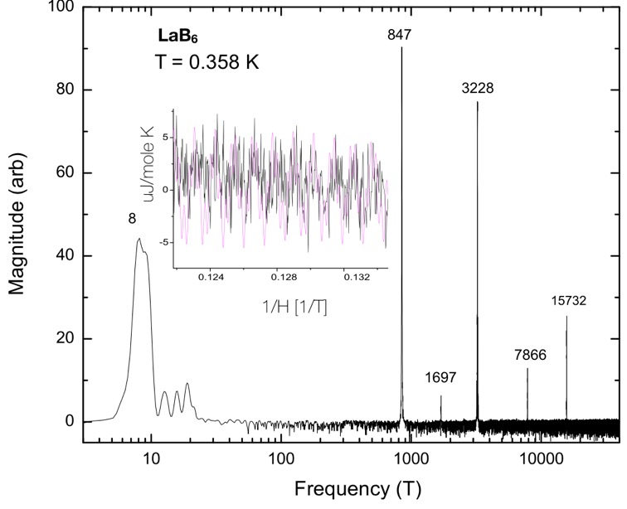
Magneto-Quantum Oscillations Measured in Insulator Samarium hexaboride
P.G Barre¹, A. Rydh², J. Palmer-Fortune³, S.T. Hannahs⁴, A.P. Ramirez¹, and N.A. Fortune⁴
UCSC; 2. Stockholm Univ.; 3. Smith College; 4. NHMFL
Funding Grants: G.S. Boebinger (NSF DMR-2128556); A.P. Ramirez (DOE DE-SC0017862)
What is the finding? Measuring specific heat, scientists observed a phenomenon called magneto-quantum oscillations in an insulator - Samarium hexaboride (SmB6). Magneto-quantum oscillations are a type of rhythmic change in a material’s properties that vary as the magnetic field changes. These new findings confirm and expand earlier torque magnetometry measurements which also showed similar oscillations. This data strongly suggests that in SmB6, it's not regular electrons causing the oscillations, but special particles called electrically-neutral quasiparticles that act like electrons.
Why is this important? Until recently, all materials that exhibited quantum oscillations could be categorized as metals. Quantum oscillations occur as energy levels of electrons in atoms cross a dividing line between occupied and unoccupied with increases or decreases to magnetic field. In an insulator, electrons are “locked” in fully-occupied energy levels with no ability to move due to an applied magnetic field. Since SmB₆ is an insulator, it should not exhibit quantum oscillations, however, does under these unique conditions. Scientists believe the quantum mechanics of SmB₆ may help produce these bizarre quasiparticles that carry no electric charge, but have magnetic properties like electrons. Materials with these properties may advance technology yielding more efficient thermoelectric materials, quantum computing and other unique electronic devices.
Why did this research need the MagLab? Observing SmB₆ magneto-quantum oscillations required very high magnetic fields & low temperatures coupled to a quiet electromagnetic environment. The thermal energy changes in the SmB6 crystal are extremely small and the MagLab’s high magnetic fields were critical for the research team to observe the quantum oscillation amplitude growth.
Fourier power spectrum indicating observed MQO oscillation frequencies for LaB₆ in the [001] direction at 0.358K between 8 and 12T. Inset: inverse field dependence of oscillatory specific heat from which Fourier power spectrum was generated (in black), along with an L–K model fit to the data using the identified frequencies (in purple).
Facilities and instrumentation used: DC field Facility. Heat capacity measurements in Cell 9 resistive and 32 tesla all superconducting magnet.
Citation: LaBarre, P.G.; Rydh, A.; Palmer-Fortune, J.; Frothingham, J.A.; Hannahs, S.T.; Ramirez, A.P.; Fortune, N.A., Magnetoquantum oscillations in the specific heat of a topological Kondo insulator, Journal of Physics-Condensed Matter, 34 (36), 36LT01 (2022) doi.org/10.1088/1361-648x/ac7d2b

