Slide 1
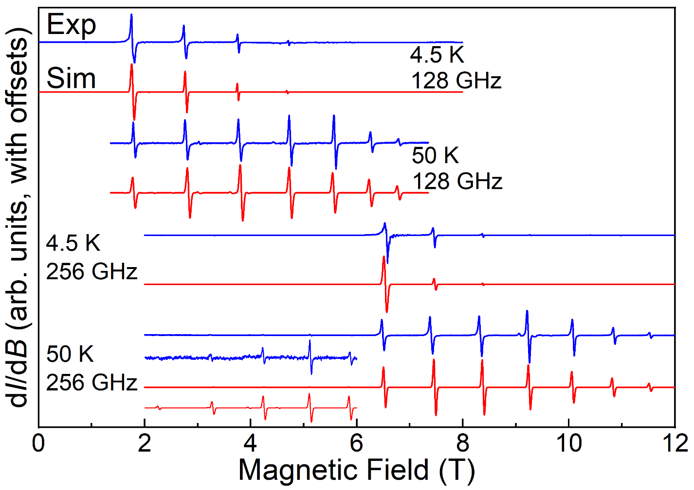
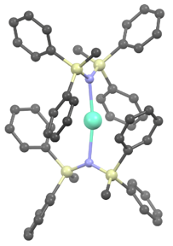
Slow Relaxation of the Magnetization in a Quasi-Linear Europium(II) Molecule
D. Errulat¹, K. L. M. Harriman¹, D. A. Gálico¹, E. V. Salerno², J. van Tol², A. Mansikkamäki³, M. Rouzières⁴, S. Hill², R. Clérac⁴, M. Murugesu¹
1. University of Ottawa, Canada; 2. NHMFL (FSU), USA; 3. University of Oulu, Finland; 4. University of Bordeaux and CNRS, France
Funding Grants: G.S. Boebinger (NSF DMR-2128556); Mansikkamäki (Acad. of Finland); Hill (DOE DE-SC0020260); Clérac (CNRS & QMBx); Murugesu (NSERC)
Molecules that can retain their magnetic state (magnetization alignment) below a characteristic blocking temperature – so-called Single-Molecule Magnets (SMMs) – have attracted significant attention due to their potential use in molecular-scale data storage applications. SMM properties typically arise from the combination of a large magnetic moment subjected to a uniaxial anisotropy, thus creating an energy barrier separating “up” and “down” magnetization states. Strong spin-orbit coupling (SOC) in the 4f shell can lead to large moments and significant magnetic anisotropy for certain molecular geometries, resulting in some of the best performing SMMs. However, until now, no europium (Eu) SMMs had been reported. This is because trivalent Eu³⁺ (4f⁶), with spin & orbital moments S = 3 & L = 3, respectively, has no net moment, i.e., J = L – S = 0; meanwhile divalent Eu²⁺ (4f⁷) has no first-order orbital moment (L = 0, S = ⁷/₂), leading to an approximately spherical ⁸S_{7/2} electronic configuration.
In this work, optimization of the crystal field acting on a Eu²⁺ ion residing in a quasi-linear molecular geometry gives rise to the first europium SMM. This is attributed to a sizeable 2nd-order orbital contribution to the magnetic ground state, resulting in appreciable anisotropy. High-field EPR is the method of choice for characterizing this anisotropy. In particular, measurements at several frequencies, spanning a wide magnetic field range (Fig. 1), are essential for constraining the multiple Hamiltonian parameters describing the effective spin S = ⁷/₂ ground state. The EPR results are supported by electronic structure calculations, highlighting the importance of 2nd order SOC and the linear geometry in achieving non-negligible uniaxial anisotropy.
The divalent oxidation state is rare for molecular lanthanide complexes. Meanwhile, achieving a linear N–Eu–N coordination geometry (Fig. 1 inset) is synthetically challenging, underscoring the importance of this work in shining a light on factors that give rise to SMM behavior for the otherwise isotropic 4f⁷ electronic configuration.
[Eu^{II}{N(SiMePh₂)₂}₂]
Fig. 1. (Blue) Powder EPR spectra recorded in derivative mode (dI/dB, I is the microwave intensity transmitted through the sample, B is the applied field) at the indicated frequencies and temperatures; simulations are shown in red, and spectra are offset for clarity. An expanded view of the 256 GHz, 50 K spectrum highlights weakly allowed low-field transitions; the inset depicts the Eu²⁺ molecule.
Facilities and instrumentation used: EMR program, 15/17 Tesla Transmission Spectrometer & 12.5T Heterodyne Quasi-Optical Spectrometer.
Citation: Errulat, D.; Harriman, K.L.M.; Gálico, D.A.; Salerno, E.V.; van Tol, J.; Mansikkamäki, A.; Rouzières, M.; Hill, S.; Clérac, R.; Murugesu, M., Slow magnetic relaxation in a europium (II) complex, Nature Communications, 15 (1), 3010 (2024) doi.org/10.1038/s41467-024-46196-w - Data Set

Slide 2
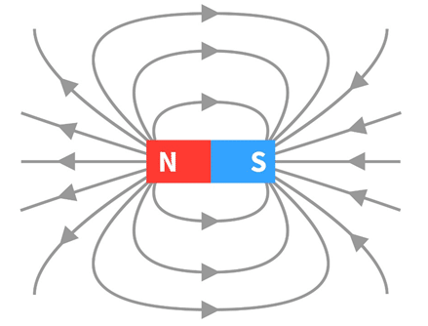
Creation of First Europium(II) Single Molecule Magnet
D. Errulat¹, K. L. M. Harriman¹, D. A. Gálico¹, E. V. Salerno², J. van Tol², A. Mansikkamäki³, M. Rouzières⁴, S. Hill², R. Clérac⁴, M. Murugesu¹
1. University of Ottawa, Canada; 2. NHMFL (FSU), USA; 3. University of Oulu, Finland; 4. University of Bordeaux and CNRS, France
Funding Grants: G.S. Boebinger (NSF DMR-2128556); Mansikkamäki (Acad. of Finland); Hill (DOE DE-SC0020260); Clérac (CNRS & QMBx); Murugesu (NSERC)
What is the finding? This study discusses the creation of a special magnetic molecule where two nitrogen atoms are connected to a europium ion in a nearly straight line. Unlike the usual state where europium loses three electrons, here it loses only two, making it different. The molecule can be magnetized to keep its 'North' and 'South' poles aligned even at low temperatures. High-field electron paramagnetic resonance (EPR) measurements were done to understand this behavior better and compare it with theoretical predictions.
Why is this important? This is the first example of a europium-based single-molecule magnet (SMM), a molecule that can be permanently magnetized. This property was unexpected because europium is non-magnetic in its more-common state, however this work suggests new strategies for the development of SMMs, which have exciting potential for molecular-scale data storage applications.
Why did this research need the MagLab? High-field EPR is the best way to obtain detailed microscopic information about magnetic molecules. By measuring at various microwave frequencies across a wide range of magnetic fields, researchers can hone in on the magnetic properties that effect single-molecule magnets (SMMs). The unprecedented range of magnetic fields and microwave frequencies available through the MagLab EMR facility were therefore central to this finding.
Europium (Eu)
Nitrogen (N)
Silicon (Si)
N
Carbon (C)
S
Fig. 2. The [Eu^{II}{N(SiMePh₂)₂}₂] SMM, where Me = methyl and Ph = phenyl; hydrogen atoms have been omitted for clarity. The molecule has a near-linear geometry with an N–Eu–N angle of 169.8º.
Facilities and instrumentation used: EMR program, 15/17 Tesla Transmission Spectrometer & 12.5T Heterodyne Quasi-Optical Spectrometer.
Citation: Errulat, D.; Harriman, K.L.M.; Gálico, D.A.; Salerno, E.V.; van Tol, J.; Mansikkamäki, A.; Rouzières, M.; Hill, S.; Clérac, R.; Murugesu, M., Slow magnetic relaxation in a europium (II) complex, Nature Communications, 15 (1), 3010 (2024) doi.org/10.1038/s41467-024-46196-w - Data Set

