Slide 1
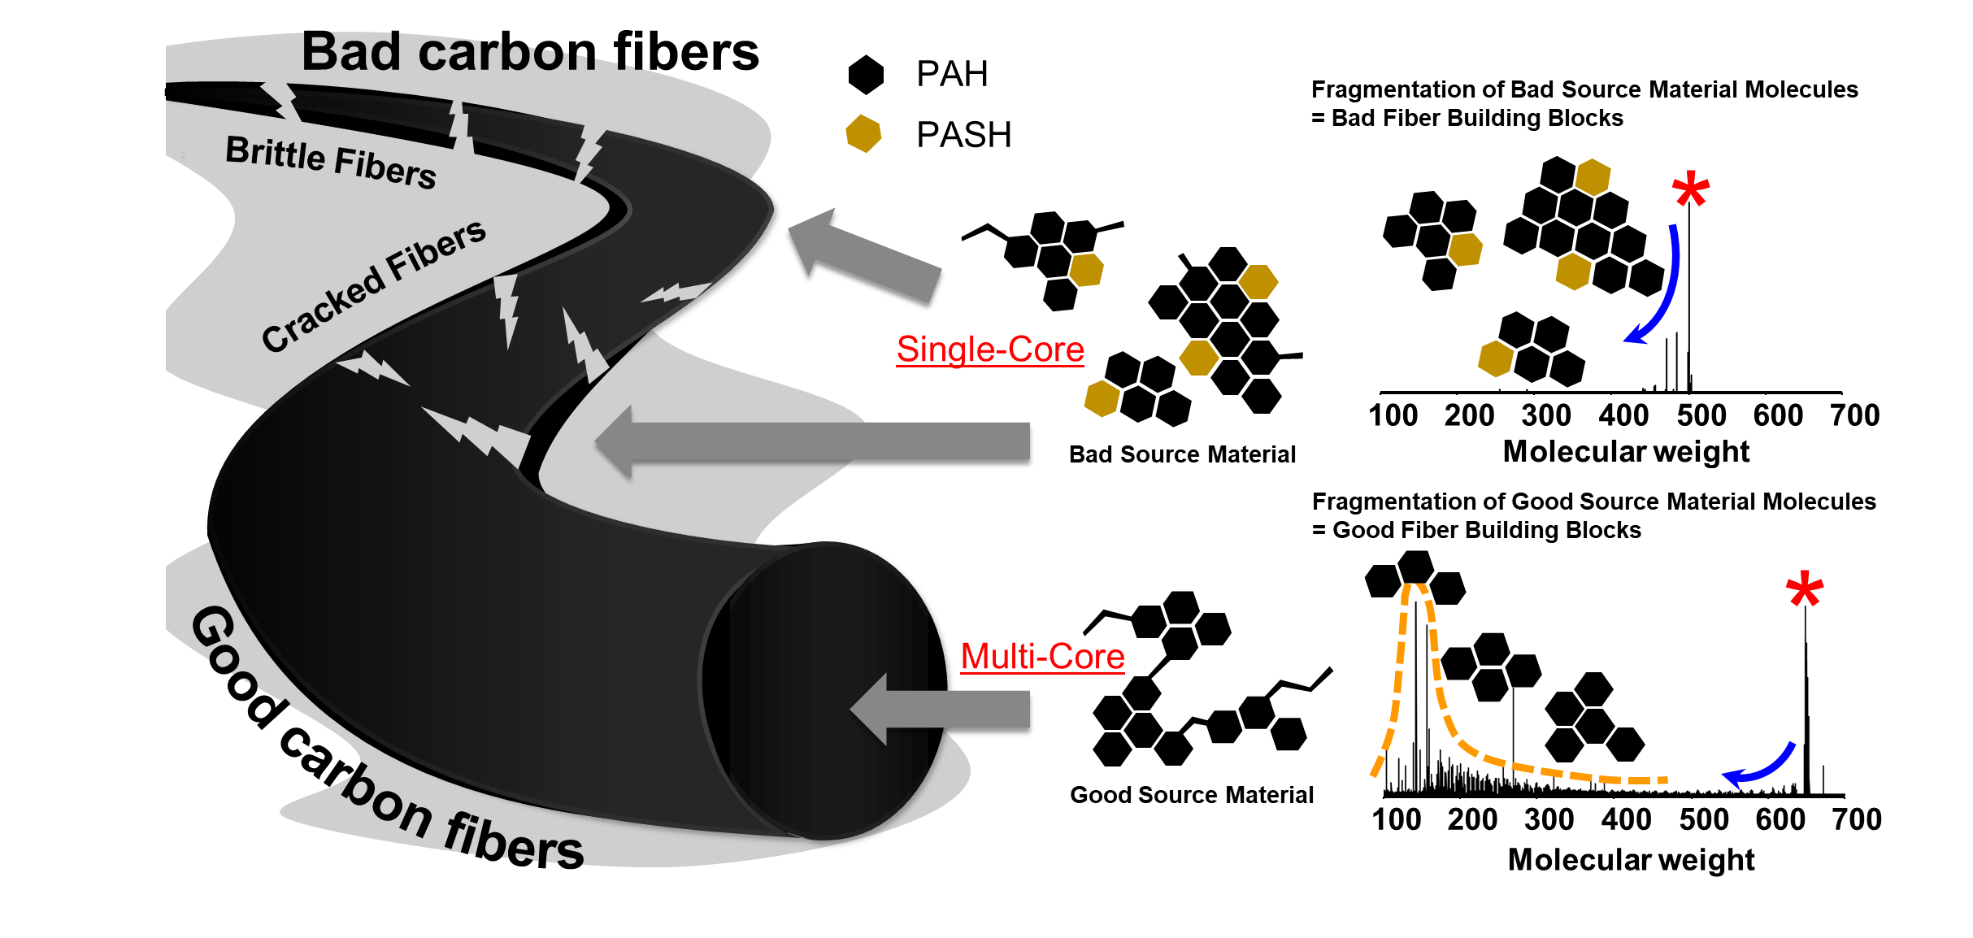
Chemistry and Properties of Carbon Fiber Feedstocks from Bitumen Asphaltenes
Martha L. Chacón-Patiño,¹ Anika Neumann,² Christopher P. Rüger,² Paolo G. Bomben,³ Lukas Friederici,² Ralf Zimmermann,² Erik Frank,⁴ Philipp Kreis,⁴ Michael R. Buchmeiser,⁴ and Murray R. Gray³
National High Magnetic Field Laboratory; 2. Joint Mass Spectrometry Centre, University of Rostock, Germany; 3. Alberta Innovates, Canada; 4. German Institutes of Textile- and Fiber Research, Denkendorf, Germany
Funding Grants: G.S. Boebinger (NSF DMR-1644779 & DMR-2128556); Zimmermann (EU_FT-ICR MS, 731077, and DFG INST 264/56)
Carbon fibers are essential for many applications, including aerospace and medical devices. Most fibers are made from polyacrylonitrile, which is quite expensive. Carbon fiber manufacturing from low-value petroleum feedstocks, which are highly enriched in asphaltenes, could decrease precursor costs by as much as 90%, and reduce greenhouse gas emissions. Asphaltenes are comprised of polycyclic aromatic hydrocarbons (PAH) organized into two structural motifs, as shown in Figure 1. “Single-core" PAH are fused into a single planar unit, whereas "multicore" compounds contain several smaller PAH units linked by flexible covalent bonds. Successful transformation of asphaltenes into carbon fibers requires a detailed understanding of how thermal treatment affects their composition and fiber stability. For example, sulfur-containing PAH (PASH) releases carbon disulfide bubbles within the fibers, diminishing fiber performance.
In this work, MagLab users investigated correlations between carbon fiber production processes and asphaltene composition. Asphaltene-enriched feedstocks were thermally treated under different conditions to direct their chemistry. Samples were characterized by 21T FT-ICR MS and gas-phase fragmentation (MS/MS spectra, Figure 1). The results indicate that severe thermal treatment yielded bad source material molecules (∗ Figure 1 upper right), which in MS/MS revealed building blocks (blue arrow) consistent with single-core, high-molecular-weight PAH/PASH. No stable carbon fibers could be produced from these samples. Conversely, a feedstock treated with mild thermal conditions in molten sodium, a process designed to remove sulfur, yielded good source material molecules (∗ Figure 1 lower right). Those compounds contained abundant multi-core structural motifs, as shown by the abundant presence of low-molecular-weight PAH (yellow dashed line). These materials produced stable carbon fibers. Thus, the investigation of complex asphaltene composition by 21T FT-ICR MS with gas-phase fragmentation guides feedstock upgrading into effective carbon fiber precursors.
Figure 1. Gas-phase fragmentation mass spectra (MS/MS) for bad (top right) and good (bottom right) source materials for carbon fiber production. Bad source material molecules contain abundant single-core molecules comprised of high-molecular-weight PAH and PASH, which produce no stable carbon fibers upon spinning. Conversely, good source material molecules contain abundant multicore compounds composed of low molecular weight, interconnected PAH and produce good carbon fibers. Bad source materials are identified in FT-ICR mass spectra by production of high mass fragments (upper right, blue arrow). Good source materials are identified by production of low mass fragments (bottom right, yellow dashed line).
Facilities and instrumentation used: ICR User Facility, 21T FT-ICR Mass spectrometer
Citation: Chacon Patino, M.L.; Neumann, A.; Ruger, C.P.; Bomben, P.G.; Friederici, L.; Zimmerman, R.; Frank, E.; Kreis, P.; Buchmeiser, M.R.; Gray, M.R., Chemistry and Properties of Carbon Fiber Feedstocks from Bitumen Asphaltenes, Energy Fuels, 37 (7), 5341-5360 (2023) doi.org/10.1021/acs.energyfuels.2c04274 - Data Set

Slide 2
Chemistry and Properties of Carbon Fiber Feedstocks from Bitumen Asphaltenes
Martha L. Chacón-Patiño,¹ Anika Neumann,² Christopher P. Rüger,² Paolo G. Bomben,³ Lukas Friederici,² Ralf Zimmermann,² Erik Frank,⁴ Philipp Kreis,⁴ Michael R. Buchmeiser,⁴ and Murray R. Gray³
National High Magnetic Field Laboratory; 2. Joint Mass Spectrometry Centre, University of Rostock, Germany; 3. Alberta Innovates, Canada; 4. German Institutes of Textile- and Fiber Research, Denkendorf, Germany
Funding Grants: G.S. Boebinger (NSF DMR-1644779 & DMR-2128556); Zimmermann (EU_FT-ICR MS, 731077, and DFG INST 264/56)
What is the finding? Low-cost petroleum feedstocks are rich in asphaltenes that can be used to make carbon fiber. Using ion cyclotron resonance mass spectrometry (21T FT-ICR MS), scientists measured the mass of asphaltene molecules. They found that good carbon fiber precursors have more low molecular weight building blocks and fewer sulfur-containing molecules, distinguishing them from poor precursors.
Why is this important? Carbon fibers are crucial for applications like aerospace and medical devices, but they are usually made from expensive polyacrylonitrile. By understanding the complex makeup of asphaltenes, we can transform them into carbon fibers. This allows low-cost petroleum feedstocks to be processed into excellent carbon fiber precursors through thermal treatment. Using these materials could cut production costs by 90% and lower greenhouse gas emissions.
Why did this research need the MagLab? The MagLab 21-tesla ICR mass spectrometer can uniquely identify the complex mix of molecules in asphaltenes, helping to pinpoint the features needed for high-quality carbon fibers. Using 21T FT-ICR MS with gas-phase fragmentation to study asphaltene samples can guide the improvement of petroleum feedstocks into good carbon fiber precursors.
Figure 1. Gas-phase fragmentation mass spectra (MS/MS) show bad (top right) and good (bottom right) materials for carbon fiber production. Bad materials have many single-core, high-molecular-weight hydrocarbons and sulfur-containing molecules, which don't make stable carbon fibers. Good materials have many multicore, low-molecular-weight hydrocarbons without sulfur, making them better for carbon fiber. The MagLab’s 21T ICR mass spectrometer identified these differences.
Facilities and instrumentation used: ICR User Facility, 21T FT-ICR Mass spectrometer
Citation: Chacon Patino, M.L.; Neumann, A.; Ruger, C.P.; Bomben, P.G.; Friederici, L.; Zimmerman, R.; Frank, E.; Kreis, P.; Buchmeiser, M.R.; Gray, M.R., Chemistry and Properties of Carbon Fiber Feedstocks from Bitumen Asphaltenes, Energy Fuels, 37 (7), 5341-5360 (2023) doi.org/10.1021/acs.energyfuels.2c04274 - Data Set

