Slide 1
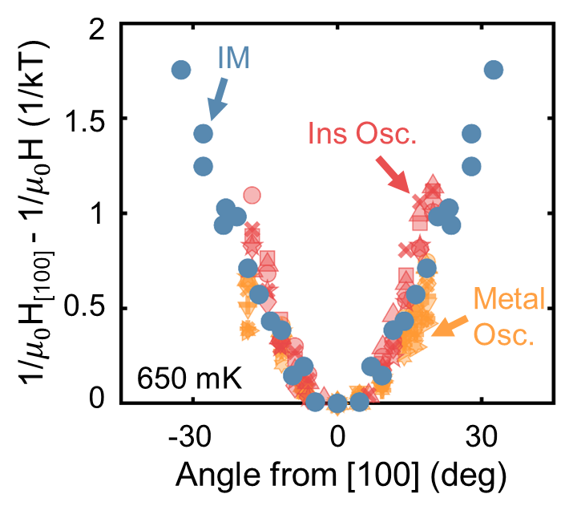
Discovery of the Reverse Quantum Limit
C.A. Mizzi¹, S.K. Kushwaha^{1,2,3,4}, P.F.S. Rosa⁵, W.A. Phelan^{3,4,6}, D.C. Arellano⁶, L.A. Pressley^{3,4,7}, T.M. McQueen^{2,3,7}, M.K. Chan¹, N. Harrison¹
1. National High Magnetic Field Laboratory, Los Alamos National Laboratory; 2. Institute for Quantum Matter, The Johns Hopkins University; 3. Department of Chemistry, The Johns Hopkins University; 4. PARADIM, The Johns Hopkins University; 5.MPA-Q, Los Alamos National Laboratory; 6. MST-16, Los Alamos National Laboratory; 7. Department of Materials Science and Engineering, The Johns Hopkins University
Funding Grants: G.S. Boebinger (NSF DMR-2128556); T.M. McQueen (NSF DMR-1539918, DOE DE-SC0019331); N. Harrison (DOE “Science of 100 Tesla”)
The quantum limit occurs in a Fermi liquid when a single Landau level is occupied in high magnetic fields. This highly degenerate configuration is susceptible to instabilities which can yield unconventional electronic states, especially in materials with strong electronic correlations. While most often considered in metals, a direct analogue to the quantum limit has been discovered in insulators that is characterized by Landau levels which fill in the reverse order compared to regular metals and are closely connected to a field-induced insulator-to-metal transition. This “reverse” quantum limit is shown to manifest in the Kondo insulator YbB₁₂ and explain many features of its behaviour under high magnetic fields.
With quantum oscillations beginning around 35T and an insulator-metal transition extending to nearly 55T, much of the rich physics exhibited by YbB₁₂ requires large magnetic fields. As such, the unique capabilities of the 65T short-pulse and 75T duplex magnet systems at the National High Magnetic Field Laboratory’s Pulsed Field Facility located within Los Alamos National Laboratory were central to this work. The collaboration between internal MagLab scientists and external users combined two different measurement techniques (conventional and contactless resistivity) on ultrahigh quality single crystals down to ³He temperatures in both the 65T short-pulse and 75T duplex magnet systems to reveal this exciting physics.
The discovery of the reverse quantum limit suggests that strongly-correlated insulators may be the leading candidates to realize and explore the rich array of unconventional electronic phases expected to arise in the (reverse) quantum limit. Since the reverse quantum limit can also explain many extraordinary observations in the strongly-correlated insulator YbB₁₂, it is possible the recent paradoxical observation of quantum oscillations in the insulating state of YbB₁₂ may be connected to electronic instabilities associated with the quantum limit.
c
Quantum oscillations in the (a) insulating state and (b) field-induced metallic state of YbB₁₂ single crystals were measured using conventional and contactless resistivity methods at the Pulsed Field Facility. (c) Both sets of quantum oscillations possessed the same angular dependence as the field-induced insulator-to-metal transition, a signature of the reverse quantum limit.
Facilities and instrumentation used: 65T short-pulse and 75T duplex magnets at the National High Magnetic Field Laboratory’s Pulsed Field Facility.
Citation: Mizzi, C.A.; Kushwaha, S.K.; Rosa, P.F.S.; Phelan, W.A.; Arellano, D.C.; Pressley, L.A.; McQueen, T.M.; Chan, M.K.; Harrison, N., The reverse quantum limit and its implications for unconventional quantum oscillations in YbB12, Nature Communications, 15 (1), 1607 (2024) doi.org/10.1038/s41467-024-45801-2

Slide 2
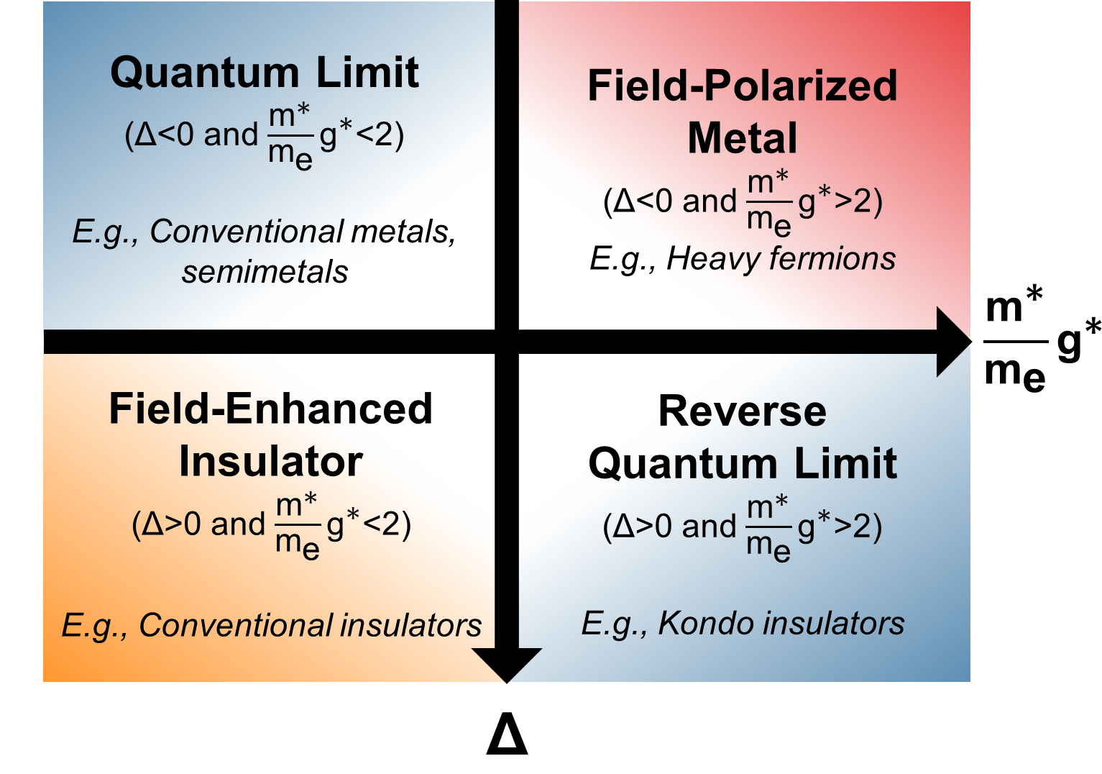
Discovery of the Reverse Quantum Limit
C.A. Mizzi¹, S.K. Kushwaha^{1,2,3,4}, P.F.S. Rosa⁵, W.A. Phelan^{3,4,6}, D.C. Arellano⁶, L.A. Pressley^{3,4,7}, T.M. McQueen^{2,3,7}, M.K. Chan¹, N. Harrison¹
1. National High Magnetic Field Laboratory, Los Alamos National Laboratory; 2. Institute for Quantum Matter, The Johns Hopkins University; 3. Department of Chemistry, The Johns Hopkins University; 4. PARADIM, The Johns Hopkins University; 5.MPA-Q, Los Alamos National Laboratory; 6. MST-16, Los Alamos National Laboratory; 7. Department of Materials Science and Engineering, The Johns Hopkins University
Funding Grants: G.S. Boebinger (NSF DMR-2128556); T.M. McQueen (NSF DMR-1539918, DOE DE-SC0019331); N. Harrison (DOE “Science of 100 Tesla”)
What is the finding? The "quantum limit" occurs when strong magnetic fields trap electrons in a single state in metals. A similar effect, called the "reverse quantum limit," has been found in insulators. This was discovered by studying the material YbB12 at low temperatures and high magnetic fields.
Why is this important? Unconventional electronic phases help scientists explore and test their understanding of condensed-matter systems. These phases are expected to appear in metals under strong magnetic fields, especially if the electrons interact strongly with each other. However, other effects often dominate in such metals, making these phases hard to study. We've found that this "quantum-limit-physics" can happen in strongly-correlated insulators instead. This "reverse quantum limit" in insulators is similar to the quantum limit in metals, but with magnetic fields causing electronic states to behave in the opposite way.
This discovery shows that strongly-correlated insulators are the best platform to explore unusual electronic phases in the "reverse" quantum limit. It also offers new insights into the strange behavior of YbB12, which blurs the usual line between metals and insulators.
Why did this research need the MagLab? The unique magnet systems available at the NHMFL’s Pulsed Field Facility were integral to this work because much of the rich physics exhibited by YbB₁₂ requires extraordinarily large magnetic fields to observe: quantum oscillations begin around 35T and the insulator-metal transition extends to nearly 55T! The 65T short-pulse and 75T duplex magnets at the Pulsed Field Facility were crucial to access these regimes in YbB₁₂.
A phase diagram categorizing material behavior under high magnetic fields. The quantum limit is accessible in metals ($Δ<0$) when they have light effective masses ($\frac{m^{∗}}{m_{e}}$) and/or small Zeeman splitting ($g^{∗}$). The reverse quantum limit is accessible in insulators ($Δ>0$) when they have heavy effective masses ($\frac{m^{∗}}{m_{e}}$) and/or large Zeeman splitting ($g^{∗}$).
Facilities and instrumentation used: 65T short-pulse and 75T duplex magnets at the National High Magnetic Field Laboratory’s Pulsed Field Facility.
Citation: Mizzi, C.A.; Kushwaha, S.K.; Rosa, P.F.S.; Phelan, W.A.; Arellano, D.C.; Pressley, L.A.; McQueen, T.M.; Chan, M.K.; Harrison, N., The reverse quantum limit and its implications for unconventional quantum oscillations in YbB12, Nature Communications, 15 (1), 1607 (2024) doi.org/10.1038/s41467-024-45801-2

