Slide 1
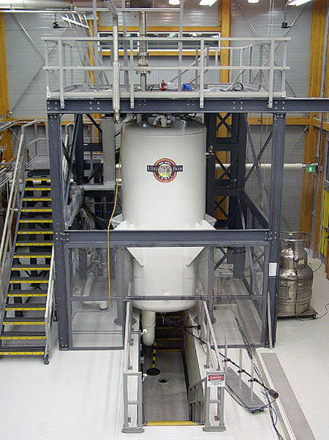
Emergency Repair: Attach Drain Pan on Upper Part of
900MHz NMR/MRI Superconducting Magnet System
Funding Grants: G.S. Boebinger (NSF DMR-1157490, NSF DMR-1644779)
What is the development?
It was reported that a helium gas vent supporting the 900MHz NMR Magnet was cycling between states of icing up and melting. The vent pipe’s temperature is low enough to freeze the ambient water vapor present in the air. However, when the pipe warms up, it causes the frozen water to melt and become liquid. This liquid water can potentially short-circuit the electronic equipment located below the vent.
Why is this important?
The 900MHz NMR/MRI Superconducting Magnet with a field strength of 21.1 tesla is the strongest MRI scanner in the world. Its high field strength allows for more detailed imaging and spectroscopy, making it an invaluable tool in various fields of scientific research. From studying diseases to analyzing the composition of solids and liquids, this magnet contributes significantly to advancements in these areas. Any downtime could delay or interrupt ongoing experiments, affecting the research progress of users who rely on the NMR facility.
How was the repair safely implemented considering the work will be done near a leading edge that drops over twenty feet and is within a 3 Tesla stray magnetic field?
Establish a Safety Standard Operating Procedure (SSOP) that includes the step of attaching a drain pan to the upper part of the magnet system.
Walk through the process and conduct a safety brief before work.
Need to take precautions to exclude magnetic fittings and tools.
With the decking removed there is a fall risk -- Need non-magnetic safety harness, lanyard, and anchor point.
Establish a Rescue Plan that includes the following: A third worker positioned outside of the stray magnetic field to assist primary workers, implementation of a two-man rule on the platform along with an extra spotter, and an attendant equipped with a radio and cell phone whose sole responsibility is to act in case of an emergency.
Figure1: 900MHz NMR/MRI Superconducting Magnet System.

Slide 2
Safety Highlight: Emergency Drain Pan for
900MHz NMR/MRI Superconducting Magnet System
Funding Grants: G.S. Boebinger (NSF DMR-1157490, NSF DMR-1644779)
What is the development?
A helium gas vent supporting the 900MHz NMR Magnet was alternating between freezing and melting. The vent pipe gets cold enough to freeze moisture in the air, but when it warms up, the ice melts into water. This water can potentially short-circuit the electronic equipment below the vent, so a drain pan needed to be added to the upper part of the magnet system.
Why is this important?
The 900MHz NMR/MRI Superconducting Magnet is the strongest MRI scanner in the world. Its 21-tesla high magnetic field strength allows for more detailed imaging and spectroscopy, making it an invaluable tool for chemists, biochemists, and biochemical engineers to identify and characterize the structure and function of molecules. Any instrument downtime as a result of unexpected water could delay or interrupt NMR experiments and negatively impact the research progress of scientists and students who rely on the lab’s NMR facility.
How was the repair safely implemented considering the work will be done near a leading edge that drops over twenty feet and is within a 3 Tesla stray magnetic field?
Establish a Safety Standard Operating Procedure (SSOP) that includes the step of attaching a drain pan to the upper part of the magnet system.
Walk through the process and conduct a safety brief before work.
Need to take precautions to exclude magnetic fittings and tools.
With the decking removed there is a fall risk -- Need non-magnetic safety harness, lanyard, and anchor point.
Establish a Rescue Plan that includes a third worker positioned outside of the stray magnetic field to assist primary workers, implementation of a two-man rule on the platform along with an extra spotter, and an attendant equipped with a radio and cell phone whose sole responsibility is to act in case of an emergency.
Figure1: 900MHz NMR/MRI Superconducting Magnet System.

