Slide 1
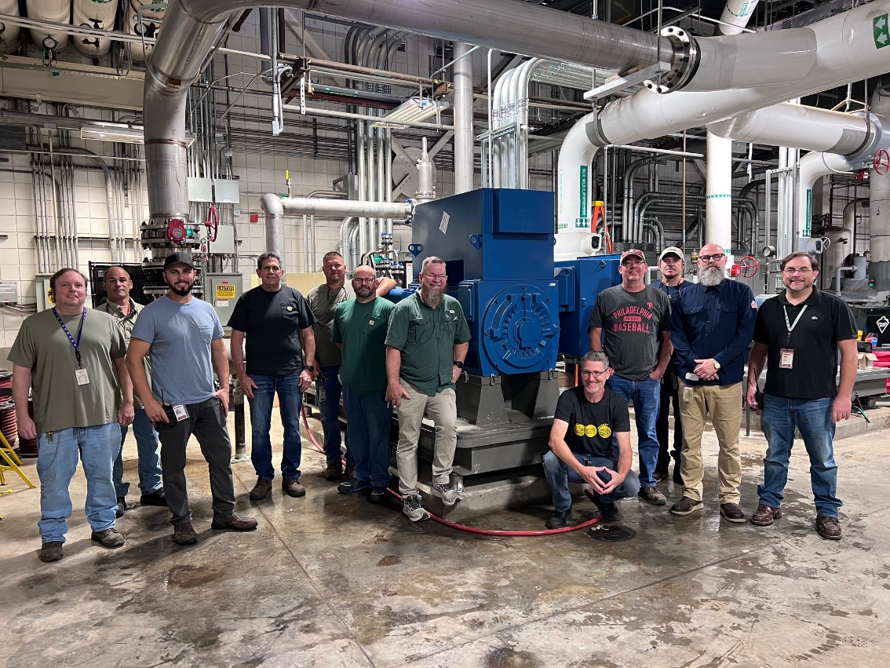
Magnet Cooling Water Pump
National High Magnetic Field Laboratory, Florida State University
Funding Grants: K.M. Amm (NSF DMR-2128556)
What is the development?
A new 900 horsepower magnet cooling water pump and the replacement of four 500hp variable speed drives for our other Magnet Cooling Water Pumps were installed.
The pump was bought with NSF Major Equipment Supplemental Funds we received in 2022.
This new pump will provide the cooling power to allow us to reach our goal of running two 34MW magnets at once. This is the last of a series of cooling plant projects dating back to 2018 towards meeting this goal. The Power Supply and Switch Gear Projects are also needed and are in progress.
This pump will provide critical redundancy for our magnet cooling water system. We will now be able to run a high-power magnet ( 45T, Cell 6, Cell 5) and a 20MW magnet even if we have one magnet cooling pump down.
The variable speed drives will replace units that are 19 years old and had become a reliability liability.
The project was particularly challenging due to a lack of space. Several other projects were required to shuffle other large plant equipment to make room for this massive pump. We were in the middle of a post pandemic shortages of manufacturing capacity and contractor availability that proved difficult to manage.
This was a project that took a village to pull off. Tra Hunter, Kevin Gamble, Marshall Wood and their teams of skilled craftsmen handled the design and installation. The control room staff provided support with pump selection, control programming and testing. Lastly, we received great support from the MagLab Safety, Purchasing, Receiving and Budget teams as well as the FSU project group.
Why is this important for the MagLab?
This development is crucial for the MagLab as it directly contributes to its ability to conduct cutting-edge research by providing necessary infrastructure improvements that enhance operational efficiency and reliability. It also showcases the collaborative spirit and problem-solving abilities of the MagLab team.
Facilities: The MagLab’s Facilities, DC Facility

